Slide 1
Learning outcomes...
Most: explain how water levels are maintained by a balance between input and output
Should: explain how the kidneys respond to changes in conditions
Could: explain the role of ADH in urine concentration and explain it’s effects during alcohol and ecstasy consumption

Slide 2
Key question....what is negative feedback?
negative feedback in a control system reverses any changes to the system’s steady state

Slide 3
Most: explain how water levels are maintained by a balance between input and output
Water input:
Water output:

Slide 4
ADH and the kidneys

Slide 5
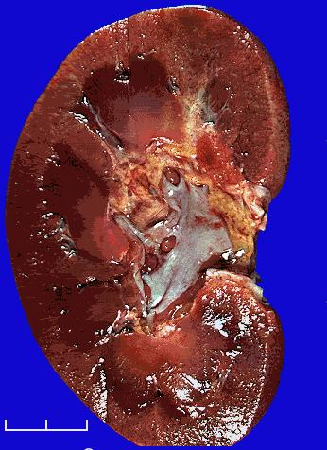
What is the function of the kidneys?
Maintain body’s water level
Filter water, sugar, salt and waste from blood
Reabsorb all sugar
Reabsorb as much salt and water as is needed
Excess is lost as urine

Slide 6
Fluids
Excess water (blood plasma)
Kidneys remove more from blood
Large volume of dilute urine
Not enough water (blood plasma)
Kidneys remove less from blood
Concentrated urine

Slide 7
Should: explain how the kidneys respond to changes in conditions

Slide 8
How does your urine change in different environments
Hot temperature
Exercise
Intake of fluids
Intake of salts

Slide 9
Hot temperature
Sweat – water loss
Kidneys reabsorb water back into blood
Small volume of concentrated urine

Slide 10
Exercise
Hot – sweat to cool down
Lose water through sweat
Same as heat – small concentrated volume of urine

Slide 11
Salts
Too much – concentrated urine. Why?
Reabsorb water into blood to dilute salt concentration

Slide 12
Explain the effect of the following on the kidneys:
Crisps
Water
Exercise

Slide 13
Could: explain the role of ADH in urine concentration and explain it’s effects during alcohol and ecstasy consumption

Slide 14
Anti-diuretic hormone (ADH)
Produced by pituitary gland-released into bloodstream
What monitors water levels in blood?
Hypothalamus/brain
Activates pituitary to release ADH in suitable levels
ADH release causes the kidney to become more permeable
What does this mean?
More water re-absorbed
Negative feedback
Low blood water levels – ADH concentration in blood is increased so kidneys absorb more water
Urine is?
High blood water levels – ADH concentration in blood is decreased so kidneys absorb less water
Urine is?

Slide 15
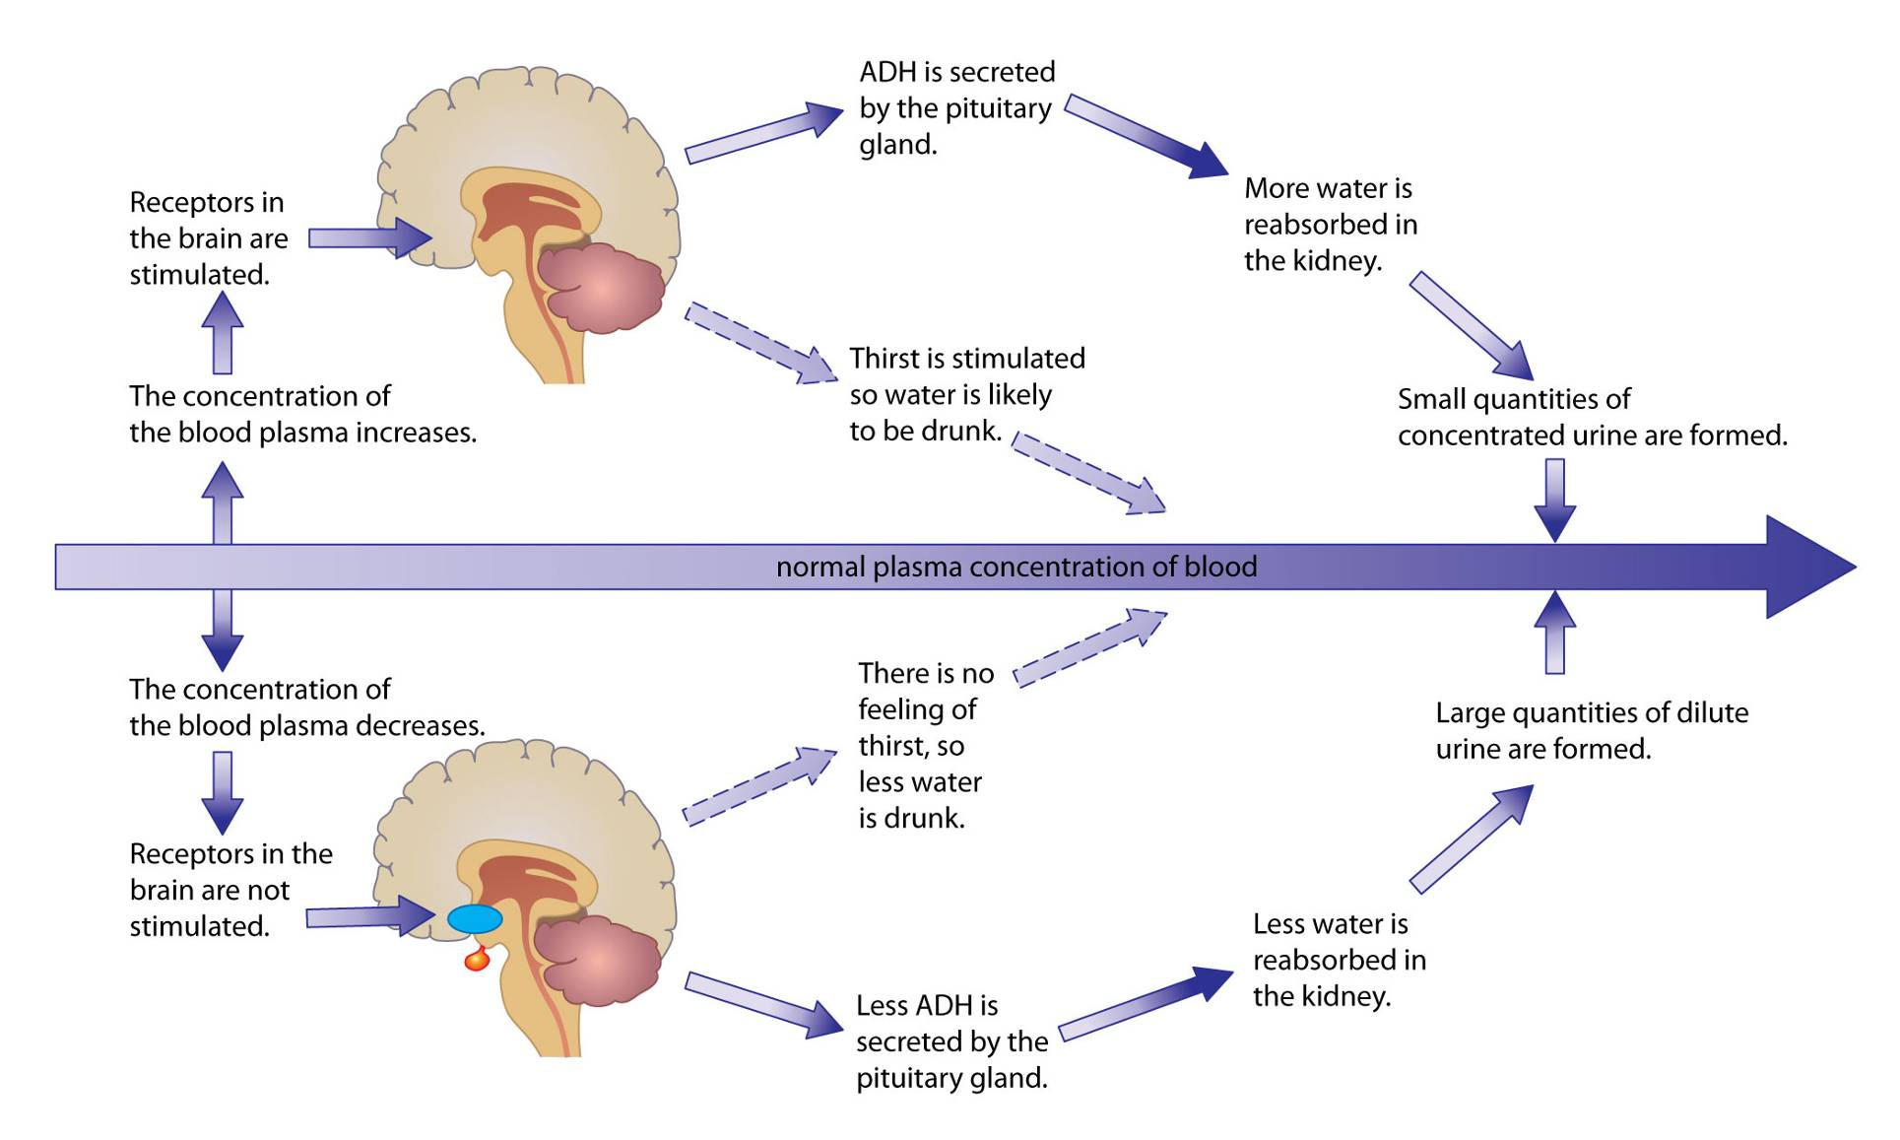

Slide 16
Stimulus – blood concentration too high (concentration looks at salts etc. So tells you that there isn’t enough water in the blood)
Receptors – hypothalamus detect levels
Hypothalamus causes an increase in ADH production
Effector – kidneys reabsorb more water from blood
Response – more concentrated urine

Slide 17
ADH - effects of.....
Alcohol:
Suppresses release of ADH
Kidneys reabsorb less water
More water passes out as urine – dehydration
Headaches, dizziness – death
Ecstasy:
Increased release of ADH
Reabsorb more water, concentrated urine, swelling of cells

