Slide 1
B2: Keeping Healthy

Slide 2
How do our bodies resist infection?
Inside your body, conditions are ideal for microorganisms like bacteria and viruses. So they reproduce quickly and give you disease symptoms by damaging cells or producing toxins.
White blood cells try to destroy harmful microorganisms. They are part of your immune system and one type of white blood cell engulfs and digests harmful microorganisms. Another type of white blood cell makes antibodies.
Some of the white blood cells that make each antibody stay in your blood. These are memory cells. If the same microorganisms invades your body in the future, the memory cells recognises the antigens and makes the correct antibodies quickly. The invaders are destroyed before you are ill. This means that you are immune to the disease.

Slide 3
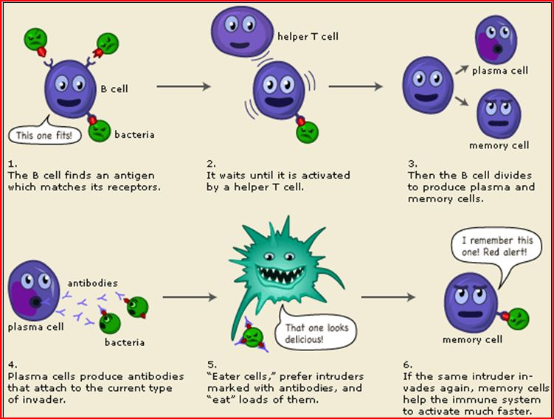

Slide 4
How do vaccines work?
Vaccines prevent you getting diseases. A vaccine contains a safe form of a disease-causing microorganism. When a vaccine is injected into your body, white blood cells make antibodies against the microorganism. Your body stores some of these memory cells. If an active form of the microorganism enters your blood in future, memory cells quickly make antibodies. You don’t get ill.
Having vaccinations is not risk free and different people have different side-effects from vaccination because they have different genes.
To prevent epidemics of infectious disease, a high percentage of the population must be vaccinated. If they are not, large numbers of the disease-causing microorganisms will remain in infected people and people who cannot be vaccinated are likely to catch the disease.

Slide 6
How do antibiotics work?
Antimicrobials are chemicals that kill bacteria, fungi and viruses.
Some types of antimicrobial inhibit the reproduction of reproduction.
Antibiotics are effective against bacteria, but not viruses. Overtime, some bacteria and fungi become resistant to antimicrobials. To reduce antibiotic resistance, people must:
Finish all the tablets, even if you feel better
Only use antibiotics when necessary
Antimicrobial resistance develops when mutations takes places in the genes of bacteria or fungi make new varieties that the antimicrobial cannot kill of inhibit.

Slide 7
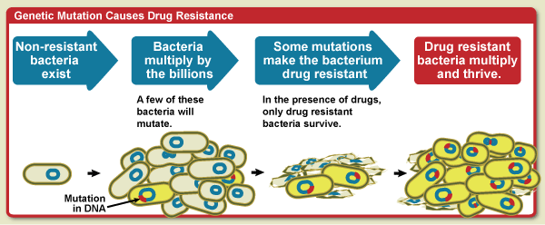

Slide 8
How are new drugs developed?
In most human trials on ill people, one group of patients takes the new drug whilst the other group of patients take the existing treatment of placebo.
A placebo looks like the new treatment but has no drugs in it. Placebos are rarely used in human trials because people who may take it may miss out the benefits on the existing and new treatments.
There are three types of human trials:
Double-blind trial – when neither the doctor or the patient know which group there are in
Blind trial – when the doctor knows who is in which group but the patients don’t
Open trial – when both the doctor and the patient know who is which group and these trials are used when the patient cannot affect the outcome of using the drug.
Long term human trial ensure that the drug is safe and works. They also identify side-effects that don’t occur immediately.

Slide 9
A new drug is tested for safety and effectiveness on lab-grown human cells and animals.
People with the illness to test for effectiveness and safety – human trials
Healthy volunteers to test for safety

Slide 10
How does your heart work?
A heart pumps blood around the body. It is a double pump:
Right lower chamber pumps blood to the lungs
Left lower chamber pumps blood around the body
Your heart is made from muscle as it has its own blood supply. The blood brings oxygen and glucose to the heart and then the heart uses it as supply of energy to allow the muscle to pump.

Slide 11
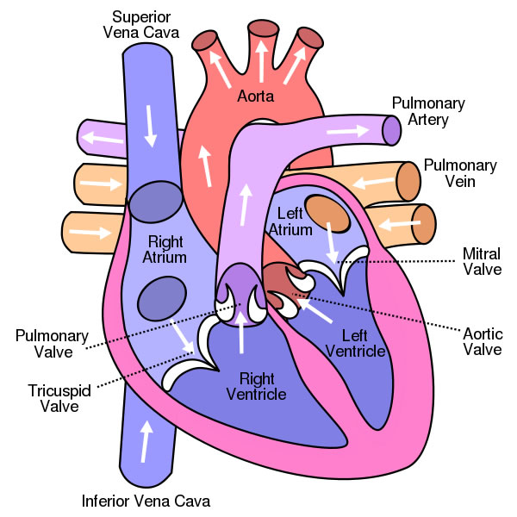
Need to know this for both B2 and B7(if you are learning so)

Slide 12
How does your heart work?
Blood travels through the blood vessels around the body and they are well adapted to their functions:
Arteries take blood from the heart to your body and their walls withstand the high pressure created by the pumping heart
Veins have thins walls that can be squashed when you move pushing the blood back to the hart
Capillaries take blood to and from the heart and have very thin walls to allow oxygen and food to diffuse into cells and allow waste to diffuse out of the cell.

Slide 13
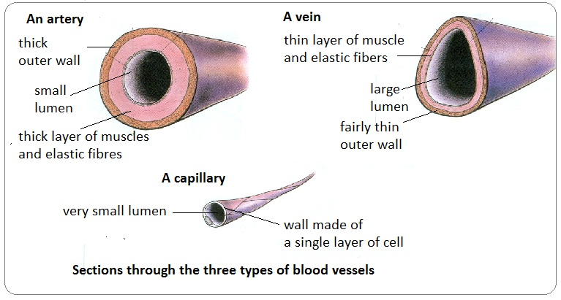

Slide 14
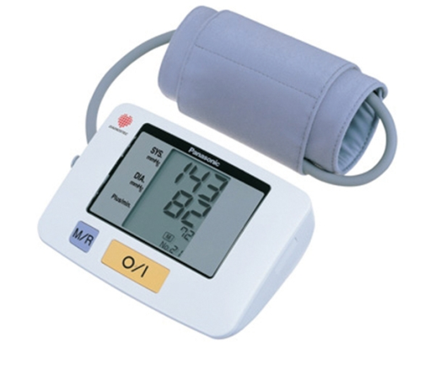
How does your heart work?
Doctors can check how well your heart is working by measuring:
Pulse rate at your wrist
Blood pressure – this measures the pressure of the blood on the walls of your arteries. It has two numbers. The higher number represents the pressure when the heart is contracting. The lower number represents the pressure when the heart is relaxing. Height, weight, age, lifestyle can affect the blood pressure, so there is a range of ‘normal’ blood pressure. Blood pressure is measured by sphygmomanometer
Factors that affect blood pressure – nicotine increases blood pressure, high salt/fat diet – increases cholesterol levels. Cholesterol deposits in arteries, increasing blood pressure. Genetic inheritance and aging also affect blood pressure

Slide 15
Blood pressure
Measured using numbers
High number is when heart is contracting
Low number when heart is relaxing
120/80 is normal
Exercise can decrease high blood pressure

Slide 16
What causes heart attack?
Coronary arteries carry oxygenated blood to the heart. Fat can build up on the artery walls. A blood clot may form on this fat. This may block the artery, which stop oxygen getting to the heart muscle. Heart cells die and the heart is permanently damage and caused a heart attack. Your genes and your lifestyle affect your chances on having a heart attack. Poor diet, high blood pressure, and misusing drugs increases the risk of heart disease. Regular exercise reduces the risk of heart diseases.
Heart disease is more common in UK than in less industrialised because British people eat less healthily and have higher level of stress or drug misuse.
Scientists use epidemiological studies to identify risk factors for heart disease and these studies look at large numbers of people. They often compare groups of people – these groups must be matched meaning that they should be similar apart from the factor being tested.
In large-scale genetic studies, scientists compare the genes of people with the disease with those of healthy people helping to identify alleles that increase the risk of a person getting the disease.

Slide 17
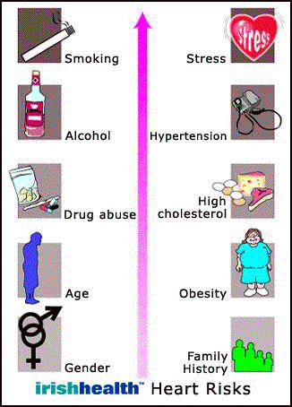

Slide 18
What is homeostasis?
Automatic control systems that keep internal body conditions constant, which are controlled by nervous and hormonal communications. Keeping a constant internal environment is called homeostasis. Body control systems have:
receptors – detect changes in the environment
processing centres – receive information and coordinate responses automatically
effectors – produce responses
Your body temperatures and water control systems are automatic and they use negative feedback systems between the effector and the receptor of a control system to reverse changes to the systems’ steady state.

Slide 20
How do we control water levels?
Cells only work properly if they have right amount of concentrations of their contents. So their water level must be kept constant.
Your kidneys get rid of waste products by excretion and they also control water levels in the body by responding to water level in plasma.
Water levels in your blood plasma may go down because of:
Sweating after exercise or on a hot day
Eating salty food
Not drinking much water

Slide 21
How do we control water levels?
When water levels in blood plasma are low, your kidneys make less urine. The urine is concentrated, so it is dark. When water levels in blood plasma are high, your kidneys make lots of dilute urine.

Slide 22
How do we control water levels?
Kidneys are part of a negative feedback system.
Receptors in the brain detect changes in concentration in blood plasma.
If the concentration is too high, the pituitary gland in the brain releases ADH into the blood stream
The ADH travels to the kidneys. The more ADH that arrives, the more water the kidneys absorb into the body. So the more concentrated the urine.

Slide 23
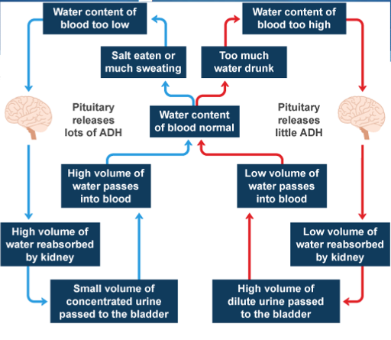

Slide 24
How do we control water levels?
Drugs affect the amount of urine you make:
Alcohol leads to big volumes of dilute urine, so you may get dehydrated because alcohol stops the pituitary gland releasing ADH
Ecstasy leads to big small volumes of concentrated urine because Ecstasy makes the pituitary gland release more ADH

