Slide 1
B4: The Processes Of Life

Slide 2
Life Processes
Movement: All living things move - to find food, escape predators or find better growing conditions.
Respire:Getting energy from food to carry out cell processes
Sensitivity: Detecting changes in the surroundings such as light levels
Growth: All living things grow.
Reproduce:Making new generations of a species
Excrete:Getting rid of waste - including carbon dioxide from respiration.
Nutrition:Taking in and using food as a supply of energy.

Slide 3
Processes in plants.
The cytoplasm of every cell in a plant contains a biological chemical factory. Different chemical reactions occur that serve different purposes. Some reactions help the plant to repair itself, some to copy itself and some to help it grow. Other reactions allow the plant to break down large food molecules to release energy in respiration.

Slide 4
Enzymes
Enzymes are catalysts that speed up chemical reactions in living organisms
Enzymes work best at their optimum temperature. This is why homeostasis is important - to keep our body temperature at a constant 37°C.
Enzymes are proteins: large molecules made up of long chains of amino acids
Amino acid chains are different in each protein, so they fold up into different shapes
The sequence of amino acids in each enzyme is determined by instructions in a gene

Slide 5
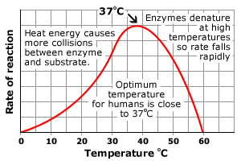
As the temperature increases, so does the rate of chemical reaction. This is because heat energy causes more collisions, with more energy, between the enzyme molecules and other molecules. However, if the temperature gets too high, the enzyme is denatured and stops working.

Slide 6
How Enzymes work?
Some enzymes break down larger molecules into smaller molecules
Some enzymes join small molecules together
In order to do so the molecules need to fit inside the part of the enzyme called the Active Site .
This is called a Lock And Key Model

Slide 8
The important part of an enzyme is called the active site. This is where specific molecules bind to the enzyme and the reaction occurs.
Anything that changes the shape of the active site stops the enzyme from working. This is similar to a key that opens a door lock. It does not matter what a key handle looks like, but if you change the shape of the ‘teeth’ the key no longer works.
The shape of the active site is affected by pH. This is why enzymes will only work at a specific pH, as well as a specific temperature. Change the pH and the enzyme stops working.
Increasing the temperature to 60°C will cause a permanent change to the shape of the active site. This is why enzymes stop working when they are heated. We say they have become denatured.

Slide 9
Photosynthesis
Photosynthesis is a process used by plants in which energy from sunlight is used to convert carbon dioxide and water into molecules needed for growth. These molecules include sugars, enzymes and chlorophyll.
Light energy is absorbed by the green chemical chlorophyll. This energy allows the production of glucose by the reaction between carbon dioxide and water. Oxygen is also produced as a waste product.
This reaction can be summarised in the word equation:
Carbon dioxide + water glucose + oxygen
6CO₂ + 6H₂O → C₆H₁₂O₆ + 6O₂

Slide 10
Glucose from Photosynthesis
Glucose is made up of carbon, hydrogen and oxygen atoms. Glucose made by the process of photosynthesis may be used in three ways:
It can be converted into chemicals required for growth of plant cells such as cellulose.
It can be converted into starch, a storage molecule, that can be converted back to glucose when the plant requires it.
It can be broken down during the process of respiration, releasing energy stored in the glucose molecules.

Slide 11
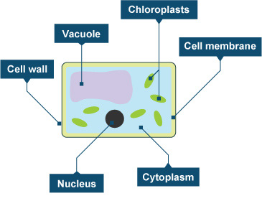
Chloroplasts - containing chlorophyll and enzymes needed for reactions in photosynthesis.
Nucleus - containing DNA carrying the genetic code for enzymes and other proteins used in photosynthesis.
Cell membrane - allowing gas and water to pass in and out of the cell while controlling the passage of other molecules.
Vacuole - containing cell sap to keep the cell turgid.
Cell wall - strengthens the cell.
Cytoplasm - enzymes and other proteins used in photosynthesis made here.

Slide 12
Diffusion
Dissolved substances have to pass through the cell membrane to get into or out of a cell. Diffusion is one of the processes that allows this to happen.
Diffusion occurs when particles spread. They move from a region where they are in high concentration to a region where they are in low concentration. Diffusion happens when the particles are free to move. This is true in gases and for particles dissolved in solutions. Particles diffuse down a concentration gradient, from an area of high concentration to an area of low concentration.
The movement of oxygen and carbon dioxide in and out of leaves during photosynthesis occurs by diffusion.
The higher concentration of carbon dioxide in the air diffuses into the leaf for photosynthesis.
Oxygen produced during photosynthesis builds up to higher concentrations and diffuses out of the leaf into the air which has a lower concentration of oxygen.

Slide 13
Osmosis
Water can move across cell membranes because of osmosis. For osmosis to happen you need:
Two solutions with different concentrations
A partially permeable membrane to separate them
Partially permeable membranes let some substances pass through them, but not others.
Osmosis is the movement of water from a high concentration of water to a lower concentration of water through a partially permeable membrane.
This is shown in the animation above. Eventually the level on the more concentrated side of the membrane rises, while the one on the less concentrated side falls. When the concentration is the same on both sides of the membrane, the movement of water molecules will be the same in both directions. At this point, the net exchange of water is zero and there is no further change in the liquid levels.
Osmosis is important to plants. They gain water by osmosis through their roots. Water moves into plant cells by osmosis, making them turgid or stiff so they that able to hold the plant upright.

Slide 14
Minerals From Soil
Possible 6 mark!!!
The concentration of minerals in the soil is very low. They dissolve in water and move around the soil in solution. Root hair cells are adapted to absorb the water out of soil by osmosis – they have a large surface area, thin walls and are close to the xylem cells used for transporting water up the plant. Minerals such as nitrate ions cannot be absorbed by osmosis (which is the movement of water only) or diffusion (because the minerals are in very low concentration). The root hair cells have carrier molecules on their surface that pick up the minerals and move them into the cell against the concentration gradient. This requires energy, and is called active transport.

Slide 15
Factors Affecting photosynthesis
Three factors can limit the speed of photosynthesis: light intensity, carbon dioxide concentration and temperature.
Light intensity.
Without enough light, a plant cannot photosynthesise very quickly, even if there is plenty of water and carbon dioxide. Increasing the light intensity will boost the speed of photosynthesis.
Carbon dioxide concentration.
Sometimes photosynthesis is limited by the concentration of carbon dioxide in the air. Even if there is plenty of light, a plant cannot photosynthesise if there is insufficient carbon dioxide.
Temperature.
If it gets too cold, the rate of photosynthesis will decrease. Plants cannot photosynthesise if it gets too hot.

Slide 16
Maximising Growth
Farmers can use their knowledge of these limiting factors to increase crop growth in greenhouses. They may use artificial light so that photosynthesis can continue beyond daylight hours, or in a higher-than-normal light intensity. The use of paraffin lamps inside a greenhouse increases the rate of photosynthesis because the burning paraffin produces carbon dioxide, and heat too.

Slide 17
Environments & Adaptations
Energy from light drives photosynthesis. The effect of light levels on plants can be investigated using a number of techniques.
The diagram below shows how apparatus can be set up to investigate the effect of changing light intensity on the rate of photosynthesis.
The distance separating the lamp and the pondweed can be altered and the resulting light intensity measured using a light meter.
A quadrat can be used to survey the plants present in a square meter.
The quadrat is a square grid that is placed on the ground. Any plants or animals present within the area of the quadrat are recorded. The organisms can be named using an identification key that provides pictures and/or descriptions of the organisms.
Quadrats are positioned randomly to remove bias and allow for reliable comparison between locations.
If appropriate, data may be recorded at regular intervals along a transect. A transect is a straight line that runs through a location upon which data on organism distribution can be recorded. An identification key can then be used to identify species present, so a link may be formed between light level and species present.

Slide 18
Energy From Respiration
Respiration releases energy for use in life processes. There are two types of respiration, aerobic (uses oxygen) and anaerobic (does not use oxygen). Respiration can produce useful products that have uses in a range of industries.
Glucose is produced during photosynthesis. This energy is released from cells by a series of chemical reactions. This process is called respiration. Energy from respiration is used in reactions that produce different molecules. Examples of these molecules include starch and cellulose, which are polymers of glucose required by plant cells.

Slide 19
Aerobic Respiration
Respiration is not the same thing as breathing. Breathing is more properly called ventilation. Instead, respiration is a chemical process in which energy is released from food substances, such as glucose - a sugar.
Aerobic respiration needs oxygen to work. Most of the chemical reactions involved in the process happen in tiny objects inside the cell cytoplasm, called mitochondria.
This is the equation for aerobic respiration:
glucose + oxygen → carbon dioxide + water (+ energy)
C₆H₁₂O₆ + 6O₂ → 6C O₂ + 6H₂O
The energy released by respiration is used to make large molecules from smaller ones. In plants, for example, sugars, nitrates and other nutrients are converted into amino acids. Amino acids can then join together to make proteins. The energy is also used:
To allow muscles to contract in animals.
To maintain a constant body temperature in birds and mammals.

Slide 20
Anaerobic Respiration
Anaerobic respiration is a type of respiration that does not use oxygen. It is used when there is not enough oxygen for aerobic respiration. It can be summarised by the following equation:
glucose → lactic acid (+ energy released)
This type of respiration may be used when, for example, an animal is being chased by a predator.
Anaerobic respiration also takes place in plants and some microbial cells in the presence of little or no oxygen. Examples of this include the roots of plants in waterlogged soils and bacteria in puncture wounds.
Anaerobic respiration in plant cells and some microorganisms (such as yeast) produces ethanol and carbon dioxide, as opposed to lactic acid. It can be summarised by the following equation:
glucose → ethanol + carbon dioxide (+ energy released)
Aerobic respiration releases more energy per glucose molecule than anaerobic respiration.

Slide 21
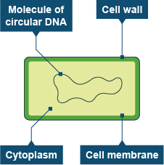
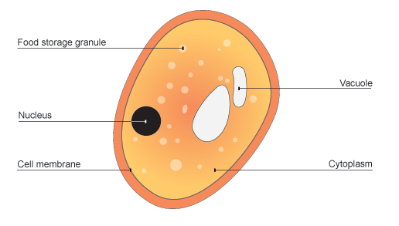
Anaerobic respiration takes place in yeast and some bacteria, producing ethanol and carbon dioxide. They have been used in the making of many foods such as bread, yoghurt and vinegar. You must know the structure and functions of a bacterial cell and yeast cell.
BACTERIA
YEAST

Slide 22
Structure and function of a bacterial cell.
Structure. Function. Molecule of circular DNA Contains genetic code for enzymes involved in respiration. Cell membrane Allows gases and water to pass in and out of the cell while controlling the passage of other chemicals. Cell wall Provide rigidity to maintain cell shape. Cytoplasm. Enzymes are made and reactions involved in respiration occur here.
Structure and function of a yeast cell.
Structure. Function. Nucleus Contains genetic code for enzymes involved in respiration. Cell membrane Allows gases and water to pass in and out of the cell while controlling the passage of other chemicals. Cell wall Provide rigidity to maintain cell shape. Cytoplasm Enzymes are made and reactions involved in respiration occur here. Mitochondria.
Contains enzymes for the reactions in aerobic respiration.

Slide 23
Useful Products From Respiration
Anaerobic respiration of microorganisms such as yeast can lead to the production of useful commodities. During anaerobic respiration sugars are converted into ethanol. This is called fermentation.
When fermentation is performed on a larger scale using yeast, water, sugar and some other nutrients bio-ethanol can be made that can be used as a fuel.
Sustainability.
Sustainability is the idea of using resources to meet the needs of the present without damaging the Earth or using up resources people might need in the future.
Biofuel is seen as a renewable resource that would seem to be more sustainable. However, there is more to it. The large areas of land used to grow crops on for biofuel could be used to grow food. As well as this, trees can be cut down to make space to grow crops for biofuel.

Slide 24
Biogas
Biogas is a fuel manufactured using animal manure (or sometimes human waste).
Biodigesters are used to convert the manure into biogas. Bacteria inside the biodigester break down parts of the manure and produce methane gas.
This gas can then be used as a fuel to run generators and heat buildings. This method of fuel production is more commonly used in developing countries.

