Slide 1
B5: Growth and Development

Slide 2
What’s inside a plant or animal?
Animals and plants are multicellular organisms so they are made up of many cells – cells can be specialised to do a certain job
In animals and plant, specialised cells of the same type group together to from tissues. Groups of tissue form organs.

Slide 3
What are human cells?
Humans develop from zygote – an single fertilised egg. The zygote divides to from an embryo – balls of cells.
When the embryo consists of 8 cells or fewer, all its cells are identical. These are embryonic stem cells, which could produce any type of cell a growing human needs.
After the 8 cell stage, most embryo cells become specialised and form different types of tissues. By about 8 weeks, these tissue group together to form organs. The growing human is now called foetus.
Some cells remain unspecialised until adulthood and are called adult stem cells, which can develop into many types of cells but not all.

Slide 4
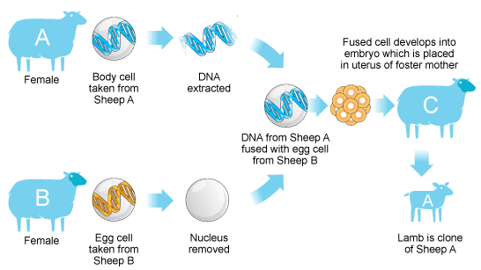

Slide 5
How do plants grow?
Most plant cells are unspecialised and specialised cells are grouped together to form tissues such as:
Xylem, which transports water through plant’s organs – flowers, leaves, stem and roots
Phloem, which transports sugars
Plant cells at room tips and shoot tips remain unspecialised. So do rings of cells at stems and roots. These are meristem cells. They can divide into make new cells that can develop into any type of cell. Meristem cells explain why plants can grow throughout their lives and why plants can regrow whole new organs when damaged.

Slide 6
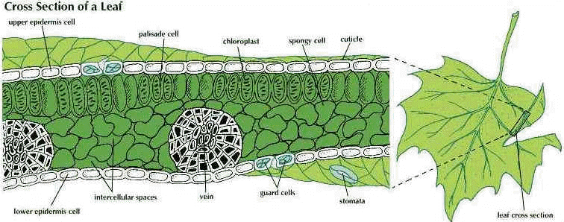

Slide 7
What are cuttings?
Gardeners sometimes grow plants from cuttings. The new plant and the parent plant are clones of each other as they are genetically identical.
First, a gardener chooses a plant with features desired. He cuts a piece of stem from the plant, which is a cutting. The gardener dips the cut end in rooting powder, which contain auxins.
The meristem cells in the cuttings divide to make new cells so plant hormones encourage some people some of these cells to divide into root cells. Other unspecialised cells become tissues that form other organs.

Slide 8
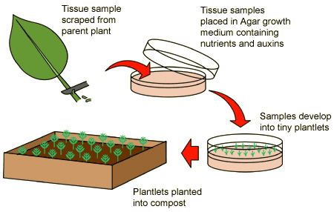

Slide 9
How does light affect plant growth?
Plants tend to grow towards the light. This is phototropism. Plants need light to photosynthesise and so phototropism increases a plant’s chance of survival. Phototropism involves auxins.
If light is above, the auxins spread out evenly. The shoot grows straight up. If light comes from the side, auxins move to the shady side. Auxins make cells on the shady side grow faster. So the shoot bends towards the light.

Slide 11
How does mitosis make new body cells?
First a cell grows and it makes copies of:
Organelles including mitochondria
Chromosomes are copied when two strands of each DNA molecule separate and new strands form alongside them
After this, mitosis happens in which the chromosomes copied separate and go to the opposite ends of the cell. Then the whole cell including the nucleus and divides to make two new cells. The new cells are clones of the parent cell.

Slide 12
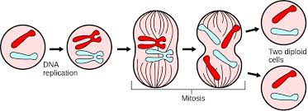

Slide 13
How does meiosis make new sex cells?
Meiosis make gametes and happens in sex organs. In meiosis a body cell divides twice and resulting cells may develop into gametes. There are not identical so they carry each different genetic information.
Gametes have half the number of chromosomes as the parent cells. Human body cells have 46 chromosomes and human gametes have only 23 single chromosomes.

Slide 14
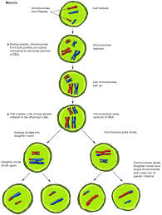

Slide 15
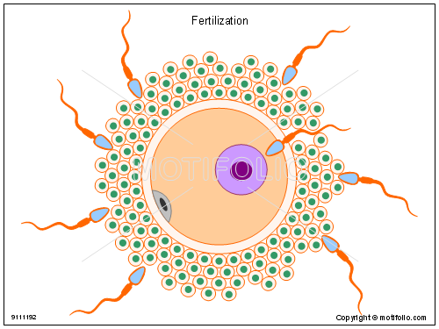
Fertilisation
When a human sperm fertilises an egg cell their nuclei join up. The zygote has one set of chromosomes from each of the parent so now it has 23 pairs of chromosomes – 46 chromosomes in all.

Slide 16
What is in DNA?
The nucleus of each of your body cells contains enough information to determine the characteristics of your whole body. This information is the genetic code.
The genetic code is stored in chromosomes – very long molecules made up of DNA wound around a protein framework. A human DNA is made up of 30,000 genes.
DNA molecule contains two strands twisted together in a spiral. This is a double helix.
Each strand is made up of 4 bases: adenine (A), thymine (T), cytosine (C) and guanine (G)
The bases on two strands of DNA always pair up in the same way, A-T and G-C

Slide 17
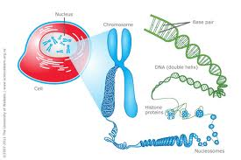

Slide 18
What is in DNA?
Cells make proteins and there are thousands of different proteins. The order of bases s the genetic code for making a particular protein.
Cells make proteins by joining together amino acids. Each protein has a certain combination of amino acids joined together in a particular order. The order of bases in a gene is the code for building up amino acids in the correct order to make a particular protein

Slide 19
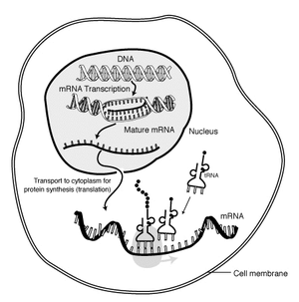
Where do cells make protein?
DNA contains genetic code for making proteins. DNA is the nucleus of the cell. But new proteins are made in the cell cytoplasm. Genes don’t leave the nucleus but a copy of the gene is made and carries the genetic code to the cytoplasm. The copy of the gene is called messenger RNA [mRNA]

Slide 20
Why some genes are switched off?
The nucleus of each body contains exact copy of the DNA of the original zygote so every cell contains the same genes. But not all these genes are active in every cell. Each cell makes only the proteins that is need to be a particular type of cell. Genes that give instructions to make other proteins are not active; they are switched off
For example, hair cells make keratin and salivary gland cells make amylase.
In every single cell one gene which is always switched on is respiration.

Slide 21
How are stem cells useful?
Scientists are doing a lot of research on stem cells. Adult stem cells and embryonic stem cells may make specialise cells to:
Replace damaged tissue
Treat some diseases i.e. skin related
However, there are ethical issues involved when using stem cells that is why government regulations are there to control this research

Slide 22
How do clones form specialised cells?
Scientists have made clones of animal such as sheep and of tissues and organs of other mammals, including humans. This process involves reactivating, or switching on, inactive genes in adult body cell nucleus.
This is how to produce an organ or tissue needed by a patient:
Take a nucleus out of egg cell and replace it with a nucleus from a body cell of the patient.
The egg cell divides by mitosis and makes an embryo and the genes in the embryo are the same as the patient’s genes
After 5 days, put stem cells from the embryo in a dish of nutrients.
The stem cells can develop into different types of tissue or organ
Transplant the organ or tissue required into the patient.

Slide 23
