Slide 1
B6 – Brain and Mind

Slide 2
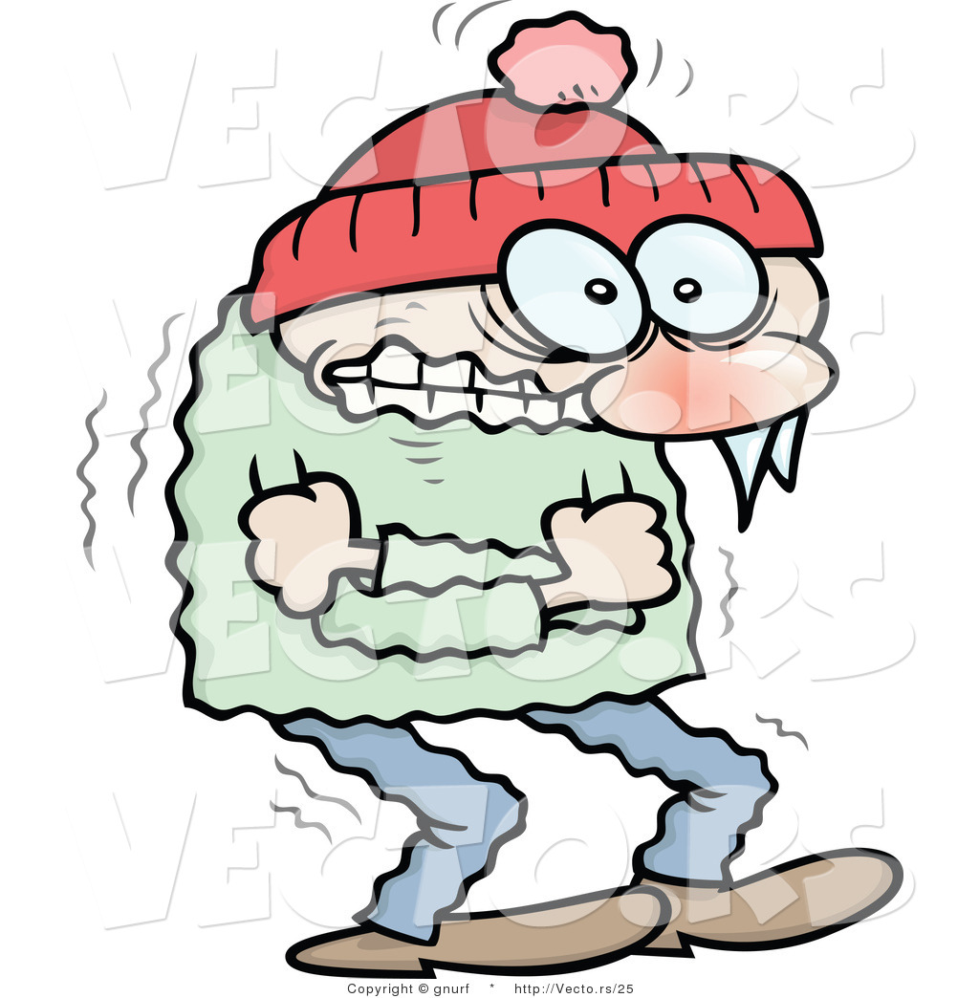
Behaviour
Response
Stimulus
Behaviour

Slide 3
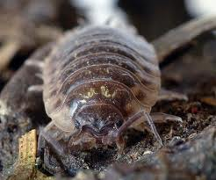
Simple Reflex Response
Simple reflex response
Involuntary
Eg E.Coli
Find food, shelter or a mate
Escape from predators
Avoid harmful environments – temps

Slide 4
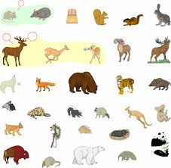
Complex Behaviour
Mammals, birds and fish have simple reflexes
Includes reflex responses altered by experience
Make conscious decisions
More likely to survive

Slide 5
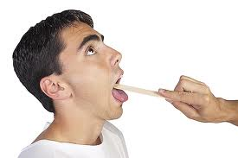
Simple reflexes in humans
Survival
Gag
Pupil
Innate (inherited through genes)

Slide 6
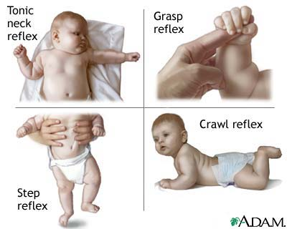
Newborn Reflexes
Present for a short while at birth
Altered by experience
Sometimes missing
Stepping; grasping; startle, sucking, swimming

Slide 7
SIDS
Sudden Infant Death Syndrome
Cot death
0.7 in 1000
Foetus reflex oxygen level low, still
Older baby; moves more; more activity to low oxygen
Newborn baby may lie still and suffocate

Slide 8
Receptors
Can only respond to change if you detect it
Receptors=detectors
Sound
Texture
Smell
Temperature
Light

Slide 9
Internal and External Receptors
External receptors monitor the external environment
Internal receptors monitor change e.g. Blood glucose levels or core temp

Slide 10
Single cells or sense organ?
Pain receptors – single
Grouped together e.g. Eye
Vision very important in mammals
3D of surroundings
Info about shape, movement and colour

Slide 11
Effectors
Body’s response to stimuli carried out by effector organs
Glands or muscles in multicellular organisms
Nervous and hormonal systems devle
Complex system developed as evolved, use long and short-term responses (survival advantage)

Slide 12
Effectors
Stimuli in environment bring about change in muscles/glands.
Nerve impulses fast
Hormones slower
Nerve impulses cause glands to release hormones

Slide 13
Nerves
Carry nerve impulses
Made up of neurons
CNS and PNS
Sheath

Slide 14
Reflex Arc
Stimulus
Receptor
Sensory neuron
CNS (relay)
Motor neuron
Effector
Response

Slide 15
Nerve Impulses and Synapses
Nerve impulses travel at 400m/s.
Quick response
Synapses are the gap between the nerves

Slide 16
How do nerve impulses travel?
Nerve impulses cannot jump a synapse
Chemicals called transmitter substances used to pass the impulse from one neuron to another.

Slide 17
How does it happen?
1) Nerve impulse arrives at synapse
2) Chemical released from sensory neuron; diffuses across synapse. Molecules are correct shape to fit receptor molecules in membrane of motor neuron
3) Nerve impulse stimulated in motor neuron. Chemical is then absorbed back into the sensory neuron to be used again.

Slide 18
Slower?
The gap at a synapse is only 20nm wide. The chemical travels across this gap in a very short time.
They do slow down nerve impulses by about 15m/s.
Still travels through your body at incredible speed.

Slide 19
Serotonin
Serotonin released at one type of synapse in the brain.
Feelings of pleasure – important response for survival
Nice-tasting food/keep eating
Lack of serotonin linked to depression (1 in 5 people)
Prozac blocks the re-uptake of serotonin

Slide 20
Drugs....
Prozac is an anti-depressant drug
Causes serotonin concentration to build up in the synapses in the brain
May feel less unhappy
Can have unwanted side effects

Slide 21
Ecstasy
MDMA
Empathogenic
Long-term destroys synapses in the brain
Permanent anxiety and depression, poor attention span and memory.
Interferes with temp control
Affects ADH

Slide 22
Beta Blockers
Angina
Stressed or excited
Nerve impulses stimulate heart to speed up
Leaves heart muscle starved of oxygen
Betas reduce transmission of impulses across synapses.

Slide 23
Neuroscience
Neuroscientists
Complex nervous and hormonal communication systems only developed once multicellular organisms evolved.
Specialised tissues and organs to carry out communication processes

Slide 24
Simple animals
Simple animals have a larger mass of neurons at one end of their body – the head end.
This end reaches new places first. Neurons act as a simple brain.
Process information coming from the receptors at the head end.

Slide 25
Complex animals
Complex behaviour needs a bigger brain
Brain made of billions of neurons
Many areas carrying out one or more specific functions
Learn from experience

Slide 26
Cerebral Cortex
Highly folded
5mm thick
Total area 0.5m²
Different regions responsible for functions

Slide 27
The conscious mind
Consciousness – when you are awake you are aware of yourself and your surroundings
Happens in the cerebral cortex
Also responsible for intelligence, language and memory
Thoughts and feelings (mind)
Large in humans compared to most mammals

Slide 28
Wilder Penfield
1940’s
Canadian brain surgeon
Patients who had epilepsy
Applied electricity to surface areas of brain to find problem areas
No pain receptors in brain
Watched for movement

Slide 29
Injured brains
Scientists study brains partly destroyed by injury
Strokes
Injured soldiers
Research how the brain functions

Slide 30
Brain Imaging
MRI – Magnetic Resonance Imaging
Brain structure and function
Tasks provide info on parts of the brain most active
fMRI – functional MRI scans
Active parts of the brain have a higher flow of blood

Slide 31
Learned Behaviour
Born with reflexes to help her stay alive
Much behaviour – how to hunt or get on with other lions in the pride she will learn from her mother – Learnt behaviour
New behaviour by experiences important for survival
Can change behaviour if environment changes

Slide 32
Pavlov’s Dog
Salivation when he sees food.
Food is the stimulus, salivation the response
Pavlov rang a bell whilst the dog was eating its food
After a while the dog salivated whilst the bell rang, but no food was present
Conditioned reflex

Slide 33
Conditioning aids survival
Bitter tasting caterpillars are usually brightly coloured
Birds learn bright colours mean nasty taste
Hoverflies

Slide 34
Conscious control of reflexes
Most human reflex arcs co-ordinated by the spinal cord. Only reflexes with receptors on the head are co-ordinated by the brain
Reflex responses happen automatically – designed to help you survive

Slide 35
Conscious control
Some reflexes can be modified by conscious control
Hot plate – want to drop it but because dinner is on it, consciously overcome it and put it down safely.
Social behaviour is learnt as humans develop
Humans made tools and language meant they could communicate
This gives them a survival advantage

Slide 36
Making ethical decisions
Our knowledge of the brain has come from experimenting on animals and humans in the past.
Allowed us to improve theories about human learning and develop treatments for diseases and injuries.
Some people think testing on animals is acceptable, others think that tampering with a vertebrate’s brain is unacceptable.

Slide 37
Ill Patients...
Scientists have learned a lot about the brain from studying mental health patients, is it fair to experiment on epileptic patients?
Soldiers?
FMRI allows this without experimentation

Slide 38
Learning
Neurons connected together to form ‘pathways.’
First time impulses make new connections. New experiences, new neuron pathways
If experience repeated or stimulus strong, repetition – strengthened pathways, easier travelling, response becomes easier

Slide 39
Babies
Develop nerve pathways very quickly
Can develop all your life but become slower
Repetition helps strengthen pathways – skills
Language – 8 years

Slide 40
Feral Children
Most cannot learn more than a few words if they stay feral past the age of language communication

Slide 41
Memory
Ability to store and retrieve information
Short-term memory lasts for approx 30 secs
- sentences
Long-term memory (songs)
Verbal memory – any info you store about words and language

Slide 42
Losing memory
Alzheimer’s disease – suffer severe short-term memory loss. Cannot remember what day it is or follow simple instructions. Can still remember childhood clearly.
Can lose long-term memory because of disease or damage.
Shows the two must work separately

Slide 43
Sensory Memory
Each little image of the sparkler is stored separately for a short while
Same occurs with sound

Slide 44
Short-Term Memory
More than seven letters in a row – excellent short-term memory
Chunking helps to remember more.

Slide 45
Models of Memory
How the neurons in the brain work to give you your memory
Multi-store model
List of words – usually get the first few an the last few correct
Use of sensory, short-term and long-term memory

Slide 46
Rehearsal and long-term memory
Repetition of info
Moves info from short-term to long-term
Working memory model
Craik and Lockhart 1972
Process more deeply/link stimulus
Active working memory

