Slide 1
B6 higher tier revision

Slide 2
Simple reflex
Draw a flow chart summarising the steps in a simple reflex
Explain how the pathway speed up the response

Slide 3
pathway
Stimulus
Receptor
Sensory neurone
Relay neurone (bypasses the brain)
Motor neurone
Effector
Response

Slide 4
Why is it fast?
As the brain isn’t involved the response is automatic and rapid (pathway is also fixed)

Slide 5
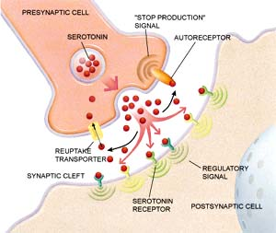
Synapse
Draw a diagram showing how serotonin allows an impulse to pass across a synapse

Slide 6
Prozac
Give two medical reasons why a person may suffer from depression
Not enough serotonin chemical produced
Serotonin receptors do not work/blocked

Slide 7
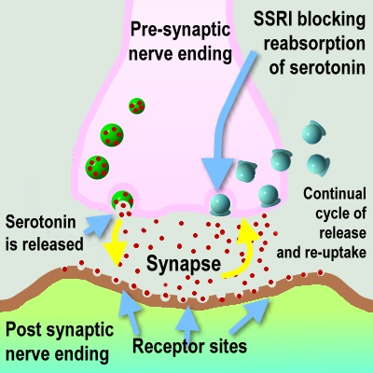
Draw a diagram to show how prozac reverses the problem with the serotonin synapse

Slide 8
Explain how ecstasy (MDMA) affects serotonin channels
Serotonin
Concentration
Block
Reuptake channel
Increased impulses

Slide 9
Conditioned reflex
Explain Pavlov’s experiment using the following terms and giving examples of these:
Primary stimulus
Reflex response - unconditioned
Secondary stimulus
Repeat
Conditioned response

Slide 10
Why learn a new reflex response?
How can a reflex response be modified?
Increase chances of survival
Brain is involved, impulse goes to brain and allows you to override the reflex response

Slide 11
Why is it that an animal can adapt to new situations, learn new skills?
How are skills learnt?
What is memory?
Write a flow chart describing how information can become long term memory
What evidence is there to show that certain skills e.g. Speech can only be learnt at an early age
Potential of brain to develop lots of different neural pathways
Repetition
Storage and retrieval of information
Feral children cannot/struggle to learn these skills at an older age
Stimulus (sensory memory), short term memory, repetition, storage in long term memory, retrieval, lack of use = forgetting

Slide 12
Multi store model
Stimulus (sensory memory), short term memory, repetition, storage in long term memory, retrieval, lack of use = forgetting
Why is this model limited?
Doesn’t fully explain why memory is lost

