Slide 1
Module B7 – Further Biology
Biology across the ecosystem

Slide 2
B7.1 Living organisms are interdependent
All organisms are dependent on energy from the Sun.
Plants absorb some of the Sun’s energy for
photosynthesis.
Autotrophs make their own food (e.g. Plants make their food from the Sun).
Heterotrophs have to catch or find their food.

Slide 3
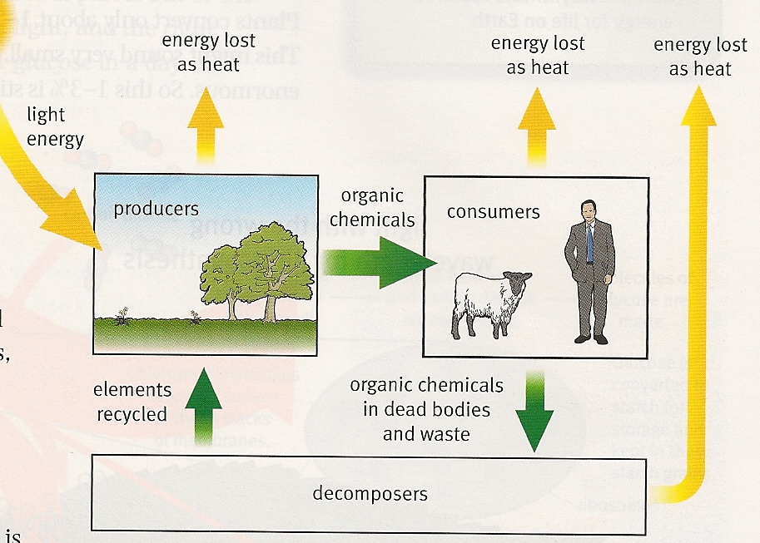
Transfer of energy
Plants capture energy from sunlight (only about 2%) and store it in their tissues.
This energy is then passed to other organisms as they eat the plant.
Some energy is lost at each stage, usually as heat from respiration,
waste products and
uneaten parts.

Slide 4
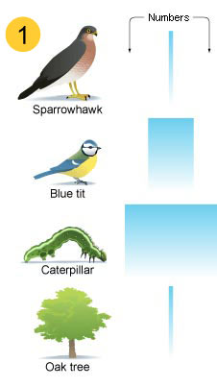
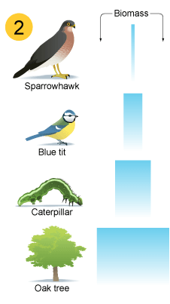
Pyramids
A pyramid of numbers shows the actual number of organisms at each stage of a food chain. They can be odd shapes (see below)
A pyramid of biomass shows the total mass of the organisms at each stage. Pyramids of biomass are always pyramid shaped.
Pyramids always start with the producer at the bottom.
Only about 10% of the energy is passed to the next level.
Energy efficiency (%) = energy to next level x 100
total energy input

Slide 5
Soil
Soil is made of:
Inorganic particles of sand, silt and clay.
Air (provides oxygen for aerobic microorganisms)
Water (with dissolved mineral ions)
Biomass (living organisms and decaying material)
Water mass in soil = wet mass – dry mass
% water content = water mass x 100
wet mass
Biomass = wet mass – oven dry mass
% biomass = biomass x 100
wet mass

Slide 6
B7.2 Photosynthesis
Carbon dioxide + water oxygen + glucose
The main stages of photosynthesis:
Light energy absorbed by chlorophyll
Energy used to rearrange the atoms of CO2 and water to produce glucose
Oxygen produced as a waste product
Glucose is then:
Converted into chemicals for growth
Used in respiration
Converted into starch for storage
This is because starch is insoluble and has little effect on the cell’s osmotic balance.

Slide 7
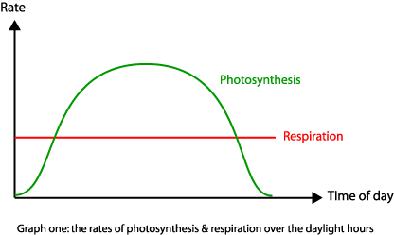
Compensation point (higher)
The plant’s compensation point is when photosynthesis and respiration are taking place at the same rate. There is no net movement of CO2 in or out of the plant.
Photosynthesis occurs only during the day, whereas respiration occurs at the same rate throughout the day and night.

Slide 8
Energy from respiration may be used to:
Change glucose to starch and cellulose
Change glucose and nitrates (from soil) to amino acids and them to proteins
Absorb nitrates through the roots by active transport
Photosynthesis can be limited by low temperature, carbon dioxide levels and light intensity.
Scientists agree that human activity is causing an increased level of atmospheric CO2.

Slide 9
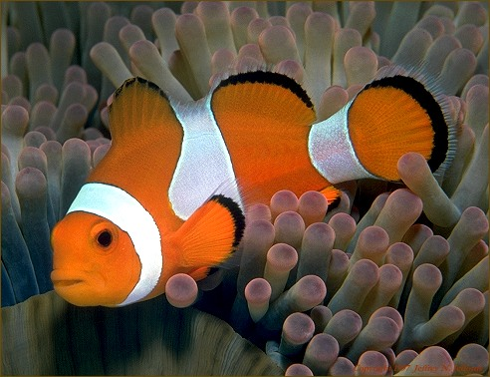
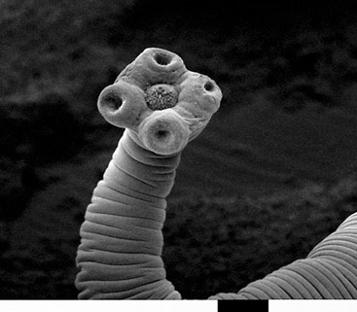
B7.3 Heterotrophic nutrition
Symbiosis is a close association between 2 different organisms.
3 types:
Mutualism – both species benefit.
Commensalism – one benefits but the other is neither harmed nor benefits, e.g. Sticky seed pods.
Parasitism – One is harmed (the host) while the other benefits (the parasite).

Slide 10
Parasites
Parasites can:
Cause human diseases, such as malaria
Impact food production by causing illness in farm animals and attacking crops.
The evolution of a parasite is thought to be closely linked to that of its host.

Slide 11
Tapeworms – a parasite
Stays in the gut and competes with the host for digested food.
Adaptations:
Heads have suckers and stickers to grip the gut wall.
Protected from digestion by a thick, enzyme resistant cuticle.
Use anaerobic respiration.
Has both male and female sex organs so can reproduce without a mate.
Produce large numbers of eggs.
Uses a secondary host (usually a pig) to transfer to human hosts.

Slide 12
Malaria
Caused by a parasite that infects mosquitos, which then infect humans.
The parasite’s life cycle protects it from out immune system:
Spends its life feeding in our RBC, therefore difficult for out WBC to detect.
When the blood cell is used up, the parasites burst out and release toxins, causing the fever.

Slide 13
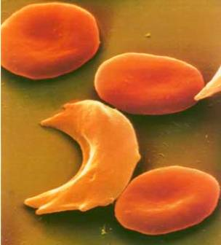
Sickle cell anaemia
Genetic disorder caused by a recessive alelle (aa). People can be carriers (Aa) but do not have the disease.
Carriers of sickle cell have a
higher resistance to malaria,
and SCA is much more
common in areas where
malaria is prevalent. This is
due to natural selection.

Slide 14
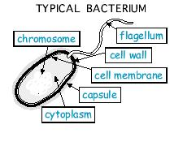
B7.4 New Technologies
Bacteria have no nucleus, but many have a ring of DNA (a plasmid).
Bacteria and fungi can be grown on a large scale to produce:
Antibiotics
SCP e.g. Quorn
Enzymes for food manufacture

Slide 15
Genetic modification
GM includes:
Isolating and replicating the required gene
Transferring the gene into a new cell using enzymes
Vectors can be used such as viruses or plasmids.
GM can be used for:
Bacterial synthesis of drugs and hormones e.g. Insulin
Disease resistance in crops.
There are many social, economic and ethical implications of the release of GM organisms.

Slide 16
B7.5 Respiration
Aerobic respiration equation:
Glucose + oxygen carbon dioxide + water
Aerobic respiration requires oxygen; anaerobic does not.
Energy released during respiration synthesizes a chemical called ATP – the ‘energy currency’ of all living things.
Muscle tissue contracts when given energy, and during exercise, respiration in muscle cells increases, HR quickens and breathing rate increases.

Slide 17
Anaerobic respiration
Glucose lactic acid (+ energy released)
Anaerobic respiration takes place in muscle cells where there is a shortage of oxygen and leads to a build up of lactic acid in cells (this causes pain such as cramps).
Oxygen is needed to break down the lactic acid and is known as the ‘oxygen debt’.
Aerobic respiration releases more energy per glucose molecule than anaerobic, but anaerobic is useful for short, sharp bursts of energy (e.g. Sprints).

Slide 18
B7.6 Circulation
Components of blood:
RBC – transport oxygen
WBC – fight infections
Platelets – blood clotting at injury sites
Plasma – carries other chemicals such as hormones

Slide 19
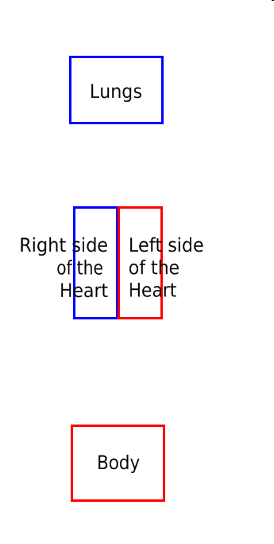
The heart
The heart is a double circulation pump – it has to pump blood to the lungs to pick up oxygen before pumping it through the heart and back round the body.
Each side of the heart has an atrium and a ventricle.
Blood enters the atria, they then contract pushing blood into the ventricles, which then contract pushing blood away from the heart.
The valves in the heart and veins stop blood flowing backwards.

Slide 20
Capillaries
When blood enters the capillary network, it is at high pressure.
Blood plasma is squeezed out of the capillary, forming a liquid called tissue fluid.
This fluid contains all of the chemicals being carried by blood plasma which then diffuses into cells.
As the blood moves through the capillaries, pressure drops, allowing tissue fluid containing waste products to move back into the capillaries.

Slide 21
B7.7 The Skeletal System
Vertebrates have an internal skeleton made of living bone for support and movement.
Muscles can only pull, so they work in antagonistic pairs e.g. Biceps and triceps.
2 or more bones meet at a joint.
Tendons (tough, not stretchy) attach muscle to bone
Ligaments (tough, stretchy) attach bone to bone
Muscles move the joint
Cartilage (smooth) covers ends of bones for easy movement
Synovial fluid (oily) gives lubrication and prevent cartilage wearing down.

Slide 22
Sports injuries
Sprains
Overstretch a ligament
Redness, swelling, bruising, ache
Knee or ankle usually
RICE treatment
Rest, Ice, Compression, Elevation
Dislocations
Bone slips out of the joint
Common in shoulder, knee
Very painful
Has to be put back into place

Slide 23
Training programs
Health check
General health check e.g. BP
Medication
Smoke? Drink?
Amount of exercise
Family medical history
Previous treatments
Info is then used to decide on the best training program, as there are different types and levels of exercise.
Same checks are done by a doctor before prescribing medication, as they may give unwanted harmful side-effects.
The side effects of treatments are often weighed against the benefits gained.

Slide 24
Progress will be checked regularly, and people monitored, to see if changes may be made.
Changes may need to be made to the fitness program if e.g. They get an injury or their fitness levels are improving quicker than was thought.
Staff must have access to records in case of an emergency or if the patient needs to go into hospital etc.

