Slide 1
Name the chemicals and write the formula
Carbon monoxide | CO

Slide 2
How do you make these molecules?
The nitrogen atoms comes
from the ______ the oxygen
atoms also come from
the _____. These react in
the _____ engine because it
Is very _____.
The oxygen atoms come from
the _______, while the
sulphur atoms are found
as an impurity in _______. This
is used in __________ stations
to make electricity. It is possible
to remove Sulphur dioxide from
the gases by wet ___________.

Slide 3
Complete the word and symbol equations
Carbon + _______ → carbon monoxide
C + ____ → 2CO
_______ + oxygen → sulphur dioxide
S + ____ → SO₂
Methane + oxygen → carbon dioxide + water
CH₄ + 2____ → CO₂ + 2_____

Slide 4
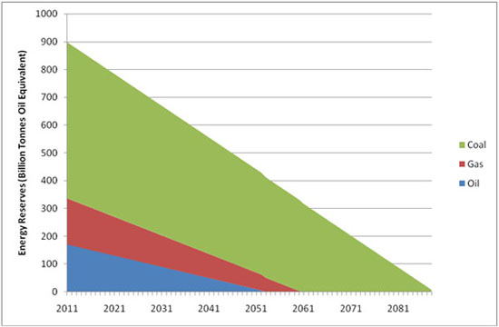
Getting information from a graph (1)
Which fossil fuel is used the most?
How much oil is used in 2011?
What year will gas run out?
What year will oil run out?

Slide 5
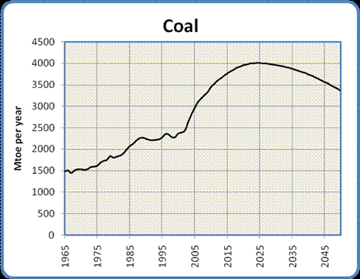
Getting information from a graph (2)
Describe the trend of the amount of coal being used from 1965 to 2025.
Describe the predicted trend from 2025 to 2045
How much coal is being used in 2005?

Slide 6
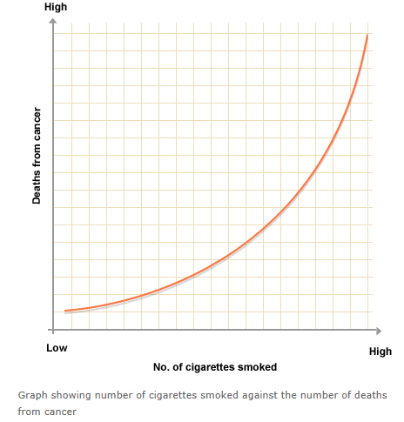
Getting information from a graph (3)
As more cigarettes are smoked what happens to the number of deaths from cancer?
Is there a correlation between these two factors?
Is there a causal link between the two?

Slide 7
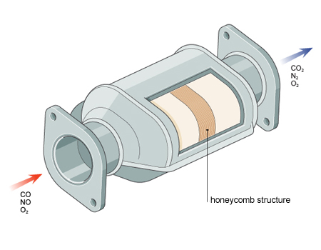
What happens in the catalytic converter?
Write more or less in the boxes to show the amount of gas with or without the catalytic converter.
 | WITHOUT A CATALYTIC CONVERTER | WITH A CATALYTIC CONVERTER
Nitrogen monoxide
Carbon monoxide
Nitrogen
Carbon monoxide
Oxygen

Slide 8
Complete combustion
This means that there will be an unlimited supply of oxygen.
The gases produced are
_______ ________ and ________
Complete the equation
CH₄ + O₂ → +
How can you prove that carbon dioxide has been made?

Slide 9
Incomplete combustion
This means that there will be an limited supply of oxygen.
The gases produced are
_______ ________ and ________
Complete the equation
CH₄ + O₂ → +
What is a danger of carbon monoxide?

Slide 10
Choose the best 3 answers.
What are the best ways to reduce your consumption of electricity?
turning up the heating at home
insulating your home
Leaving lights on when you leave a room
using low-energy lamps
using a microwave instead of an electric oven
leaving TV sets on standby
Can you suggest any other ways to reduce your consumption of electricity?

