Slide 1
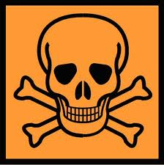
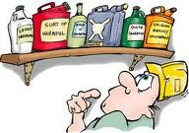
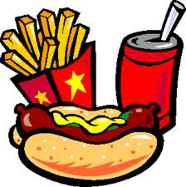
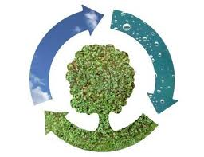
C3 Chemicals in our lives: Risks and Benefits

Slide 2
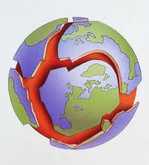
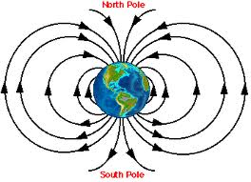
A journey through geological time
The Earth’s outer layers are divided into a number of _________ ________ . These move because of very slow ____________ currents in the underlying solid mantle.
Movements of the tectonic plates can cause oceans to open up between some continents or create mountain ranges between others. Most major ___________ and ______________ happen at plate boundaries.
Scientists in the 1950’s showed that it was possible to track the position of slowly drifting countries by studying _________ particles in the rocks, such as magnetite. The magnetism of crystals in sediments line up in the direction of the Earth’s __________ field at the time the sediments were formed. Near the _______________ the magnetism lies horizontally, so by measuring the angle at which crystals are magnetised in rocks, scientists can work out the ___________ of at which the rock was originally formed.

Slide 3
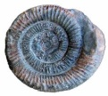
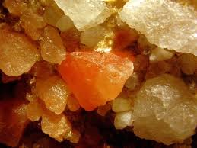
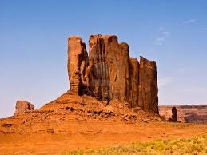
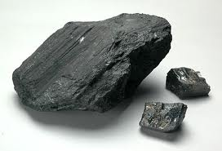
Mineral wealth in Britain
You can find out the history of sedimentary rock such as ________________ by looking at the shape and size of the sand _________ in the rock. Comparing sand grains in rocks with grains in deserts today, geologists can find out about the conditions when rock was formed. Some sedimentary rocks are rich in __________ , which can be used to put rock layers in order of age. In Britain there is a large variety of rocks, many are ______________ important. They formed at different times in different climates.
Limestone
________________________
________________________
________________________
________________________
Rock Salt
_____________________
_____________________
_____________________
_____________________
Sandstone
______________________
______________________
______________________
______________________
Coal Shale
______________________
______________________
______________________
______________________

Slide 4
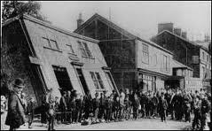
Salt: sources and uses
Salt can be used for _______________________ and for _____________________________ . Sea salt can be extracted from the sea by ____________________________________________
______________________________________________________________________________ . There are two underground rock salt mines in Britain. This salt is used on ___________________
______________________________________________________________________________
______________________________________________________________________________ . Salt used on roads does not have to be pure.
Salt used in the chemical industry in Britain is not mined, it is extracted by solution mining. Water is pumped into the rock, the salt ___________ and is carried to the surface in ________________ . A solution of salt plus water is called _______________ . Salt crystals are recovered from brine by _______________ the water. The crystals are separated from the remaining brine by _______________ or using a centrifuge.
Solution mining can create large underground holes. This can lead to ____________ and collapses that can destroy buildings. Nowadays, pumping is planned so that pillars of rock are left to prevent subsidence.

Slide 5
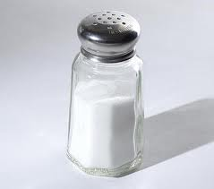
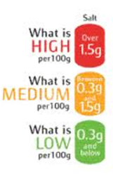
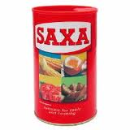
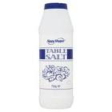
Salt in food
Salt (sodium chloride) is an essential part of a healthy diet and your body uses it in your ______ and _________ . It is used by the food industry as a ______________ and as a ___________________ .
Health risks from salt
UK government departments have a role in protecting the health of the public. These departments :
carry out ________on the chemicals in food.
Advises the ___________ about the effect of food on health.
Try to reduce the _______ intake in adults and humans.
Government agencies say that eating too much salt can raise people’s blood pressure. This can increase the risk of developing ______________________ or having a __________ .
Challenging the salt theory
The European salt producers’ association have produced a report challenging the theory that reducing salt intake brings health benefits to everyone in the population. Other scientists also argue that ___________ suggests that reducing salt intake in the whole population will not benefit those with normal to low blood pressure.

Slide 6
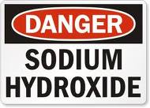
Alkalis and their uses
Alkalis have been used even before large scale industrialisation to neutralise acid soils, convert fats and oils into soap, to make glass and to make chemicals that bind natural dyes to cloth e.g. Alum.
Making Alum
Roast aluminium mix with water take solution containing boil liquid add alkali let crystals
rich rock chemicals (potash or ammonia from urine) of alum form
Alkalis and their reactions
All alkalis are _________ in water. When then dissolve they raise the pH of the water above __ .
Alkalis are important because they _____________ acids. When acids and alkalis react they produce different salts. If hydrochloric acid is used, the salt will be a __________ . If nitric acid is used, the salt will be a __________ .
Alkaline hydroxide + acid salt + water
e.g. ______ hydroxide + hydrochloric acid sodium ________ + water
Sodium and potassium carbonate dissolve in water to form a solution with a pH above __ . They fizz when mixed with an acid because the reaction produces _____________________ .
Alkaline carbonate + acid salt + carbon dioxide + water
e.g. ____________ + sulfuric acid potassium + carbon + water
carbonate ______ _ dioxide

Slide 7
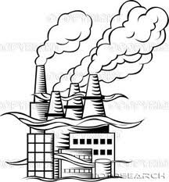
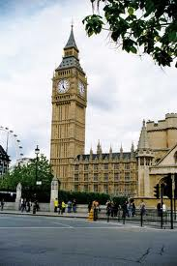
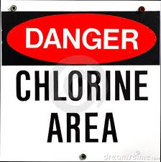
Chemicals from salt – the foul way
Making alkali on a large scale
During the industrial revolution (1700s), natural sources of alkali were too scarce to meet demand. Nicholas Leblanc invented a new process that used calcium carbonate (limestone), sodium chloride (salt) and coal were used to make the alkali ________ ________ .
The Leblanc process was highly polluting. For every tonne of the product sodium carbonate, two tonnes of solid waste were produced. It also released one tonne of __________ ___________ gas into the air, which harmed the land around. Solid waste gave off toxic _________ _________ gas.
In 1868 the government passed the first of the Alkali Acts to control pollution by the chemical industry in response to public demand. In response, the industry dissolved the hydrogen chloride in water to make __________ acid. This killed life in rivers.
It was then found that hydrogen chloride could be oxidised to make chlorine, which has different properties. Chlorine could then be used to ________ paper and textiles.

Slide 8
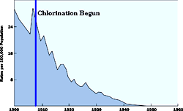
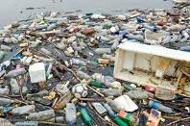
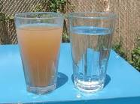
Benefits and risks of water treatment
Water contaminated with sewage can sometimes carry fatal diseases such as __________ and typhoid . Drinking water can be filtered and then treated with chlorine to kill the microorganisms. Chlorination of drinking water in Britain became common in the early 20th century. This led to a ___________ in the deaths from ________ .
Chlorination can also remove unpleasant tastes and helps to stop ________________ growing in water storage tanks.
Risks of water treatment
Some scientists are concerned about side effects of chlorination and think that it may form groups of chemicals called trialomethanes (THMs). These form when chlorine reacts with naturally found _________ matter in water. When people drink the water, the THMs may be absorbed into their bodies. Ozone gas and carbon filters can be used to remove __________
material before disinfection by chlorination.

Slide 9
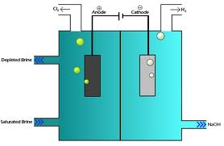
Chemicals from salt – a better way
Today, electricity is used to make chlorine from salt. Brine is a solution of sodium chloride (_____) in water ( ____ ) . These 4 elements can be rearranged to make chlorine (___), sodium hydroxide (______) and hydrogen (___) by passing an electric current through the solution by electrolysis. Chemical changes take place at the surface of the _______ that conduct the electrical current in and out of the solution. The chemicals produced from salt have many uses.
Chlorine | Sodium hydroxide | Hydrogen
Environmental impacts
Manufacturing chemicals from salt by electrolysis needs a lot of ________ , which is mainly generated using fossil fuels. Renewable sources of energy are being investigated. Mercury is often used as one of the metals in contact with the solution, however, this is ______ and can damage the environment if it leaks from the system.

Slide 10
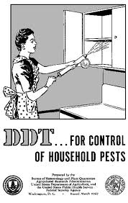
Protecting health and the environment
Untested chemicals
Some people are fearful of man-made (___________ ) chemicals. Campaign groups have highlighted evidence suggesting that chemicals found in plastics and pesticides may cause cancer. Scientists agree that some synthetic chemicals can be harmful in _____ doses, but not at the lower concentrations usually found in people’s bodies.
Hazard: the danger of exposure to risk. Some hazards are only significant if we are exposed to them for long periods of time.
Risk: ________________________________________________________________________
____________________________________________________________________________
REACH (Registration Evaluation and Authorisation of Chemicals) is a system introduced in the EU to collect information about the ________ of chemicals and to assess their ______. The chemical industry has to manage the risks of chemicals for human health and the environment.
Persistent organic pollutants (POPs )and pollution
Some synthetic chemicals are harmful even in small amounts. They do not break down in the environment easily and so can be passed around. They build up ( ___________) in fatty tissues of animals including humans. They harm both people and wildlife. Examples of these chemicals include dioxins, PCBs, _____ and _______ . Some of these chemicals have been banned in Britain, others have never been introduced intentionally.

Slide 11
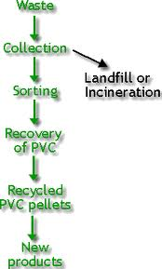
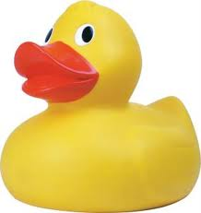
Stages in the life cycle of PVC
PVC is a synthetic polymer. It is strong, easy to mould and quite cheap. It is also hardwearing, durable and can be used to make a wide variety of different products e.g. _________, ________
Production
Use
Disposing

Slide 12
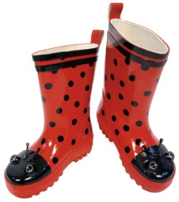
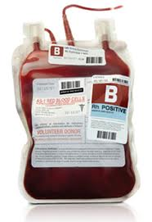
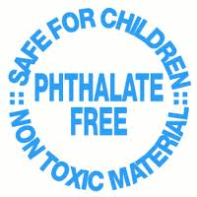
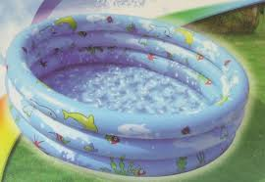
Benefits and Risks of plasticisers
Toymakers like to use PVC because it:
______________________________________
______________________________________
______________________________________
______________________________________
Plasticisers are chemicals that make PVC ______ and _________ . The most common plasticisers for PVC are __________ . However, these can dissolve out of a plastic toy into the saliva of a baby that chews it or can leach out of plastic used to make blood bags and so enter patients’ blood. Some campaigners say that phthalates should be banned because of evidence linking them to health problems such as cancer. However, makers of PVC say that there are no known cases of anyone being harmed by phthalates.
Regulators
Regulators are concerned about _________________________________________________ . Therefore they have ___________________________________________________________ and ________________________________________________________________________ . Regulators are worried about DEHP because ________________________________________
____________________________________________________________________________ PVC plasticised with DEHP is used in many medical devices because it is __________________
____________________________________________________________________________ . This can increase people’s exposure to DEHP. Alternatives to DEHP are often ______________ .

Slide 13
From Cradle to Grave
The life of the products that you use have four distinct phases:
_____________________________________
_____________________________________
_____________________________________
_____________________________________
Life cycle assessment (LCA)
_________________________
_________________________
_________________________
_________________________
_________________________
_________________________
CRADLE
Once the life of a product is over, its materials should go back into another product. This is recycling.
_________________________
_________________________
_________________________
_________________________
_________________________
_________________________
USE
_________________________
_________________________
_________________________
_________________________
GRAVE
LCA involves collecting data about each stage in the life of a product.
Draw the life cycle of a polymer

