Slide 1
C3
Revision

Slide 2
Geological map of Britain.
Geologists explain most of the history of the surface of the Earth in terms of processes that can be seen today.

Slide 3
A rock hard question!
Why are there so many different types of rock in Britain?
Impact of plate movement.
The movement of the plates means that Britain has experienced different climates during its long history.

Slide 4
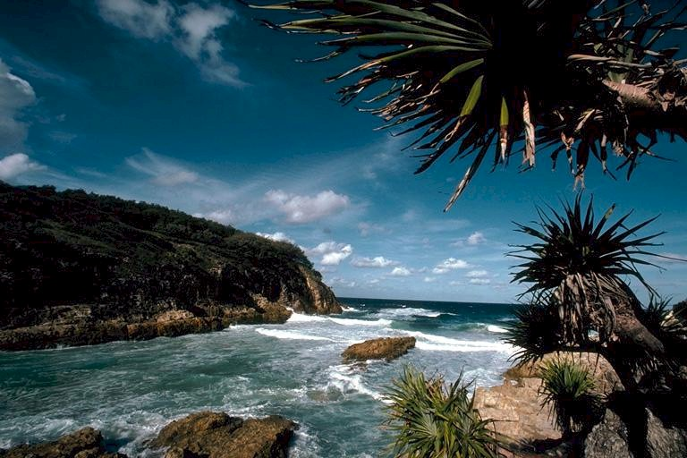
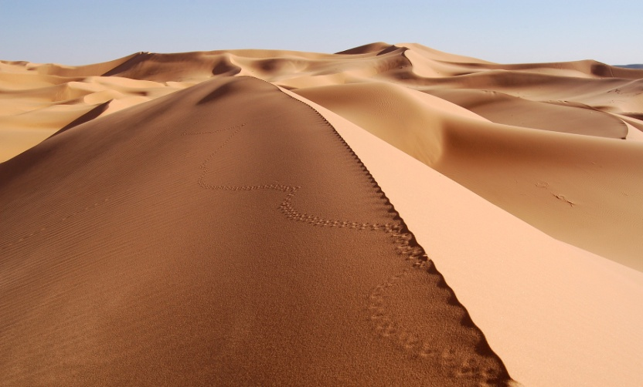
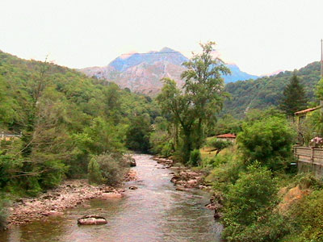
Different climates – different rocks!
1
2
Tropical
Polar
3
4
Dry
Temperate

Slide 5
Paleomagnetism
Paleomagnetism is the study of the magnetic properties of rocks.
Paleomagnetism aids in our understanding of plate tectonics and the history of the Earth's magnetic field.

Slide 6
Bernard Brunhes
Bernard Brunhes (1867–1910) was a French geophysicist known for his pioneering work in paleomagnetism, in particular, his 1906 discovery of geomagnetic reversal

Slide 7
How coal was formed.

Slide 8
How coal was formed.

Slide 9
Chatterley Whitfield Pit in 1930
Can you predict what the area would have been like 300 million years ago?

Slide 10
Formation of limestone.
Limestone was formed below a shallow warm sea.
At the time the sea was full of living things.
As the animals died their shells and skeletons turned into sediment that then turned into limestone.

Slide 11
Formation of salt.
Deposits of rock salt formed as the water in the salt marsh (opposite) evaporated.
Evaporating Mediterranean Sea
How could this be demonstrated in the classroom?

Slide 12
Raw materials for the chemical industry.
Chemical industries grow up where resources are available locally, eg salt, limestone and coal.

Slide 13
Clues in the rock.
Geologists use the following evidence to predict the conditions under which the rock was formed;
A) Fossils.
B) Shapes of water borne grains and air blown grains.
C) Presence of shell fragments.
D) Ripples from sea or river bottom.

Slide 14
Comparing grains of rock.
Which grains of rock are air blown and which are water borne (carried by water)?
A – water borne.
B – air blown.
Can you explain why?

Slide 15
Clues in the rock – sorting grain sizes.
Which grains were deposited very quickly – for example during a storm?
A.
Which grains were deposited over a period of time by wind action in deserts or wave action on beaches?
C

Slide 16
Shell fragments
If you found a rock with shell fragments in it what would you say about the rock?
Rocks have been found on Mount Everest with shells in them, what does this suggest?

Slide 17
Mountain building.
The initial mountain building process started about seventy million years ago (or the Upper Cretaceous period) when the two land masses (or plates) began to collide with each other.

Slide 18
How was this fossil formed?
Ripples from sea or river bottom

Slide 19
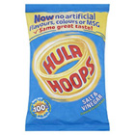
Why is salt used?
Salt has two major uses:
1. To flavour foods.
2. To preserve foods.

Slide 20
The role of salt in our body.
Salt is involved in regulating the water content (fluid balance) of the body.
The sodium ion itself is used for electrical signaling in the nervous system.
This is why we naturally seek out salty-tasting food.

Slide 21
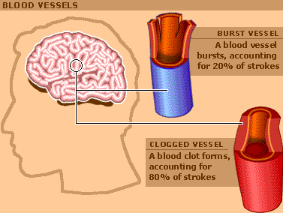
Too much salt.
UK government agencies say that eating too much salt can raise people’s blood pressure.
This can increase the risk of developing heart disease or having a stroke.

Slide 22
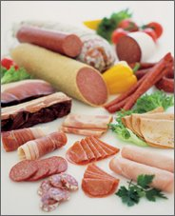
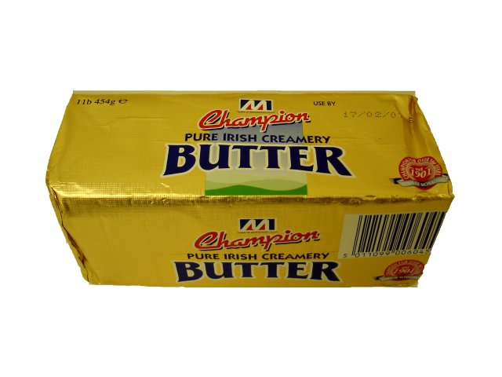
What are the main sources of salt in our diet?
Cereal products – bread, biscuits and cakes.
Processed meat and fish products.
Some dairy products – cheese.

Slide 23
Where does the salt come from?
Fact:
On average 75% of the salt we eat is already in the food, the other 25% is either added at the table or during cooking.
How do we know how much salt is in our food?
Check the food label.

Slide 24
Understanding food labels
Look at the food labels opposite.
1. Why is this known as the traffic light system of food labelling?
2. What is good about the label?
3. What could be improved?

Slide 25
Understanding food labels.
What amount of salt is there in one serving?
How much is that in terms of recommended daily intake?
How does this label compare with the previous label?

Slide 26
How would you rate this label?

Slide 27
What role do these two Government departments play?

Slide 28
What role do these two Government departments play?
Advising the public in relation to the effect of food on health
Carrying out risk assessments in relation to chemicals in food.

Slide 29
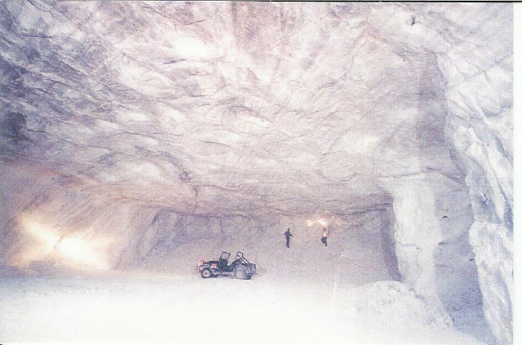
Brine.
Brine is concentrated sodium chloride solution.
Where does all the salt come from?
Sea.
Underground salt
deposits.

Slide 30
Which salt would you eat?
Sea - salt
Rock salt
What use can you think of for rock salt?

Slide 31
Road Gritting

Slide 32
Large-scale extraction of salt.
Task:
Watch the following clips and answer these 2 questions.
1. Where would this take place?
2. What must the climate be like?
Clip 1
Clip 2

Slide 33
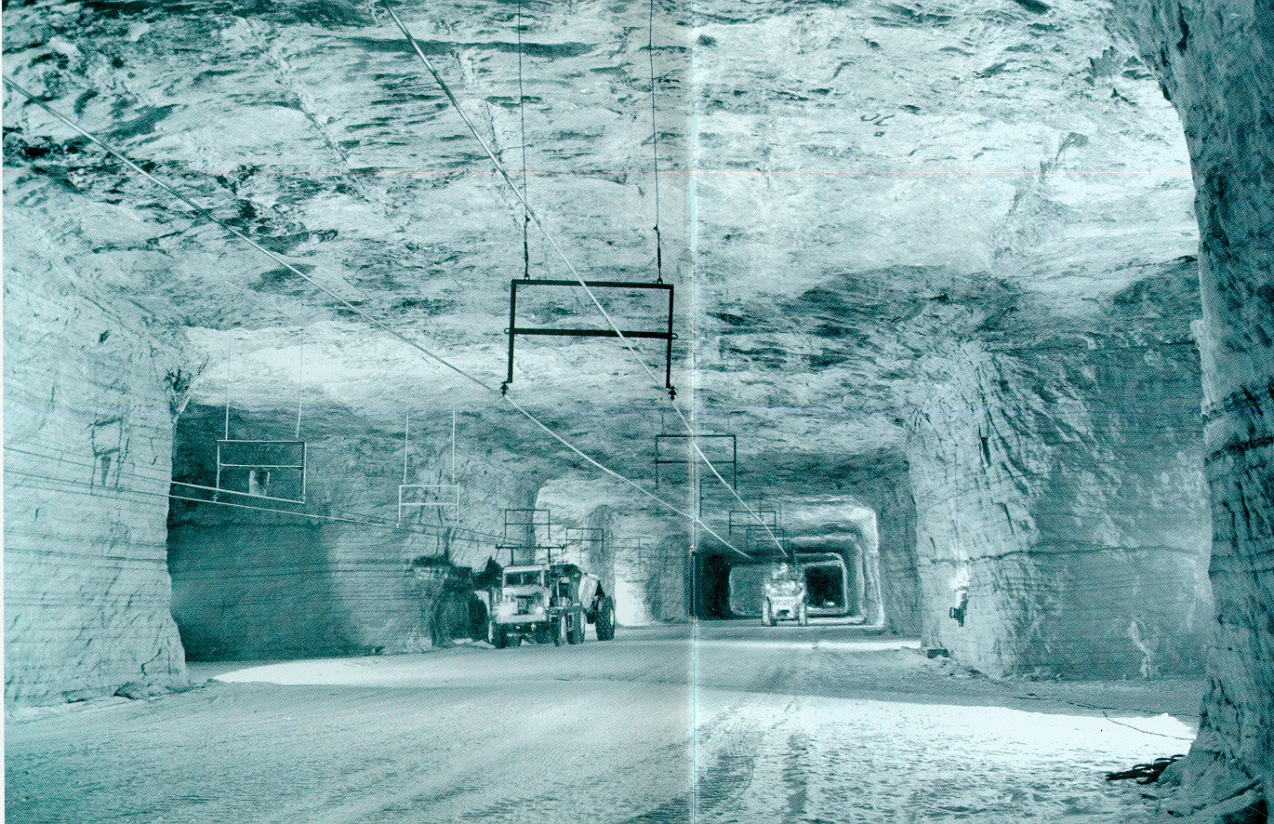
Rock salt mining.

Slide 34
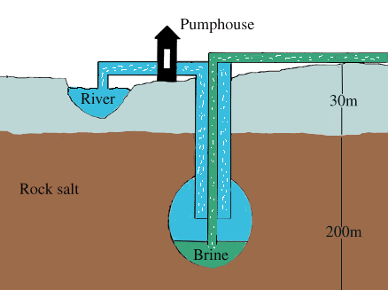
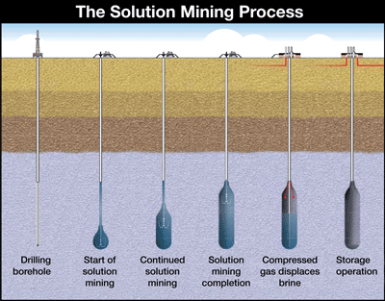
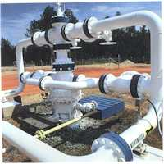
Solution mining of salt
Solution mining wellhead

Slide 35
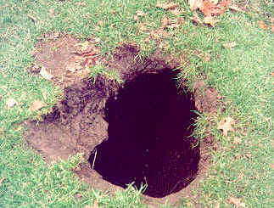
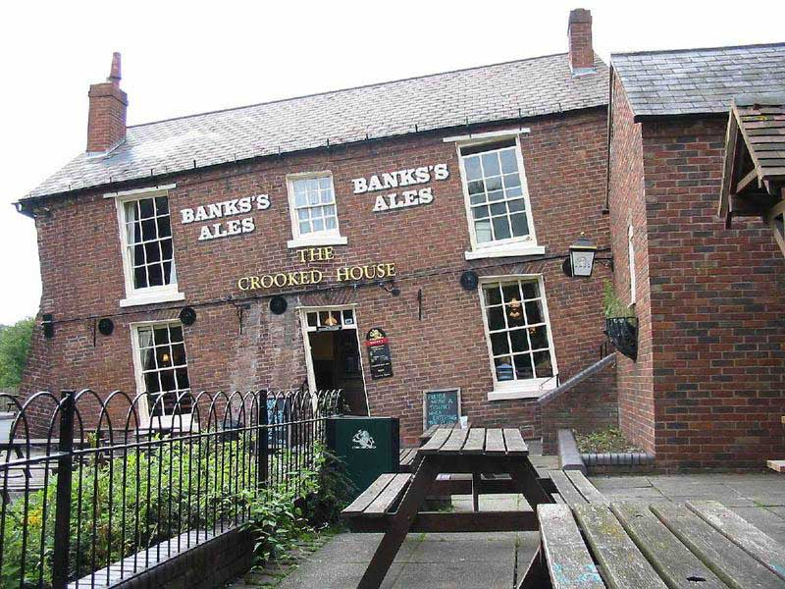
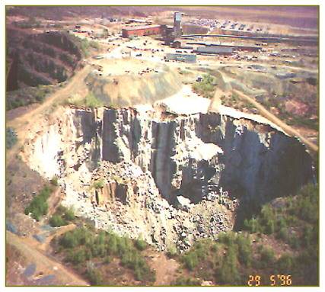
Mining subsidence

Slide 36
Electrolysis.
Electrolysis simply means – splitting up by electricity.
Brine – concentrated salt solution – can be split up by passing an electric current through the solution.
What 4 elements are present in brine?

Slide 37
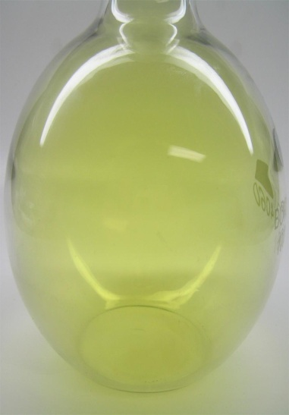
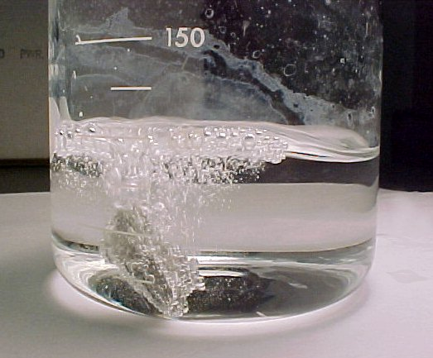
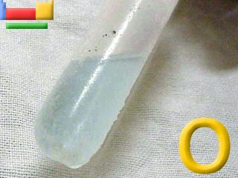
Brine – salt solution.
The 4 elements are;
Sodium Na
Chlorine Cl
Hydrogen H
Oxygen O

Slide 38
Chemicals from salt.
Chlorine is used to sterilise water and to make solvents, household bleach and plastics.
Hydrogen is used in the manufacture of margarine.
Sodium hydroxide is used to make soap, chemicals, fibres and paper.
Household bleach is made from reacting sodium hydroxide and chlorine.

Slide 39
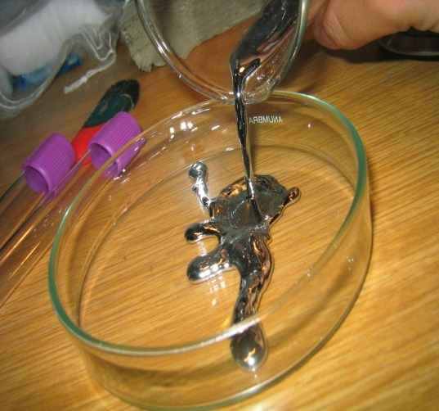
Environmental impact of electrolysis.
Fact:
Electrolysis uses a lot of electricity.
Fact:
Mercury is used during the electrolysis of brine.

Slide 40
Timeline for water purification.
Chlorination of water.
What does the graphic opposite show?
Is this a strong enough case for adding chlorine to water?

Slide 41
Water purification.
The 3 main processes in the purification process are;
Sedimentation – removes large insoluble material.
Filtration – removes the smaller insoluble material.
Chlorination – kills microbes that might otherwise cause disease.

Slide 42
Possible disadvantage of chlorination.
During the water treatment process, chlorine reacts with organic matter such as decomposing leaves or soil to create what are called disinfection by-products (DBPs). The most common class of DBPs is trihalomethanes (THMs).

Slide 43
Possible disadvantage of chlorination of water
Toxicological studies suggested that some THMs are carcinogenic to laboratory animals, but only at levels many thousands of times greater than those found in drinking water.
In addition to concerns about carcinogenicity attention has also focused on possible relationships between DBPs and adverse reproductive and developmental effects.

Slide 44
Uses of alkalis
Neutralise acid soils.
Make chemicals that bind natural dyes to cloth.
Convert fats and oils into soap.
To manufacture glass.

Slide 45
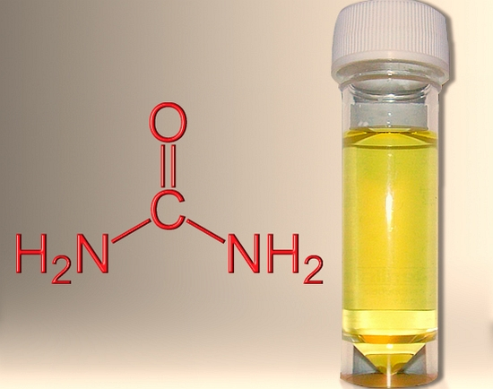
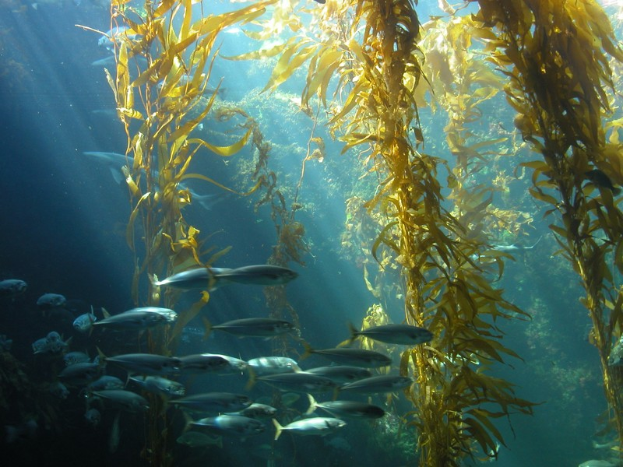
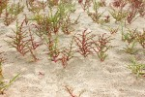
Traditional sources of alkali
Burnt wood.
Stale urine.
Kelp.
Barilla.

Slide 46
At what point did the population grow fastest in the UK?
How would this affect the demand for products?

Slide 47
Traditional method of making alkali.
Would this method make high volumes of alkali or low volumes?
Would it be enough to meet the demand of a growing population?
What would you do?

Slide 48
Leblanc process
In 1775 the French Royal Academy offered a prize to anyone who could develop a process for transforming common salt (sodium chloride) into soda ash. Leblanc achieved the goal by 1789 and opened a small factory at Saint Denis that began production in 1791.

Slide 49
Leblanc process.
The 3 main reactants for the Leblanc process were; salt, limestone and coal.
The downside was that large volumes of hydrogen chloride (acidic gas) were released as well as creating great heaps of waste that slowly released a toxic and foul smelling gas (hydrogen sulfide).

Slide 50
A factory in Widnes using the Leblanc process.
What do you think it would be like living close to the factory?

Slide 51
Deacon Process
The Deacon process is an example of an oxidation reaction.
4HCl_{(g)} + O_{2(g)} <=> 2H₂O_{(l)} + 2Cl_{2(g)}.
Hydrogen + oxygen <=> water + chlorine chloride
The oxygen combines with the hydrogen chloride gas to make chlorine and water.

Slide 52
Acid alkali reactions
A neutralisation reaction occurs when an acid reacts with an alkali. An alkali is a metal oxide or metal hydroxide dissolved in water.
ACID + ALKALI SALT + WATER
O
Cl
H
Na
H
Cl
Na
O
H
H
Copy and complete the following reactions:
Sodium hydroxide + hydrochloric acid
Calcium hydroxide + hydrochloric acid
Sodium hydroxide + sulphuric acid
Magnesium hydroxide + sulphuric acid

Slide 53
Reactions of metals carbonates with acid
A metal carbonate is a compound containing a metal, carbon and oxygen.
METAL CARBONATE + ACID SALT + CARBON DIOXIDE + WATER
Mg
O
H
Cl
Cl
O
Mg
O
C
C
H
H
O
O
H
Cl
Cl
O
Copy and complete the following reactions:
Magnesium carbonate + hydrochloric acid
Calcium carbonate + hydrochloric acid
Sodium carbonate + sulphuric acid

Slide 54
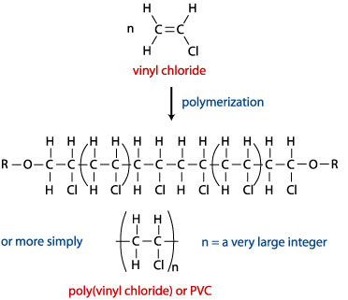
What is PVC?
PVC is a polymer that contains chlorine, carbon and hydrogen.
It has many uses from rigid pipe for construction applications to a thin crystal clear film for consumer packaging.
33 million tonnes were produced in 2008.

Slide 55
Why the difference in properties?
It is all to do with what is added.

Slide 56
Slip in a plasticizer.
Plasticizers are small molecules that sit between the polymer chains.
The chains are further apart – weaker forces between chains - chains can move more easily – polymer becomes softer and more flexible.

Slide 57
Leaching of plasticisers.
Phthalates do not bind to the PVC polymer but float around like water in a sponge. They remain present as a freely mobile and leachable phase in the plastic. As a result, phthalates are continuously lost from soft PVC over time.
What would happen if the molecules above were squeezed together?

Slide 58
Why might these toys be a danger to young children?

Slide 59
It sucks!
Pressure on a PVC product will increase leaching substantially. Of most concern is the leaching of plasticisers resulting from sucking or chewing on soft PVC toys, representing a direct bodily dose of these chemical to the infant or child.

Slide 60
PVC as a toxin.
Watch the news report.
What does Sam Suds have to say?
Find out more click here.

Slide 61
Problems with toxic chemicals.
Toxic chemicals cause problems because;
They persist in the environment.
Can be carried over large distances.
May accumulate in food and human tissue.

Slide 62
Sustainable Development
Using the Earth’s resources in a way that can continue in the future.
Meeting the needs of today without stopping people meeting their needs in the future.

Slide 63
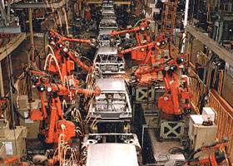
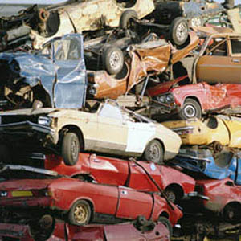
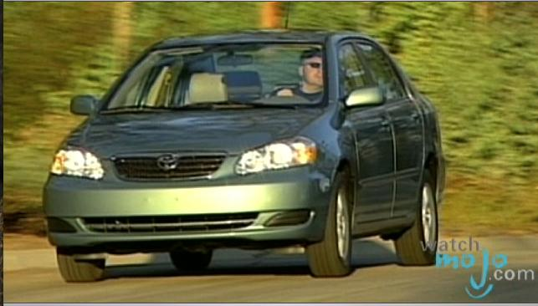
Life Cycle of a Product.
This can be simplified into 3 stages.
1. Product is made.
2. Product is used.
3. Product is disposed of.

Slide 65
Life Cycle Assessment – Factors to be considered
Energy required.
Sustainability and impact on environment of using natural resources (raw material).
Environmental impact of manufacturing.
Environmental impact of using product.
Environmental impact of disposing of product.

Slide 66
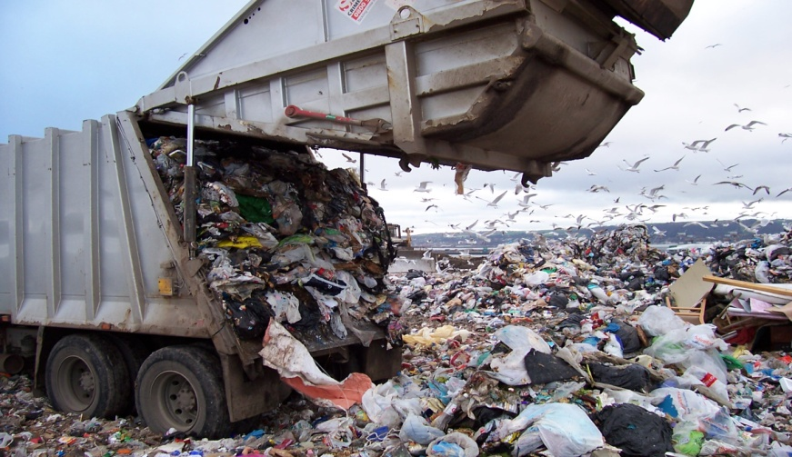
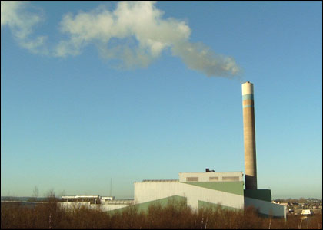
Disposing of product.
Landfill
Recycle/reuse
Incinerate

Slide 67
Applying understanding.
Points to consider:
1. Use and processing of raw material:
Are these renewable?
Where are they found?
How far do they need to be transported?
What economic impact does this have?

Slide 68
Points to Consider.
2. Use of product.
Does it have an environmental impact.
How long does it last?
3. Disposal of product.
Can it be recycled?
Is it biodegradable?
Is there a choice between landfill and incineration?

