Slide 1
1. Atomic structure
Copy and label the parts of the Helium atom.
Protons and neutrons both have a mass equivalent to 1 but electrons have very little mass. Neutrons have no charge and electrons are negatively charged.
Use this information to complete the table below.
Copy into your book.
Particle | Mass | Charge
 | 1 | +
 | 1 | 0
 | 0.0005 | -

Slide 2
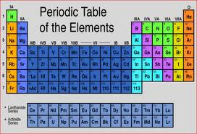
2. The periodic table
Match the key words to the definitions. Record in your book.
Period |  | Elements found on the right of the periodic table
Group |  | A highly reactive group of metals which all react with water.
Non metals |  | A vertical column on the periodic table
Metals |  | The only non metal in group 4.
Group 1 |  | The most reactive halogen.
Group 7 |  | Elements found on the left of the periodic table
Carbon |  | A horizontal row on the periodic table
Mercury |  | The only liquid metal.
Fluorine |  | A very reactive group of non metals.
Lithium |  | The least reactive alkali metal.

Slide 3
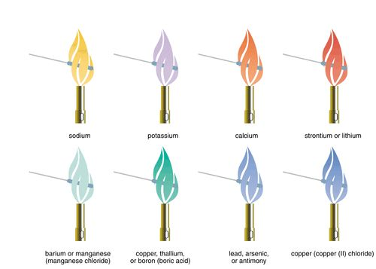
3. Line Spectrum
When elements are heated they emit coloured flames. Some elements emit distinctive flame colours. This coloured light can be split into a line spectrum. It is unique to each element.
Use your knowledge to copy and complete the paragraph below.
Spectrum, elements, light, excited,
electrons, line, electron
When heated, the __________ in an atom become _________ and release energy as __________. The wavelengths of ________ emitted can be recorded as a ______ spectrum. Different ________ emit different wavelengths of light due to their different _________ arrangements. This means that each element will produce a different line ______, allowing them to be identified.

Slide 4
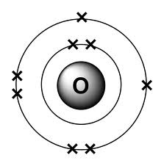
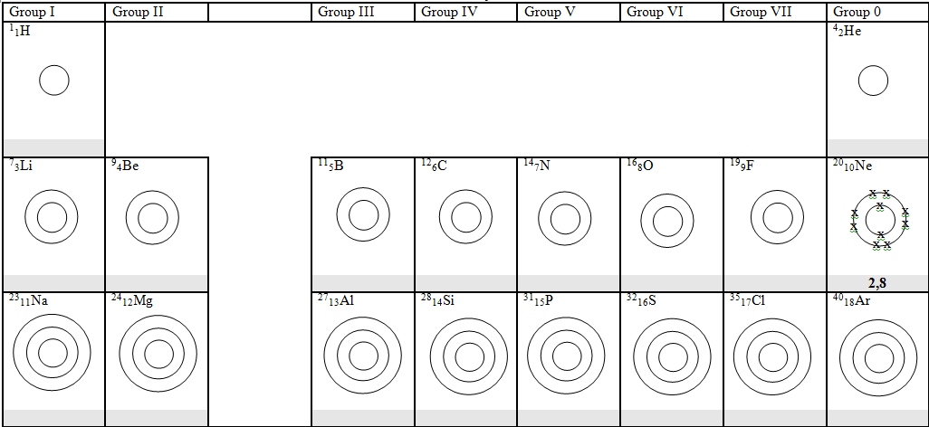
4. Electron arrangement
Electrons are arranged in shells around the nucleus. The first shell can hold 2 electrons and the second and third shells hold up to 8 electrons.
You can write the electron configuration like this.
Oxygen 2.6
Or draw the electron configuration like this.
Copy and complete as many of these as you can

Slide 5
5. Group 1 metals
Reactive metals
Low densities
One electron in outer shell
Form positive ions with charge of 1+
Soft solids at room temperature with low melting and boiling points
React with air and water, with water they produce hydrogen gas and a metal hydroxide (which is a strong alkali) hence the name Alkali Metals
Complete the following equations. Do the word equations first (C-D) and then attempt the symbol equations (A-B)
Lithium + water → Lithium hydroxide + hydrogen
Li _{(s)} + H₂O _{(l)} → LiOH _{(aq)} + H_{2(g)}
Sodium + water → _____________________ + hydrogen
____ _{(s)} + H₂O _{(l)} → ____ _{(aq)} + H_{2(g)}
Potassium + water → ___________________ + ____________
______ _{(s)} + H₂O _{(l)} → ______ _{(aq)} + _____ _{(g)}

Slide 6
6. Halogens
The halogens are non metals and are coloured.
They are reactive.
They can bleach dyes and kill bacteria.
The halogens are toxic.
Halogens exist as diatomic molecules.
Eg. F2, Cl₂, Br₂, I₂
When they react with metal ions they form salt. Eg. 2Na + Cl₂ → 2NaCl
Copy and complete the table below. Then try the word equations.
Halogen | Symbol | Description | Reactivity
 |  |  | Most
Chlorine |  |  | Very
 |  | Brown liquid | Quite
Iodine |  |  | Least
Sodium + chlorine → sodium chloride
Na_{(s)} + Cl₂ _{(g)} → NaCl _{(s)}
Lithium + iodine → Lithium iodide
____ _{(s)} + _____ _{(l)} → ____ _{(s)}
Iron + bromine → Ironbromide
____ _{(s)} + _____ _{(l)} → FeBr₃ _{(s)}

Slide 7
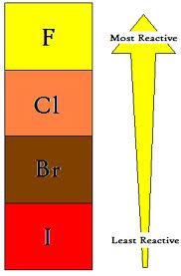
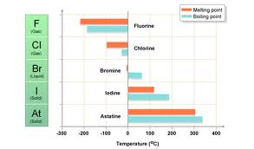
7. Trend in the groups
Fluorine is the most reactive halogen. If you react halogens with halogen containing compounds the more reactive halogen will displace the other. This often results in a colour change.
Potassium bromide + chlorine → potassium chloride + bromine
2KBr + Cl₂ → 2KCl + Br₂
Decide if there will be a reaction or not in the following experiment. If there is a reaction, write an equation for it, like the one above.
Potassium iodide + bromine →
Potassium bromide + iodine →
Potassium chloride + bromine →
Potassium iodide + chlorine →

Slide 8
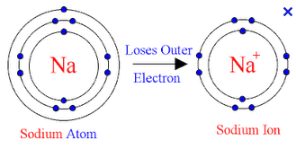
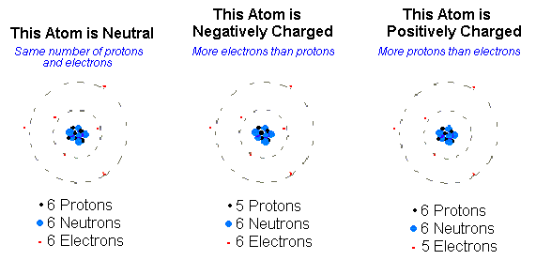
8. Ions
An ion is produced when an atom loses or gains an electron. This results in the ion having a charge because the number of protons and electrons are no longer equal. It wants to lose or gain electrons so its outer shell is complete.
What is the charge on the following ions?
Metal Ion | charge | Non metal Ion | charge
Na |  | Cl
Li |  | Br
Mg |  | O
Be |  | S

Slide 9
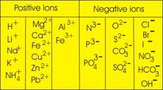
9. Ionic compounds
Ionic compounds are made when non metal and metal ions join together. The overall charge on a ionic compound must be 0. So the ions charges must balance out.
Eg. Na⁺ + Cl⁻ → NaCl but Mg²⁺ + Cl⁻ → MgCl₂
Use the table above to help you write the formula of the following compounds. Some have been completed for you.
Compound | Positive ion | Negative ion | Compound formula
Lithium bromide | Li ⁺ | Br⁻ | LiBr
Magnesium iodide | Mg ²⁺
Aluminium bromide | Al³⁺
Sodium oxide |  | O²⁻
Calcium chloride
Calcium carbonate |  | CO₃²⁻
Magnesium sulphate |  | SO₄²⁻

Slide 10
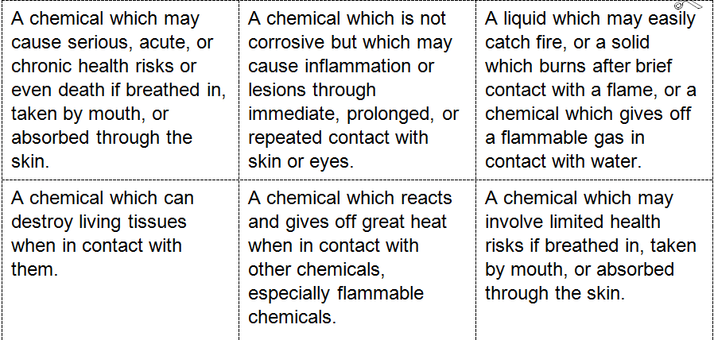
10. Hazards
The alkali metals (Grp 1) and the halogens (Grp 7) are very reactive and there needs to be detailed risk assessments when using these chemicals.
Use the information below and match the name, the symbol and the description to each other. Record these in your book.

Slide 11
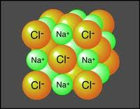
11. Ionic theory
Salts are ionic compounds. Often formed from Grp 1 and Grp 7 elements reacting together to make compounds. They have very specific structures and properties. They form a lattice structure which means each positive ion is attracted to a number of negative ions and vice versa. This means a lot of energy is needed to overcome this attraction. The lattice network is a highly ordered structure.
High melting points
High boiling points
Conduct electricity when dissolved in water
Conduct electricity when liquid
Complete the table below, with either the property or explanation.
Property | Explanation
All crystals of an ionic compound are the same shape.
 | The giant ionic structure is held together by a strong electrostatic attraction between the ions. It takes lots of energy to break down the arrangement.
 | When molten the positive and negative ions can move around independently.
Ionic compounds dissolved in water conduct electricity.

Slide 12
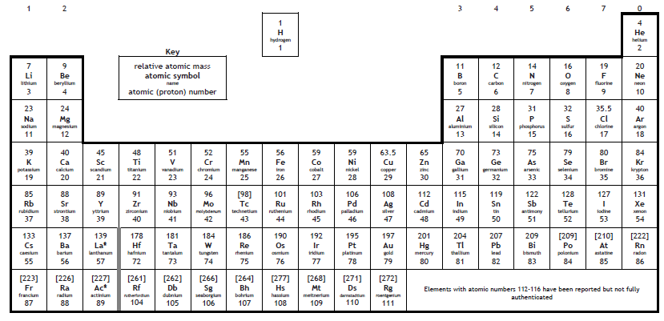
12. Using information from the periodic table
name | Proton number | Atomic mass | No. of protons | No. of neutrons | No. of electrons
Helium | 2 | 4 | 2 | 2 | 2
Lithium | 3 | 7 | 3 |  | 3
Carbon
Oxygen
Neon
Sodium
Sulphur
Argon
Calcium

Slide 13
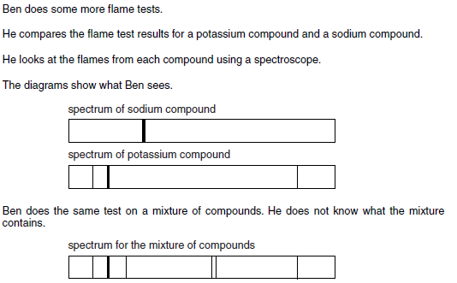
13. Using data from flame tests
Using the two spectrums above to answer the questions.
How do you carry out a flame test?
What are the key safety precautions?
What conclusion can you make?
Does it contain sodium?
Does it contain potassium?
What more information do you need?

Slide 14
14. Using information to compare elements.
Info | FLUORINE | LITHIUM
Metal or Non metal?
Which group?
No of electrons in outer shell?
Period?
Lithium is at the top of Group 1 in the Periodic Table .
Fluorine is at the top of Group 7 in the Periodic Table.
The position of an element tells us
The arrangement of the outer shell
Whether the element is a metal or non metal
The reactivity of the element
Describe the differences between lithium and fluorine based on their positions in the Periodic Table.

Slide 15
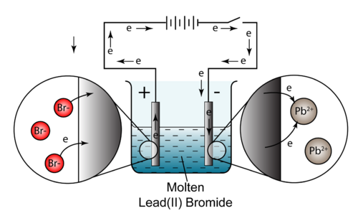
15. Electrolysis
There are two ions in the salt lead bromide (Li⁺ and Br⁻). They can be separated into the individual elements using a process called electrolysis.
Use the picture above to describe how electrolysis works.
Use the following key words in your explanation.
anode, cathode, free ions, positive, negative
attracted to, conduct, gain electrons, lose electrons

