Slide 1
Unit C7
Further Chemistry

Slide 2
Alkanes
Alcohols
Carboxylic Acids
Energy Changes
Fats and Oils
Esters
Equilibrium
Chromotography
Atom Economy
Gas Chromotography
Titrations
Catalysts
Green Chemistry
Unit C7

Slide 3
LESSON 1

Slide 4
Alkanes
Alcohols
Carboxylic Acids
Energy Changes
Fats and Oils
Esters
Equilibrium
Chromotography
Atom Economy
Gas Chromotography
Titrations
Catalysts
Green Chemistry
Unit C7

Slide 5
The Alkanes
Lesson Objectives:
Grade A* – Create ball and stick representation of the structural formula of alkanes.
Grade A – Assess the differences between chemical and physical properties of alkanes.
Grade B – Investigate the properties of alkanes.

Slide 6
Grade A* – Create ball and stick representation of the structural formula of alkanes.
Grade A – Assess the differences between chemical and physical properties of alkanes.
Grade B – Investigate the properties of alkanes.
Starter
Periodic Table Bingo!!!

Slide 7
Grade A* – Create ball and stick representation of the structural formula of alkanes.
Grade A – Assess the differences between chemical and physical properties of alkanes.
Grade B – Investigate the properties of alkanes.
To call bingo you need at least 3 symbols!

Slide 8
Grade A* – Create ball and stick representation of the structural formula of alkanes.
Grade A – Assess the differences between chemical and physical properties of alkanes.
Grade B – Investigate the properties of alkanes.
To call bingo you need at least 5 symbols!

Slide 9
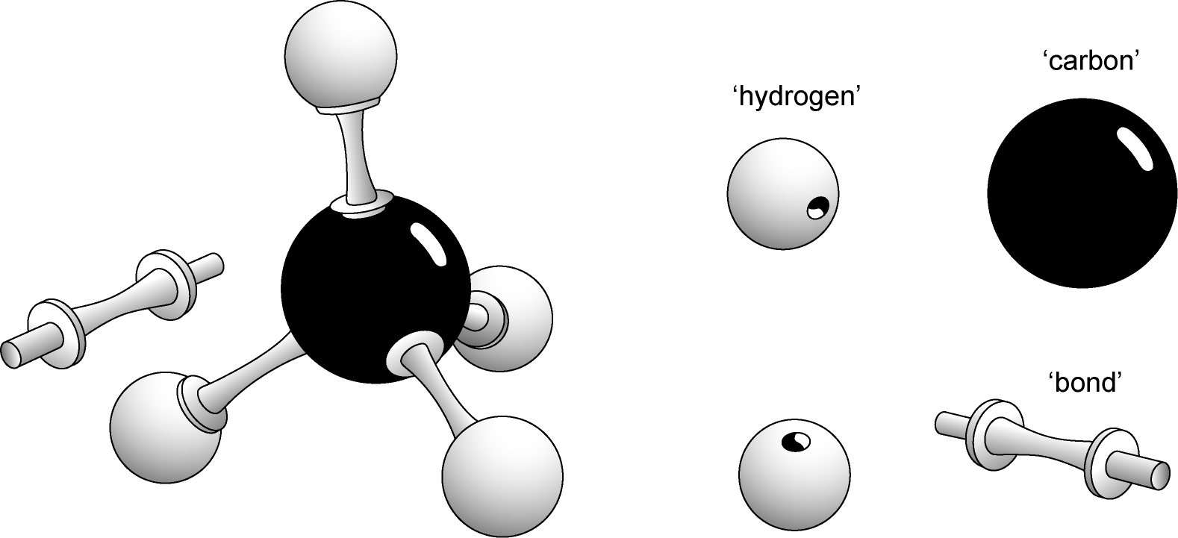
Grade A* – Create ball and stick representation of the structural formula of alkanes.
Grade A – Assess the differences between chemical and physical properties of alkanes.
Grade B – Investigate the properties of alkanes.

Slide 10
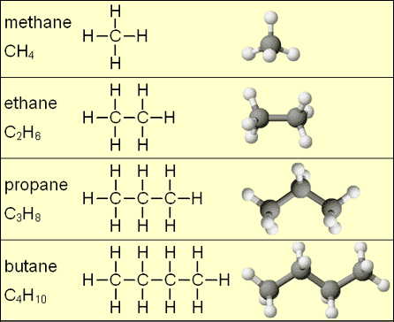
Grade A* – Create ball and stick representation of the structural formula of alkanes.
Grade A – Assess the differences between chemical and physical properties of alkanes.
Grade B – Investigate the properties of alkanes.

Slide 11
Grade A* – Create ball and stick representation of the structural formula of alkanes.
Grade A – Assess the differences between chemical and physical properties of alkanes.
Grade B – Investigate the properties of alkanes.
CnH2n+2

Slide 12
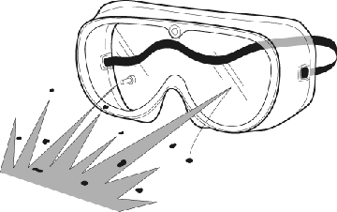
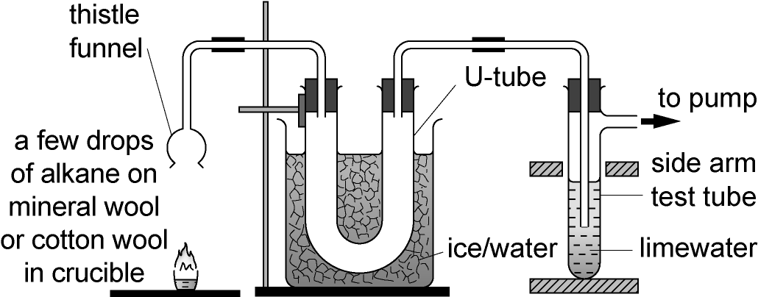
Grade A* – Create ball and stick representation of the structural formula of alkanes.
Grade A – Assess the differences between chemical and physical properties of alkanes.
Grade B – Investigate the properties of alkanes.
DEMO – The properties of Alkanes

Slide 13
Grade A* – Create ball and stick representation of the structural formula of alkanes.
Grade A – Assess the differences between chemical and physical properties of alkanes.
Grade B – Investigate the properties of alkanes.
Watch the demonstration and complete the table...

Slide 14
Grade A* – Create ball and stick representation of the structural formula of alkanes.
Grade A – Assess the differences between chemical and physical properties of alkanes.
Grade B – Investigate the properties of alkanes.
Have you got all of this detail?

Slide 15
Grade A* – Create ball and stick representation of the structural formula of alkanes.
Grade A – Assess the differences between chemical and physical properties of alkanes.
Grade B – Investigate the properties of alkanes.
Ethane
?

Slide 16
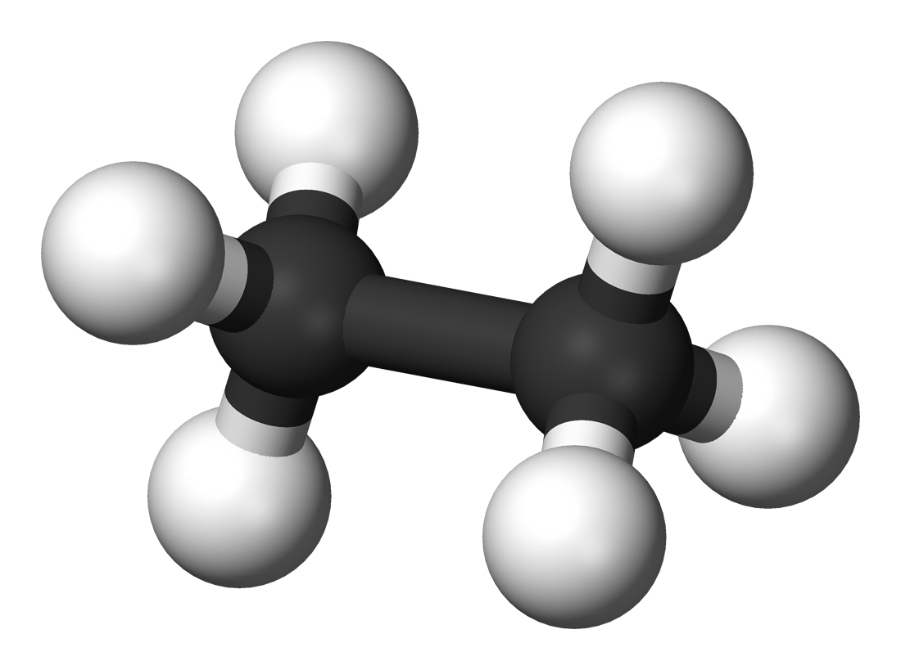
Grade A* – Create ball and stick representation of the structural formula of alkanes.
Grade A – Assess the differences between chemical and physical properties of alkanes.
Grade B – Investigate the properties of alkanes.
Ethane

Slide 17
Grade A* – Create ball and stick representation of the structural formula of alkanes.
Grade A – Assess the differences between chemical and physical properties of alkanes.
Grade B – Investigate the properties of alkanes.
Butane
?

Slide 18
Grade A* – Create ball and stick representation of the structural formula of alkanes.
Grade A – Assess the differences between chemical and physical properties of alkanes.
Grade B – Investigate the properties of alkanes.
Butane

Slide 19
Grade A* – Create ball and stick representation of the structural formula of alkanes.
Grade A – Assess the differences between chemical and physical properties of alkanes.
Grade B – Investigate the properties of alkanes.
Methane
?

Slide 20
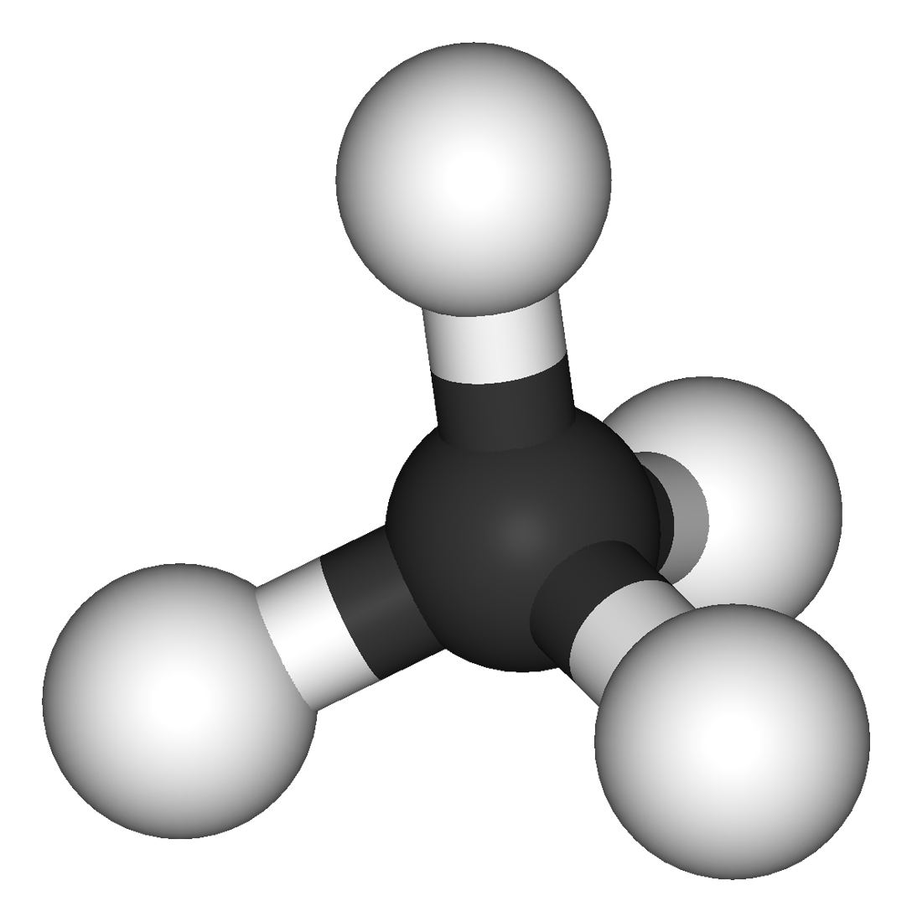
Grade A* – Create ball and stick representation of the structural formula of alkanes.
Grade A – Assess the differences between chemical and physical properties of alkanes.
Grade B – Investigate the properties of alkanes.
Methane

Slide 21
LESSON 2

Slide 22
Alkanes
Alcohols
Carboxylic Acids
Energy Changes
Fats and Oils
Esters
Equilibrium
Chromotography
Atom Economy
Gas Chromotography
Titrations
Catalysts
Green Chemistry
Unit C7

Slide 23
What do these images have in common?

Slide 24
Alcohols
Lesson Objectives:
Grade A* – Generate a practical to compare alcohols with water and alkanes.
Grade A – Explain what is meant by the term functional group.
Grade B – Investigate the properties of alcohols.

Slide 25
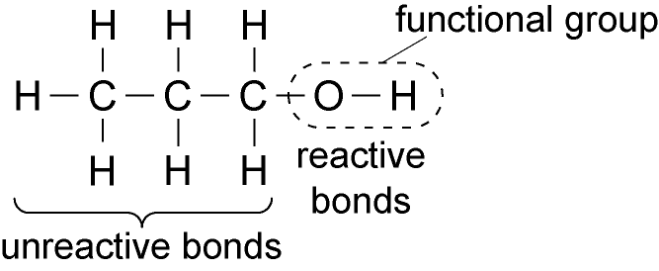
Grade A* – Generate a practical to compare alcohols with water and alkanes.
Grade A – Explain what is meant by the term functional group.
Grade B – Investigate the properties of alcohols.
CnH2n+1OH

Slide 26
Grade A* – Generate a practical to compare alcohols with water and alkanes.
Grade A – Explain what is meant by the term functional group.
Grade B – Investigate the properties of alcohols.
Q1+Q2 – Grade C
Q3+Q4 – Grade B
Q5 – Grade A
Q6 – Grade A*
(Extension: Q7)

Slide 27
Grade A* – Generate a practical to compare alcohols with water and alkanes.
Grade A – Explain what is meant by the term functional group.
Grade B – Investigate the properties of alcohols.
Have you got all of this detail?

Slide 28
Grade A* – Generate a practical to compare alcohols with water and alkanes.
Grade A – Explain what is meant by the term functional group.
Grade B – Investigate the properties of alcohols.
Have you got all of this detail?

Slide 29
Grade A* – Generate a practical to compare alcohols with water and alkanes.
Grade A – Explain what is meant by the term functional group.
Grade B – Investigate the properties of alcohols.
Ethanol
?

Slide 30
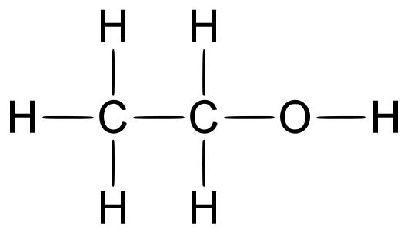
Grade A* – Generate a practical to compare alcohols with water and alkanes.
Grade A – Explain what is meant by the term functional group.
Grade B – Investigate the properties of alcohols.
Ethanol

Slide 31
Grade A* – Generate a practical to compare alcohols with water and alkanes.
Grade A – Explain what is meant by the term functional group.
Grade B – Investigate the properties of alcohols.
Propanol
?

Slide 32
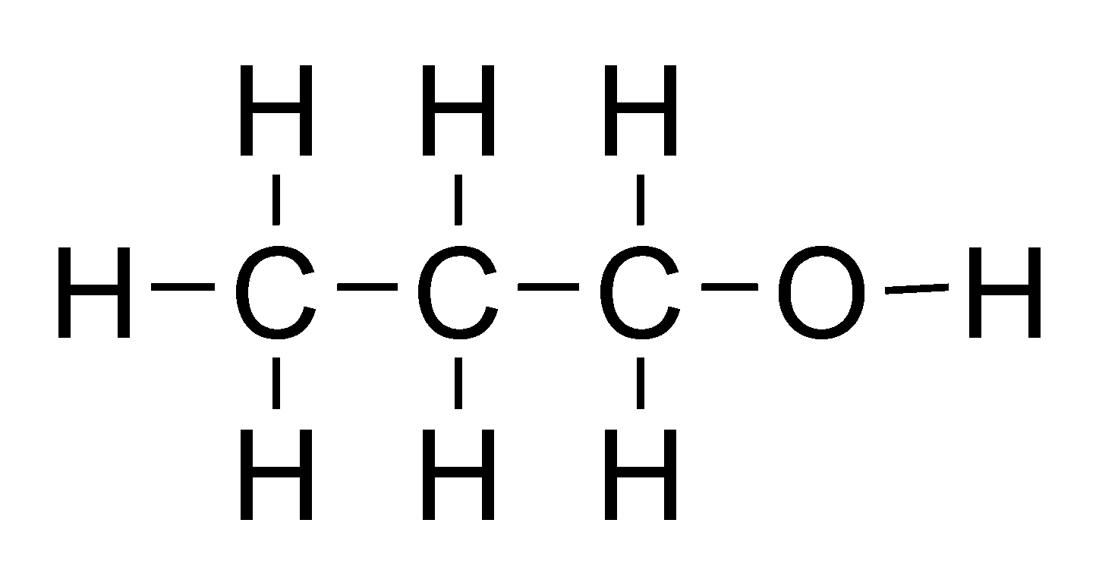
Grade A* – Generate a practical to compare alcohols with water and alkanes.
Grade A – Explain what is meant by the term functional group.
Grade B – Investigate the properties of alcohols.
Propanol

Slide 33
Grade A* – Generate a practical to compare alcohols with water and alkanes.
Grade A – Explain what is meant by the term functional group.
Grade B – Investigate the properties of alcohols.
Pentanol
?

Slide 34
Grade A* – Generate a practical to compare alcohols with water and alkanes.
Grade A – Explain what is meant by the term functional group.
Grade B – Investigate the properties of alcohols.
Pentanol

Slide 35
LESSON 3

Slide 36
Alkanes
Alcohols
Carboxylic Acids
Energy Changes
Fats and Oils
Esters
Equilibrium
Chromotography
Atom Economy
Gas Chromotography
Titrations
Catalysts
Green Chemistry
Unit C7

Slide 37
Can you rate these smells 1-5?
1 – good
5 - bad

Slide 38
What causes these smells?

Slide 39
Which compounds cause the worst smells?

Slide 40
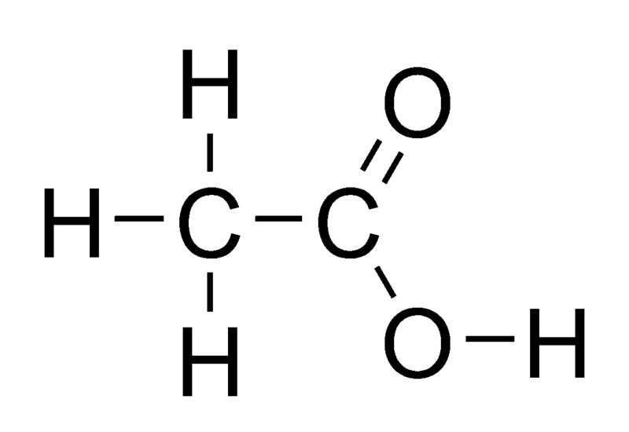
Carboxylic Acids!

Slide 41
Reactions of Carboxylic Acids
Lesson Objectives:
Grade A* – Generate a practical to show that carboxylic acids in solution show the characteristic reactions of acids.
Grade A – Explain the practical importance of carboxylic acids.
Grade B – Summarise the term carboxylic acid.

Slide 42
Grade A* – Generate a practical to show that carboxylic acids in solution show the characteristic reactions of acids.
Grade A – Explain the practical importance of carboxylic acids.
Grade B – Summarise the term carboxylic acid.
Carboxylic Acid Characteristic Properties:
acid + metal salt + hydrogen
acid + soluble hydroxide salt + water
acid + metal carbonate salt + carbon dioxide + water

Slide 43
Grade A* – Generate a practical to show that carboxylic acids in solution show the characteristic reactions of acids.
Grade A – Explain the practical importance of carboxylic acids.
Grade B – Summarise the term carboxylic acid.
Practical equipment available to you:
ethanoic acid
(1 x 30 ml per group only!)
sodium hydroxide
magnesium strips
copper (II) carbonate

Slide 44
Grade A* – Generate a practical to show that carboxylic acids in solution show the characteristic reactions of acids.
Grade A – Explain the practical importance of carboxylic acids.
Grade B – Summarise the term carboxylic acid.

Slide 45
LESSON 4

Slide 46
Alkanes
Alcohols
Carboxylic Acids
Energy Changes
Fats and Oils
Esters
Equilibrium
Chromotography
Atom Economy
Gas Chromotography
Titrations
Catalysts
Green Chemistry
Unit C7

Slide 47
Peer assess your neighbours progress!!!

Slide 48
QUESTION TIME
One way of removing the smell of vomit is to use sodium hydrogen carbonate powder.
Can you explain why the smell might disappear after this reaction?

Slide 49
Properties of Carboxylic Acids
Lesson Objectives:
Grade A* – Create balanced equations describing the reactions of carboxylic acids.
Grade A – Conclude how vinegar is a dilute solution of ethanoic acid.
Grade B – Explain the importance of the –COOH functional group in relation to its properties.

Slide 50
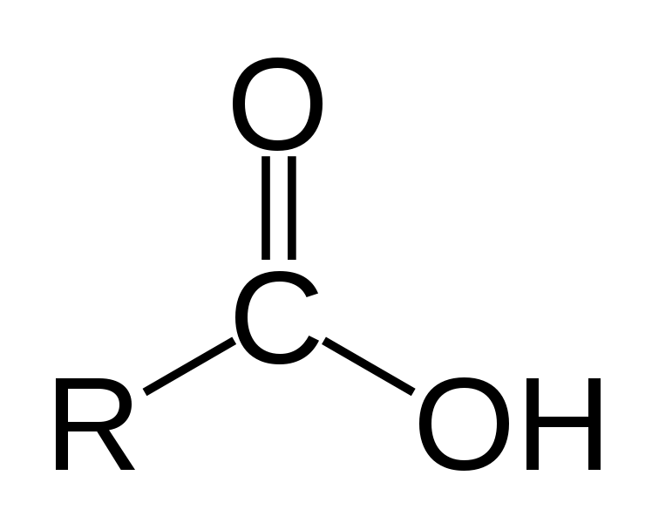
Grade A* – Create balanced equations describing the reactions of carboxylic acids.
Grade A – Conclude how vinegar is a dilute solution of ethanoic acid.
Grade B – Explain the importance of the –COOH functional group in relation to its properties.
Carboxylic acids have the functional group -COOH

Slide 51
Grade A* – Create balanced equations describing the reactions of carboxylic acids.
Grade A – Conclude how vinegar is a dilute solution of ethanoic acid.
Grade B – Explain the importance of the –COOH functional group in relation to its properties.
Ethanoic Acid
Methanoic Acid
Extension: Can you work out propanoic acid?

Slide 52
Grade A* – Create balanced equations describing the reactions of carboxylic acids.
Grade A – Conclude how vinegar is a dilute solution of ethanoic acid.
Grade B – Explain the importance of the –COOH functional group in relation to its properties.
Important safety info!!!

Slide 53
Grade A* – Create balanced equations describing the reactions of carboxylic acids.
Grade A – Conclude how vinegar is a dilute solution of ethanoic acid.
Grade B – Explain the importance of the –COOH functional group in relation to its properties.
Have you got all of this detail?

Slide 54
LESSON 5

Slide 55
Alkanes
Alcohols
Carboxylic Acids
Energy Changes
Fats and Oils
Esters
Equilibrium
Chromotography
Atom Economy
Gas Chromotography
Titrations
Catalysts
Green Chemistry
Unit C7

Slide 57
Safety Quiz Time!!!
Q1
Q2
Q3
Q4 – What colour should these labels be?

Slide 58
Safety Quiz Time!!!
BONUS QUESTION
Can you name a chemical for each hazard sign Q1-3?

Slide 59
Safety Quiz Answers
Corrosive
Harmful
Flammable
Q4 – Orange

Slide 60
Safety Quiz Time!!!
BONUS QUESTION

Slide 61
Making Esters
Lesson Objectives:
Grade A* – Generate molecular models to show the differences between an acid, an alcohol and an ester.
Grade A – Investigate and observe the properties of esters.
Grade B – Summarise esters as the products of the reactions of alcohols with carboxylic acids.

Slide 62
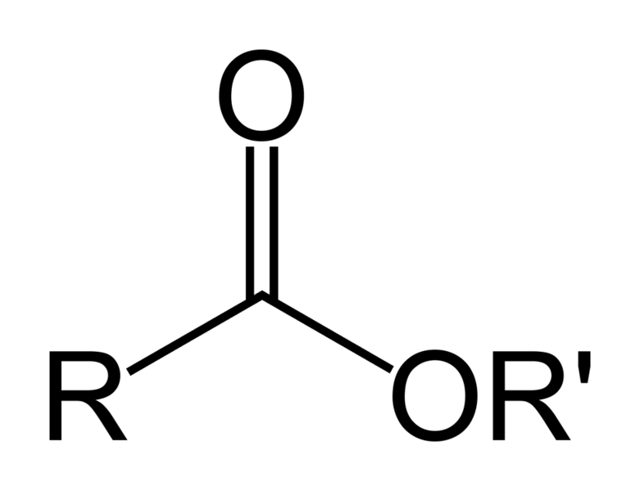
Grade A* – Generate molecular models to show the differences between an acid, an alcohol and an ester.
Grade A – Investigate and observe the properties of esters.
Grade B – Summarise esters as the products of the reactions of alcohols with carboxylic acids.
What are ESTERS?

Slide 63
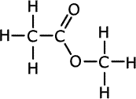
Grade A* – Generate molecular models to show the differences between an acid, an alcohol and an ester.
Grade A – Investigate and observe the properties of esters.
Grade B – Summarise esters as the products of the reactions of alcohols with carboxylic acids.
What are ESTERS?

Slide 64
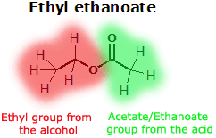
Grade A* – Generate molecular models to show the differences between an acid, an alcohol and an ester.
Grade A – Investigate and observe the properties of esters.
Grade B – Summarise esters as the products of the reactions of alcohols with carboxylic acids.
What are ESTERS?

Slide 65
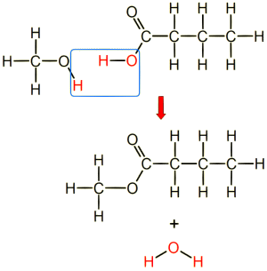
Grade A* – Generate molecular models to show the differences between an acid, an alcohol and an ester.
Grade A – Investigate and observe the properties of esters.
Grade B – Summarise esters as the products of the reactions of alcohols with carboxylic acids.
methanol + butanoic acid → methyl butanoate + water

Slide 66
Grade A* – Generate molecular models to show the differences between an acid, an alcohol and an ester.
Grade A – Investigate and observe the properties of esters.
Grade B – Summarise esters as the products of the reactions of alcohols with carboxylic acids.
Some esters have fruity smells.
benzyl ethanoate peach flavour
ethyl butanoate pineapple
ethyl methanoate raspberry
methyl butanoate apple
pentyl ethanoate pear

Slide 67
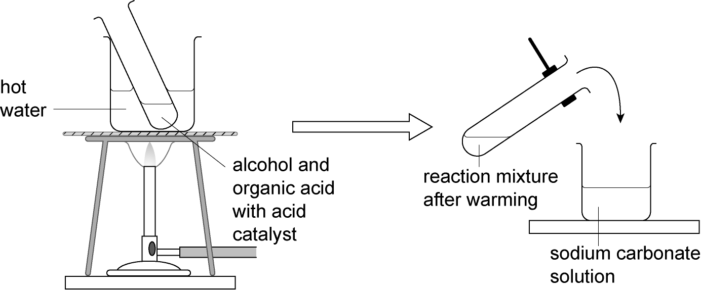
Grade A* – Generate molecular models to show the differences between an acid, an alcohol and an ester.
Grade A – Investigate and observe the properties of esters.
Grade B – Summarise esters as the products of the reactions of alcohols with carboxylic acids.
Making Esters

Slide 68
Grade A* – Generate molecular models to show the differences between an acid, an alcohol and an ester.
Grade A – Investigate and observe the properties of esters.
Grade B – Summarise esters as the products of the reactions of alcohols with carboxylic acids.
Important safety info!!!

Slide 69
Grade A* – Generate molecular models to show the differences between an acid, an alcohol and an ester.
Grade A – Investigate and observe the properties of esters.
Grade B – Summarise esters as the products of the reactions of alcohols with carboxylic acids.
Important safety info!!!

Slide 70
Grade A* – Generate molecular models to show the differences between an acid, an alcohol and an ester.
Grade A – Investigate and observe the properties of esters.
Grade B – Summarise esters as the products of the reactions of alcohols with carboxylic acids.
Practical equipment available to you per table:
Activity sheets AC7.5
Test tubes (×3)
Water bath (or 250 cm³ beaker and heating apparatus)
Beakers, 100 cm³ (×3)
Making Esters

Slide 71
Grade A* – Generate molecular models to show the differences between an acid, an alcohol and an ester.
Grade A – Investigate and observe the properties of esters.
Grade B – Summarise esters as the products of the reactions of alcohols with carboxylic acids.

Slide 72
Grade A* – Generate molecular models to show the differences between an acid, an alcohol and an ester.
Grade A – Investigate and observe the properties of esters.
Grade B – Summarise esters as the products of the reactions of alcohols with carboxylic acids.
methanol + butanoic acid → methyl butanoate + water

Slide 73
Grade A* – Generate molecular models to show the differences between an acid, an alcohol and an ester.
Grade A – Investigate and observe the properties of esters.
Grade B – Summarise esters as the products of the reactions of alcohols with carboxylic acids.

Slide 74
LESSON 6

Slide 75
Alkanes
Alcohols
Carboxylic Acids
Energy Changes
Fats and Oils
Esters
Equilibrium
Chromotography
Atom Economy
Gas Chromotography
Titrations
Catalysts
Green Chemistry
Unit C7

Slide 76
Can you name the seven stages in chemical synthesis?
Think back to C6!

Slide 77
Risk Assessment
Working out quantities
Carrying out the reaction
Separating the product
Choosing the reaction
Purifying the product
Measuring the yield and purity
1
2
7
Seven Stages
in Chemical Synthesis
3
6
4
5

Slide 78
Preparation of an ester
Lesson Objectives:
Grade A* – Generate yield and percentage yield calculations.
Grade A – Summarise the purposes of practical techniques involved in the preparation of an ester.
Grade B – Demonstrate the procedure for making an ester on a laboratory scale.

Slide 79
Grade A* – Generate yield and percentage yield calculations.
Grade A – Summarise the purposes of practical techniques involved in the preparation of an ester.
Grade B – Demonstrate the procedure for making an ester on a laboratory scale.
Can you work out what is happening at each stage of the reaction?

Slide 80
Grade A* – Generate yield and percentage yield calculations.
Grade A – Summarise the purposes of practical techniques involved in the preparation of an ester.
Grade B – Demonstrate the procedure for making an ester on a laboratory scale.
Can you label and annotate this diagram?

Slide 81
Grade A* – Generate yield and percentage yield calculations.
Grade A – Summarise the purposes of practical techniques involved in the preparation of an ester.
Grade B – Demonstrate the procedure for making an ester on a laboratory scale.

Slide 82
Grade A* – Generate yield and percentage yield calculations.
Grade A – Summarise the purposes of practical techniques involved in the preparation of an ester.
Grade B – Demonstrate the procedure for making an ester on a laboratory scale.
Choose your past paper to your target level or above!

Slide 83
LESSON 7

Slide 84
Alkanes
Alcohols
Carboxylic Acids
Energy Changes
Fats and Oils
Esters
Equilibrium
Chromotography
Atom Economy
Gas Chromotography
Titrations
Catalysts
Green Chemistry
Unit C7

Slide 85
Can you think of sources or keywords associated with fats and oils?

Slide 86
Fats and Oils
Lesson Objectives:
Grade A* – Summarise how C=C and C-C bonding affects a compounds properties and uses.
Grade A – Assess that the differences between a saturated and unsaturated compound is due to bonding.
Grade B – Explain that animal fats and vegetable oils are esters of fatty acids and glycerol.

Slide 87
Grade A* – Summarise how C=C and C-C bonding affects a compounds properties and uses.
Grade A – Assess that the differences between a saturated and unsaturated compound is due to bonding.
Grade B – Explain that animal fats and vegetable oils are esters of fatty acids and glycerol.

Slide 88
Grade A* – Summarise how C=C and C-C bonding affects a compounds properties and uses.
Grade A – Assess that the differences between a saturated and unsaturated compound is due to bonding.
Grade B – Explain that animal fats and vegetable oils are esters of fatty acids and glycerol.
In fats (e.g. butter), the fatty acids are mostly saturated. This means that there are single C-C bonds in the fatty acids.
In oils (e.g. olive oil), the fatty acids are unsaturated. This means that there are some double C=C bonds in the fatty acids.

Slide 89
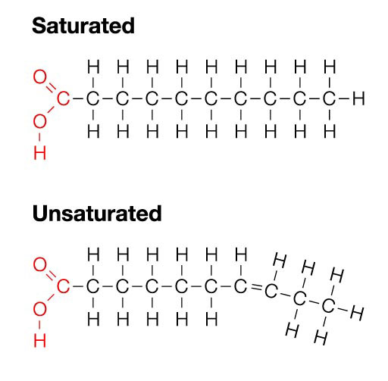
Grade A* – Summarise how C=C and C-C bonding affects a compounds properties and uses.
Grade A – Assess that the differences between a saturated and unsaturated compound is due to bonding.
Grade B – Explain that animal fats and vegetable oils are esters of fatty acids and glycerol.

Slide 90
Grade A* – Summarise how C=C and C-C bonding affects a compounds properties and uses.
Grade A – Assess that the differences between a saturated and unsaturated compound is due to bonding.
Grade B – Explain that animal fats and vegetable oils are esters of fatty acids and glycerol.
The double bonds stop the fatty acid molecules being straight. This means that the oil molecules can’t pack together very well. This makes oils liquids at room temperature because the forces of attraction between the molecules are weak.

Slide 91
Grade A* – Summarise how C=C and C-C bonding affects a compounds properties and uses.
Grade A – Assess that the differences between a saturated and unsaturated compound is due to bonding.
Grade B – Explain that animal fats and vegetable oils are esters of fatty acids and glycerol.
Task 2 Properties of Fats and Oils
You need to produce an A5 fact card highlighting the differences in structure and properties between saturated and unsaturated fats.

Slide 92
Grade A* – Summarise how C=C and C-C bonding affects a compounds properties and uses.
Grade A – Assess that the differences between a saturated and unsaturated compound is due to bonding.
Grade B – Explain that animal fats and vegetable oils are esters of fatty acids and glycerol.

Slide 93
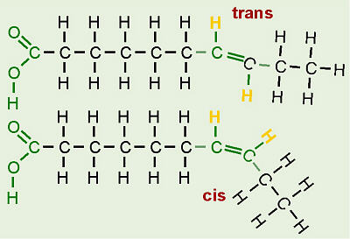
Grade A* – Summarise how C=C and C-C bonding affects a compounds properties and uses.
Grade A – Assess that the differences between a saturated and unsaturated compound is due to bonding.
Grade B – Explain that animal fats and vegetable oils are esters of fatty acids and glycerol.

Slide 94
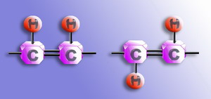
Grade A* – Summarise how C=C and C-C bonding affects a compounds properties and uses.
Grade A – Assess that the differences between a saturated and unsaturated compound is due to bonding.
Grade B – Explain that animal fats and vegetable oils are esters of fatty acids and glycerol.

Slide 95
Grade A* – Summarise how C=C and C-C bonding affects a compounds properties and uses.
Grade A – Assess that the differences between a saturated and unsaturated compound is due to bonding.
Grade B – Explain that animal fats and vegetable oils are esters of fatty acids and glycerol.
HOMEWORK!

Slide 96
LESSON 8

Slide 97
Alkanes
Alcohols
Carboxylic Acids
Energy Changes
Fats and Oils
Esters
Equilibrium
Chromotography
Atom Economy
Gas Chromotography
Titrations
Catalysts
Green Chemistry
Unit C7

Slide 98
What kind of reaction occurs between methane and oxygen?

Slide 99
Energy Changes
Lesson Objectives:
Grade A* – Calculate energy changes in a range of reactions, given the energy changes when bonds break or form.
Grade A – Explain how energy is needed to break chemical bonds and given out when making chemical bonds.
Grade B – Explain how energy changes within reactions using an energy level diagram and explain the role of activation energy.

Slide 100
Grade A* – Calculate energy changes in a range of reactions, given the energy changes when bonds break or form.
Grade A – Explain how energy is needed to break chemical bonds and given out when making chemical bonds.
Grade B – Explain how energy changes within reactions using an energy level diagram and explain the role of activation energy.
Important safety info!!!

Slide 101
Grade A* – Calculate energy changes in a range of reactions, given the energy changes when bonds break or form.
Grade A – Explain how energy is needed to break chemical bonds and given out when making chemical bonds.
Grade B – Explain how energy changes within reactions using an energy level diagram and explain the role of activation energy.

Slide 104
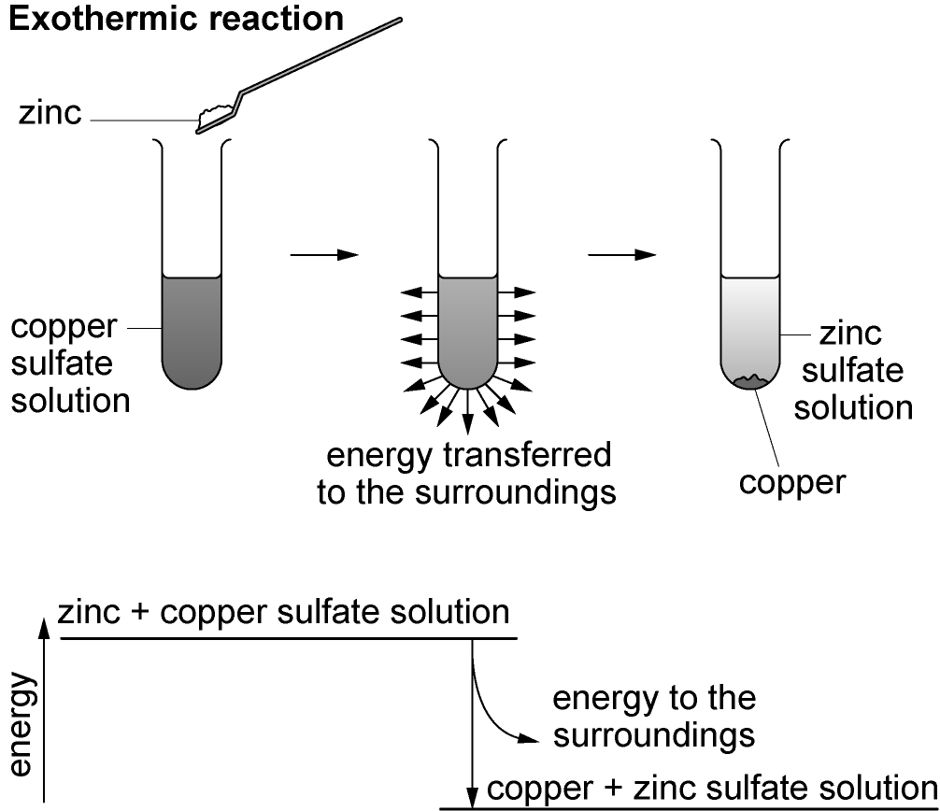

Slide 105
Grade A* – Calculate energy changes in a range of reactions, given the energy changes when bonds break or form.
Grade A – Explain how energy is needed to break chemical bonds and given out when making chemical bonds.
Grade B – Explain how energy changes within reactions using an energy level diagram and explain the role of activation energy.

Slide 107
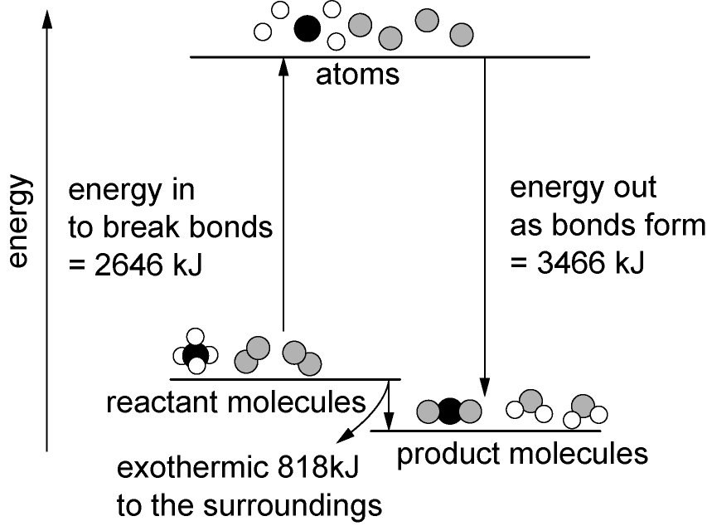

Slide 108
Grade A* – Calculate energy changes in a range of reactions, given the energy changes when bonds break or form.
Grade A – Explain how energy is needed to break chemical bonds and given out when making chemical bonds.
Grade B – Explain how energy changes within reactions using an energy level diagram and explain the role of activation energy.
Know | Want | Learnt

Slide 109
LESSON 9

Slide 110
Alkanes
Alcohols
Carboxylic Acids
Energy Changes
Fats and Oils
Esters
Equilibrium
Chromotography
Atom Economy
Gas Chromotography
Titrations
Catalysts
Green Chemistry
Unit C7

Slide 111
QUIZ TIME
Name ALL of the factors that can affect the rate of reaction.
For each factor can you name an example chemical reaction? (each one must be different!)
First team to finish WINS!

Slide 112
Equilibrium
Lesson Objectives:
Grade A* – Interpret the strength of acids in solution in terms of dynamic equilibrium.
Grade A – Explain the concept of dynamic equilibrium.
Grade B – Explain how reversible changes can reach a state of equilibrium.

Slide 113
Grade A* – Interpret the strength of acids in solution in terms of dynamic equilibrium.
Grade A – Explain the concept of dynamic equilibrium.
Grade B – Explain how reversible changes can reach a state of equilibrium.
Important safety info!!!

Slide 114
Grade A* – Interpret the strength of acids in solution in terms of dynamic equilibrium.
Grade A – Explain the concept of dynamic equilibrium.
Grade B – Explain how reversible changes can reach a state of equilibrium.
Can you define the term ‘dynamic equilibrium’ in no more than 20 words?

Slide 115
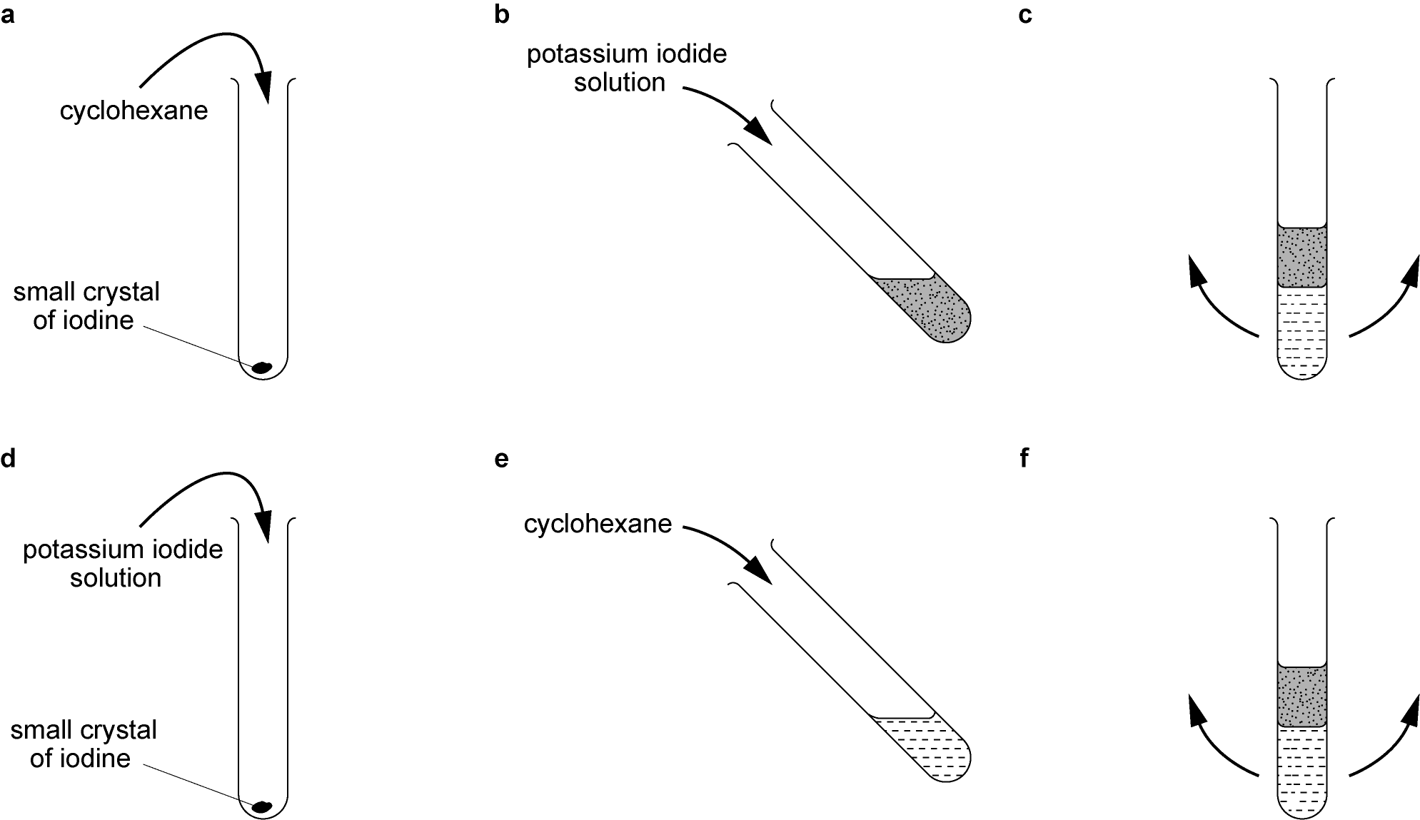
Grade A* – Interpret the strength of acids in solution in terms of dynamic equilibrium.
Grade A – Explain the concept of dynamic equilibrium.
Grade B – Explain how reversible changes can reach a state of equilibrium.

Slide 116
Grade A* – Interpret the strength of acids in solution in terms of dynamic equilibrium.
Grade A – Explain the concept of dynamic equilibrium.
Grade B – Explain how reversible changes can reach a state of equilibrium.
Can you define the term ‘dynamic equilibrium’ again in no more than 20 words?

Slide 117
LESSON 10

Slide 118
Alkanes
Alcohols
Carboxylic Acids
Energy Changes
Fats and Oils
Esters
Equilibrium
Chromotography
Atom Economy
Gas Chromotography
Titrations
Catalysts
Green Chemistry
Unit C7

Slide 119
Can you define the process of ‘chromotography’ in no more than 20 words?

Slide 120
Chromatography
Lesson Objectives:
Grade A* – Demonstrate thin-layer chromatography to distinguish metal ions.
Grade A – Summarise the process of paper chromatography.
Grade B – Distinguish between qualitative and quantitative methods of analysis.

Slide 121
Grade A* – Demonstrate thin-layer chromatography to distinguish metal ions.
Grade A – Summarise the process of paper chromatography.
Grade B – Distinguish between qualitative and quantitative methods of analysis.

Slide 122
Grade A* – Demonstrate thin-layer chromatography to distinguish metal ions.
Grade A – Summarise the process of paper chromatography.
Grade B – Distinguish between qualitative and quantitative methods of analysis.
Important safety info!!!

Slide 123
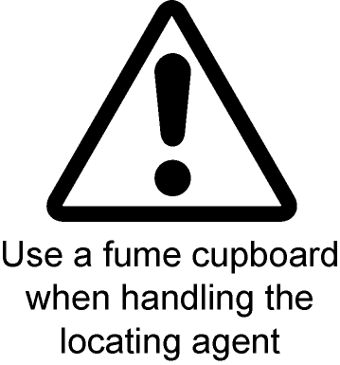
Grade A* – Demonstrate thin-layer chromatography to distinguish metal ions.
Grade A – Summarise the process of paper chromatography.
Grade B – Distinguish between qualitative and quantitative methods of analysis.
Important safety info!!!

Slide 124
Grade A* – Demonstrate thin-layer chromatography to distinguish metal ions.
Grade A – Summarise the process of paper chromatography.
Grade B – Distinguish between qualitative and quantitative methods of analysis.
You will need to know the definitions of these keywords to complete the activity:
chromatography
chromatogram
mobile phase
stationary phase
aqueous
non-aqueous

Slide 125
Grade A* – Demonstrate thin-layer chromatography to distinguish metal ions.
Grade A – Summarise the process of paper chromatography.
Grade B – Distinguish between qualitative and quantitative methods of analysis.

Slide 126
Grade A* – Demonstrate thin-layer chromatography to distinguish metal ions.
Grade A – Summarise the process of paper chromatography.
Grade B – Distinguish between qualitative and quantitative methods of analysis.
Did you get them all correct?
If not why not?

Slide 127
Grade A* – Demonstrate thin-layer chromatography to distinguish metal ions.
Grade A – Summarise the process of paper chromatography.
Grade B – Distinguish between qualitative and quantitative methods of analysis.
Know | Want | Learnt

Slide 128
LESSON 11

Slide 129
Alkanes
Alcohols
Carboxylic Acids
Energy Changes
Fats and Oils
Esters
Equilibrium
Chromotography
Atom Economy
Gas Chromotography
Titrations
Catalysts
Green Chemistry
Unit C7

Slide 130
Gas Chromotography
Lesson Objectives:
Grade A* – Compare the different methods of chromatography.
Grade A – Explain the term ‘retention time’.
Grade B – Illustrate the technique of gas chromatography and its applications.

Slide 131
Grade A* – Compare the different methods of chromatography.
Grade A – Explain the term ‘retention time’.
Grade B – Illustrate the technique of gas chromatography and its applications.
Define the following keywords :
chromatography
chromatogram
mobile phase
stationary phase
aqueous
non-aqueous

Slide 132
Grade A* – Compare the different methods of chromatography.
Grade A – Explain the term ‘retention time’.
Grade B – Illustrate the technique of gas chromatography and its applications.

Slide 133
LESSON 12

Slide 134
Alkanes
Alcohols
Carboxylic Acids
Energy Changes
Fats and Oils
Esters
Equilibrium
Chromotography
Atom Economy
Gas Chromotography
Titrations
Catalysts
Green Chemistry
Unit C7

Slide 135
Q) Will 1 tonne of Carbon contain the same number of atoms as 1 tonne of Uranium?

Slide 136
NO!!!

Slide 137
Titration Calculations
Lesson Objectives:
Grade A* – Analyse calculations related to concentration of solutes in solution.
Grade A – Produce a standard solution.
Grade B – Explain the procedure for producing a standard solution.

Slide 138
Grade A* – Analyse calculations related to concentration of solutes in solution.
Grade A – Produce a standard solution.
Grade B – Explain the procedure for producing a standard solution.
Units for concentration:
g/dm³

Slide 139
Grade A* – Analyse calculations related to concentration of solutes in solution.
Grade A – Produce a standard solution.
Grade B – Explain the procedure for producing a standard solution.

Slide 140
Grade A* – Analyse calculations related to concentration of solutes in solution.
Grade A – Produce a standard solution.
Grade B – Explain the procedure for producing a standard solution.
Example:
For Grade A produce this standard solution.

Slide 141
Grade A* – Analyse calculations related to concentration of solutes in solution.
Grade A – Produce a standard solution.
Grade B – Explain the procedure for producing a standard solution.

Slide 142
Grade A* – Analyse calculations related to concentration of solutes in solution.
Grade A – Produce a standard solution.
Grade B – Explain the procedure for producing a standard solution.
Did you get them all correct?
If not why not?

Slide 143
Grade A* – Analyse calculations related to concentration of solutes in solution.
Grade A – Produce a standard solution.
Grade B – Explain the procedure for producing a standard solution.
Know | Want | Learnt

Slide 144
LESSON 13

Slide 145
Alkanes
Alcohols
Carboxylic Acids
Energy Changes
Fats and Oils
Esters
Equilibrium
Chromotography
Atom Economy
Gas Chromotography
Titrations
Catalysts
Green Chemistry
Unit C7

Slide 146
Can you list all of the items and their quantities?

Slide 147
Titration Practical
Lesson Objectives:
Grade A* – Analyse titration results using balanced equations and relative formula masses.
Grade A – Interpret titration results quantitatively.
Grade B – Conduct an acid-base titration using a pipette and burette.

Slide 148
Grade A* – Analyse titration results using balanced equations and relative formula masses.
Grade A – Interpret titration results quantitatively.
Grade B – Conduct an acid-base titration using a pipette and burette.
SOME HELPFUL HINTS:
- The term "neutral point" is best avoided.
- The term "equivalence point" means that the solutions have been mixed in exactly the right proportions according to the equation.
- The term "end point" is where the indicator changes colour. This is not always the equivalence point!

Slide 149
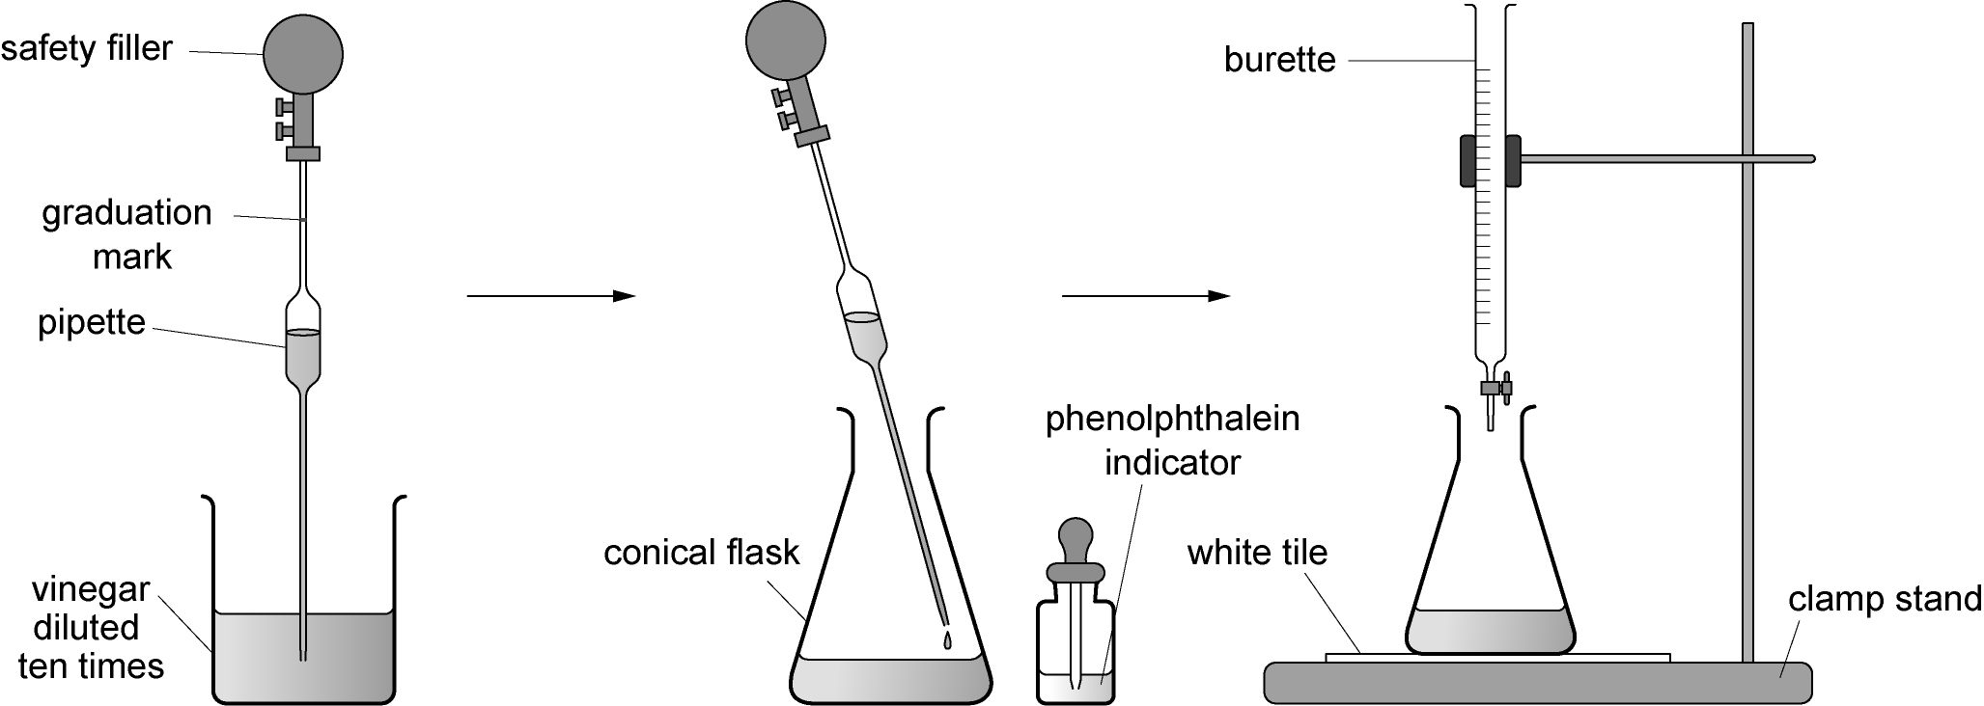
Grade A* – Analyse titration results using balanced equations and relative formula masses.
Grade A – Interpret titration results quantitatively.
Grade B – Conduct an acid-base titration using a pipette and burette.

Slide 150
Grade A* – Analyse titration results using balanced equations and relative formula masses.
Grade A – Interpret titration results quantitatively.
Grade B – Conduct an acid-base titration using a pipette and burette.
Important safety info!!!

Slide 151
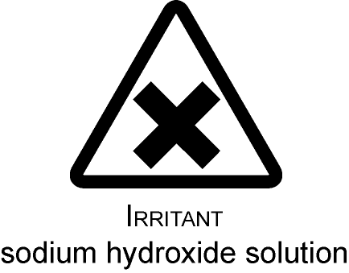
Grade A* – Analyse titration results using balanced equations and relative formula masses.
Grade A – Interpret titration results quantitatively.
Grade B – Conduct an acid-base titration using a pipette and burette.
Important safety info!!!

Slide 152
Grade A* – Analyse titration results using balanced equations and relative formula masses.
Grade A – Interpret titration results quantitatively.
Grade B – Conduct an acid-base titration using a pipette and burette.
Possible steps in the calculation:
The titre is y cm³ of a 4.0 g/dm³ solution of sodium hydroxide. So:
y ×
g NaOH reacted with the acid in 25.0 cm³ of diluted vinegar.
From the reacting masses, this shows that in 25.0 cm³ vinegar there were:

Slide 153
Grade A* – Analyse titration results using balanced equations and relative formula masses.
Grade A – Interpret titration results quantitatively.
Grade B – Conduct an acid-base titration using a pipette and burette.
Possible steps in the calculation:
The titre is y cm³ of a 4.0 g/dm³ solution of sodium hydroxide. So:
y ×
g NaOH reacted with the acid in 25.0 cm³ of diluted vinegar.
From the reacting masses, this shows that in 25.0 cm³ vinegar there were:

Slide 154
Grade A* – Analyse titration results using balanced equations and relative formula masses.
Grade A – Interpret titration results quantitatively.
Grade B – Conduct an acid-base titration using a pipette and burette.
Know | Want | Learnt

Slide 155
LESSON 14

Slide 156
Alkanes
Alcohols
Carboxylic Acids
Energy Changes
Fats and Oils
Esters
Equilibrium
Chromotography
Atom Economy
Gas Chromotography
Titrations
Catalysts
Green Chemistry
Unit C7

Slide 157
Can you define the term of ‘catalyst’ in no more than 10 words?

Slide 158
Catalysts
Lesson Objectives:
Grade A* – Investigate the effect of a range of possible catalysts on the rate of reaction.
Grade A – Explain how catalysts work.
Grade B – Define the term catalyst.

Slide 159
Grade A* – Investigate the effect of a range of possible catalysts on the rate of reaction.
Grade A – Explain how catalysts work.
Grade B – Define the term catalyst.
Important safety info!!!

Slide 160
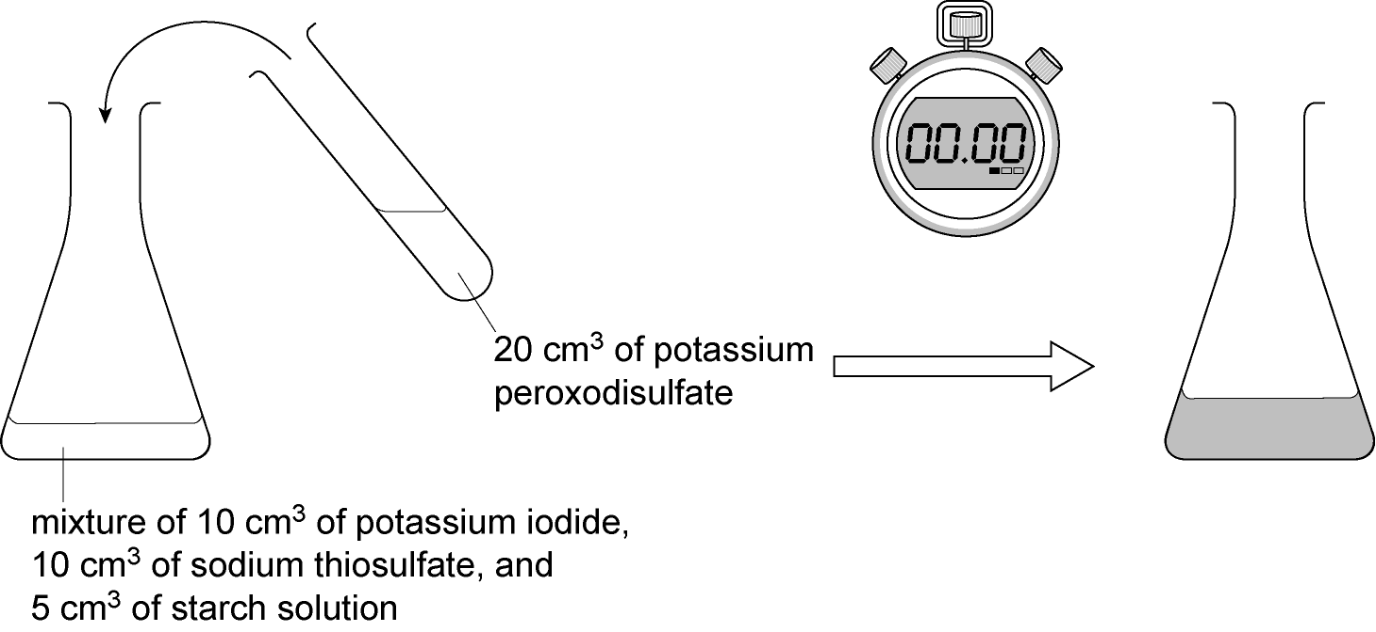
Grade A* – Investigate the effect of a range of possible catalysts on the rate of reaction.
Grade A – Explain how catalysts work.
Grade B – Define the term catalyst.

Slide 161
Grade A* – Investigate the effect of a range of possible catalysts on the rate of reaction.
Grade A – Explain how catalysts work.
Grade B – Define the term catalyst.

Slide 162
Can you review your definition of a ‘catalyst’ in no more than 20 words?

Slide 163
LESSON 15

Slide 164
Alkanes
Alcohols
Carboxylic Acids
Energy Changes
Fats and Oils
Esters
Equilibrium
Chromotography
Atom Economy
Gas Chromotography
Titrations
Catalysts
Green Chemistry
Unit C7

Slide 165
Green Chemistry
Lesson Objectives:
Grade A* – Summarise the importance of ‘green chemistry’ within industrial chemical synthesis.
Grade A – Identify and describe examples to illustrate the green principle.
Grade B – Define the term ‘green chemistry’.

Slide 166
Green Chemistry Market
TOPICS:
By-products and waste
Energy inputs and outputs
Environmental Impact
Health and safety issues
Social and economic benefits and risks
Renewable feedstocks

Slide 167
Green Chemistry Market
AIM: to produce a market stall and question sheet about your assigned topic.
INCLUDE THE FOLLOWING:
Brief description of your title (Grade C/D)
Explanations of the processes involved including relevant diagrams/pictures (Grade B)
Use of national/international examples in detail (Grade A)
Link to regional examples in detail (Grade A*)
*Include http references*

Slide 168
LESSON 16

Slide 169
Alkanes
Alcohols
Carboxylic Acids
Energy Changes
Fats and Oils
Esters
Equilibrium
Chromotography
Atom Economy
Gas Chromotography
Titrations
Catalysts
Green Chemistry
Unit C7

Slide 170
Theoretical yield + Percentage yield

Slide 171
Atom Economy
Lesson Objectives:
Grade A* – Calculate the reactant and product mass using symbol equations only.
Grade A – Explain the term ‘atom economy’ and its importance within the butanol conversion reaction.
Grade B – Calculate yield and percentage yield from a range of practical data.

Slide 172
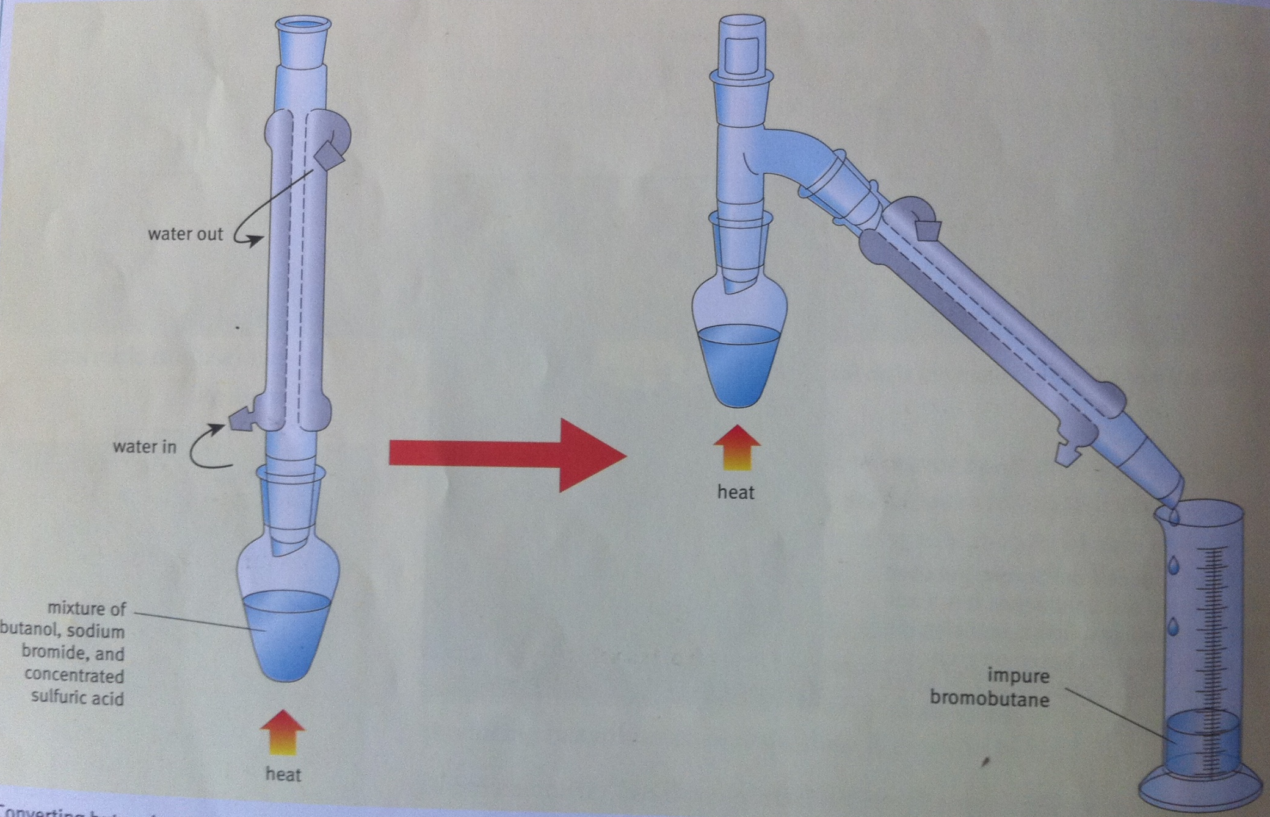
Grade A* – Calculate the reactant and product mass using symbol equations only.
Grade A – Explain the term ‘atom economy’ and its importance within the butanol conversion reaction.
Grade B – Calculate yield and percentage yield from a range of practical data.

Slide 173
Grade A* – Calculate the reactant and product mass using symbol equations only.
Grade A – Explain the term ‘atom economy’ and its importance within the butanol conversion reaction.
Grade B – Calculate yield and percentage yield from a range of practical data.
butanol to impure bromobutane
C₄H₉-OH
C₄H₉-Br
20g
30g
Work out theoretical yield and percentage yield!

Slide 174
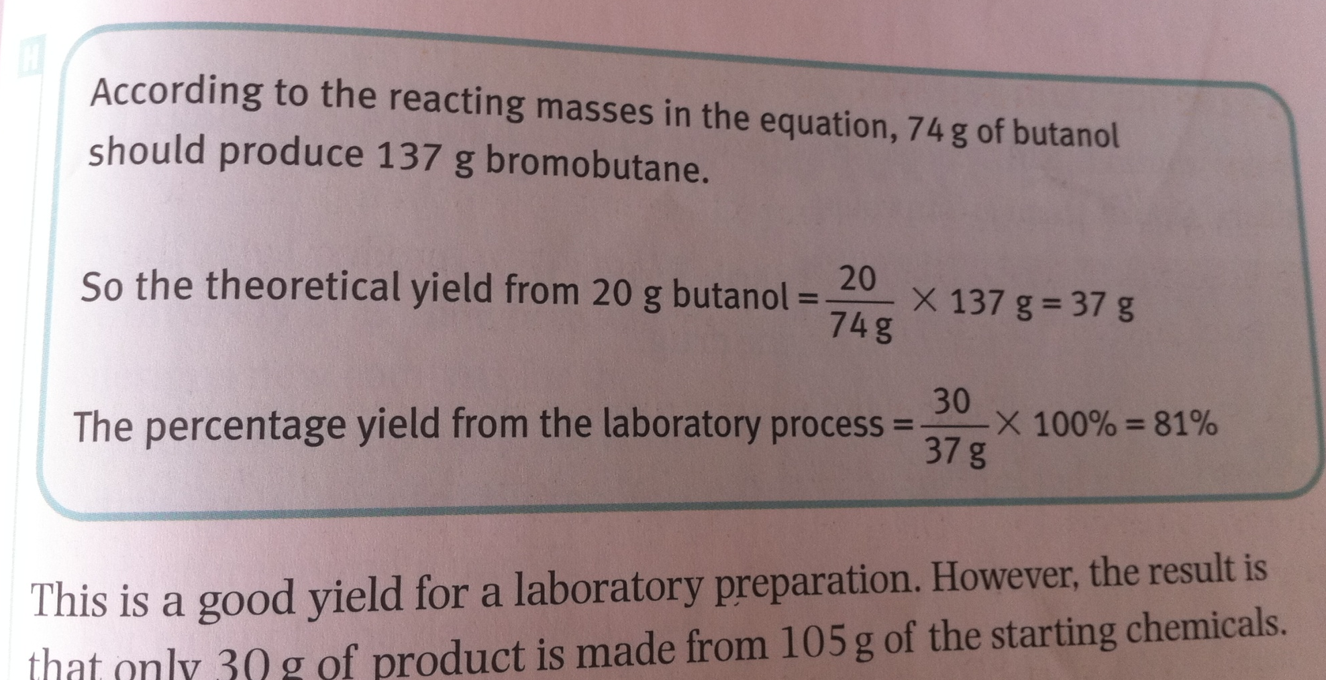
Grade A* – Calculate the reactant and product mass using symbol equations only.
Grade A – Explain the term ‘atom economy’ and its importance within the butanol conversion reaction.
Grade B – Calculate yield and percentage yield from a range of practical data.

Slide 175
Grade A* – Calculate the reactant and product mass using symbol equations only.
Grade A – Explain the term ‘atom economy’ and its importance within the butanol conversion reaction.
Grade B – Calculate yield and percentage yield from a range of practical data.

Slide 176
Revision

