Slide 1
C7 Further Chemistry
Alcohols, carboxylic acids and esters
Energy changes in Chemistry
Reversible reactions and equilibria
Analysis
Green Chemistry

Slide 2
Alcohols, carboxylic acids and esters

Slide 3
Organic molecules and functional groups
Organic chemistry is the study of carbon-based compounds.
Organic chemistry covers most fuels, plastics and synthetic fibers, as well as drugs and various classes of biomolecules.
Organic molecules are grouped into a number of classes.
The best-known are hydrocarbons, which are made of only carbon and hydrogen.
There are several subclasses of hydrocarbons, the simplest being the "alkanes", which are straight or branch-chained molecules, all joined with single C-C bonds.
The simplest alkane is methane (CH₄), followed by ethane (C₂H₆), propane (C₃H₈), butane (C₄H₁₀), pentane (C₅H₁₂), hexane (C₆H₁₄), heptane (C₇H₁₆), octane (C₈H₁₈), and so on.
Alcohols, carboxylic acids and esters

Slide 4
Organic molecules and functional groups
SOME ORGANIC CHEMISTRY RULES:
C atoms always make 4 bonds
H atoms always make just 1 bond
O atoms always make 2 bonds
So, when you draw a structure, it’s worth checking it to make sure that all the atoms have the right number of bonds.
Alcohols, carboxylic acids and esters

Slide 5
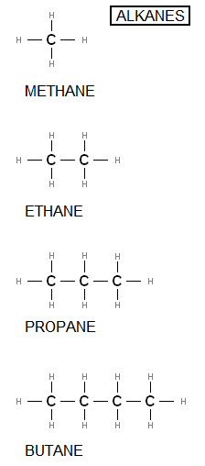
Organic molecules and functional groups
= CH₄ or lab or kitchen gas
= C₂H₆ or used in chemical industry to make ethene
= C₃H₈ or camping and BBQ gas
= C₄H₁₀ or
Alcohols, carboxylic acids and esters

Slide 6
Organic molecules and functional groups
Alkanes burn in plenty of air to give carbon dioxide and water
Methane CH_{4(g)} + 2O_{2(g)} → CO_{2(g)} + 2H₂0_{(g)}
Ethane 2C₂H_{6(g)} + 7O_{2(g)} → 4CO_{2(g)} + 6H₂0_{(g)}
Propane C₃H_{8(g)} + 5O_{2(g)} → 3CO_{2(g)} + 4H₂0_{(g)}
Butane 2C₄H_{10(g)} + 13O_{2(g)} → 8CO_{2(g)} + 10H₂0_{(g)}
These are balanced equations with state symbols
Alcohols, carboxylic acids and esters

Slide 7
Organic molecules and functional groups
Calculating reacting masses
Methane CH_{4(g)} + 2O_{2(g)} → CO_{2(g)} + 2H₂0_{(g)}
1 x C 1 x C
4 x H 4 x H
4 x O 4 x 0
Relative atomic masses (from periodic table):
C=12, H=1, O=16
These are balanced equations with state symbols
Alcohols, carboxylic acids and esters

Slide 8
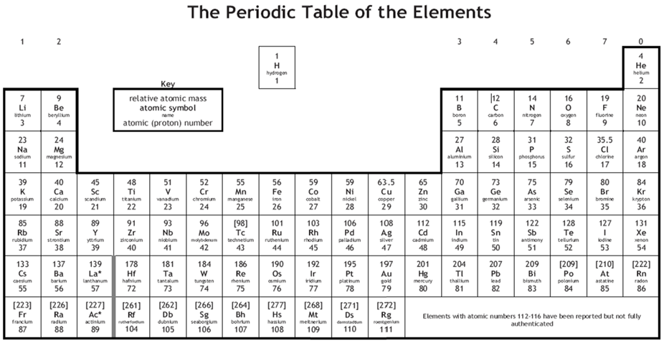
Organic molecules and functional groups
Alcohols, carboxylic acids and esters

Slide 9
Organic molecules and functional groups
Calculating reacting masses
Methane CH_{4(g)} + 2O_{2(g)} → CO_{2(g)} + 2H₂0_{(g)}
1 x 12 =12 1 x C=12
4 x 1 =4 4 x H=4
4 x 16=64 4 x 0=64
Total =80 Total =80
mass of reactants = mass of products
(always! No exception)
Alcohols, carboxylic acids and esters

Slide 10
Organic molecules and functional groups
The first 4 alkanes are gases and they do not dissolve in water.
As the hydrocarbon chains get longer the alkanes become oily viscous liquids instead of gases.
C-C and C-H bonds are unreactive and strong, so the alkanes do not react with aqueous reagents.
Aqueous reagents = chemicals dissolved in water
Alkanes do not have any functional groups, they are simple hydrocarbon chains.
Alcohols, carboxylic acids and esters

Slide 11
Alcohols
ALCOHOLS
Chemical feedstock
(to make other chemicals)
Antifreeze
Solvent
Fuel
H
= CH₃OH or
= C₂H₅OH or
H
C
O
H
H
METHANOL
H
H
H
C
C
O
H
Solvent
Fuel
Alcoholic drinks
H
H
ETHANOL
Alcohols all have a the –OH functional group
Alcohols, carboxylic acids and esters

Slide 12
Alcohols
The alcohols are liquids and are soluble in water.
As the hydrocarbon chains the get longer the alcohols become viscous liquids.
Like in alkanes, the C-C and C-H bonds are unreactive, but the C-O and O-H bonds DO react with other things.
The properties of alcohols are due to the –OH functional group.
Alcohols burn in air because of their hydrocarbon chain.
Alcohols, carboxylic acids and esters

Slide 13
Alcohols
Reaction of alcohols with air (the brandy on your christmas pudding!)
Alcohols burn in air because of the hydrocarbon chain, just like alkanes.
In plenty of air, alcohols burn with a clean blue flame.
C₂H₅OH_{(l)} + 3O_{2(s)} → 3H₂O_{(g)} + 2CO_{2(g)}
Alcohols, carboxylic acids and esters

Slide 14
Alcohols
Reaction of alcohols with metals (eg sodium,a group 1 alkali metal)
If a small piece of sodium is dropped into some ethanol, it reacts steadily to give off bubbles of hydrogen gas and leaves a colourless solution of sodium ethoxide, CH₃CH₂ONa. Sodium ethoxide is known as an alkoxide.
Although this looks new and complicated, it is exactly the same as the reaction between sodium and water (although gentler!) - something you have probably known about for years.
2C₂H₅OH_{(l)} + 2Na_{(s)} → 2C₂H₅O⁻Na⁺_{(s)} + H_{2(g)}
2H₂O + 2Na → 2NaOH + H₂
Alcohols, carboxylic acids and esters

Slide 15
Alcohols
Comparing the physical properties of alcohols with water and alkanes
 | Boiling point (ºC) | Melting point (ºC) | Density (g/cm³)
Alcohol (eg. ethanol) | 78 | -114 | 0.79
Water | 100 | 0 | 1.0
Alkane (eg. ethane) | -89 | -183 | 0.546
The –OH group in alcohols makes the boiling point higher, more like water. This makes alcohol a liquid at room temperature. Alkanes don’t have the –OH and so are gases at RT
The hydrocarbon chain in alcohol and alkane make them less dense than water. They will form a layer on top of water. Eg. Oil is a hydrocarbon
Alcohols, carboxylic acids and esters

Slide 16
Carboxylic Acids
CARBOXYLIC ACIDS
O
aka formic acid
The painful chemical in ant stings
= HCOOH or
= CH₃COOH or
H
C
O
H
METHANOIC ACID
H
O
aka acetic acid
Vinegar!
H
C
C
O
H
H
ETHANOIC ACID
Carboxylic acids all have a the –COOH functional group
Alcohols, carboxylic acids and esters

Slide 17
Carboxylic Acids
Most carboxylic acids taste and smell unpleasant (sweaty socks and rancid butter)
Carboxylic acids react with metals, alkalis and carbonates in the same way as other acids do.
The properties of carboxylic acids are due to the –COOH functional group.
Vinegar is a dilute solution of ethanoic acid
Alcohols, carboxylic acids and esters

Slide 18
Esters
Most carboxylic acids taste and smell unpleasant (sweaty socks and rancid butter)
Carboxylic acids react with metals, alkalis and carbonates in the same way as other acids do.
The properties of carboxylic acids are due to the –COOH functional group.
Vinegar is a dilute solution of ethanoic acid
Alcohols, carboxylic acids and esters

Slide 19
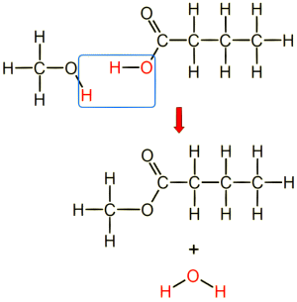
Esters
alcohol + carboxylic acid → ester + water
alcohol
Carboxylic acid
Esters are characterised by the –COC- group where the acid and alcohol joined
ester
water
Alcohols, carboxylic acids and esters

Slide 20
Esters
Different esters have different, but pleasant smells.
Can you spot the pattern in naming esters?
Alcohol | Carboxylic acid | Ester | Smell of ester
Pentanol | Ethanoic acid | Pentyl ethanoate | Pears
Octanol | Ethanoic acid | Octyl ethanoate | Bananas
Pentanol | Butanoic acid | Pentyl butanoate | Strawberries
Methanol | Butanoic acid | Methyl butanoate | Pineapples
Alcohols, carboxylic acids and esters

Slide 21
Esters
Esters occur naturally, but can be made in the laboratory by reacting an alcohol with an organic acid. A little sulfuric acid is needed as a catalyst.
They have distinctive pleasant (usually) smells.
They are responsible for the smells and flavours of fruits
They are used in products such as food, perfumes, solvents and plasticisers
Some esters used in perfumes are natural, while others are synthetic - made artificially.
Alcohols, carboxylic acids and esters

Slide 22
Esters
Alcohols, carboxylic acids and esters

Slide 23
Esters
Making pure esters.
Step 1.The carboxylic acid and alcohol (and a small amount of sulfuric acid catalyst) are heated under reflux. This allows them to be heated for a long time so that the reaction can complete without losing any of the product by evaporation.
Alcohols, carboxylic acids and esters

Slide 24
Esters
Alcohols, carboxylic acids and esters

Slide 25
Esters
Making pure esters.
Step 2.The ester and water mixture is distilled and the product (ester) collected at it’s boiling point and condensed in the liebig condenser, then collected in a beaker.
Ethyl ethanoate boils at 77ºC
Alcohols, carboxylic acids and esters

Slide 26
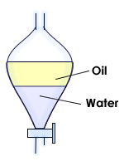
Esters
Making pure esters.
Step 3.The ester is then purified in a separating funnel by adding sodium carbonate. This reacts with any remaining acid in the mixture. This includes any unreacted carboxylic acid as well as the catalyst.
Oily layer (pure ester)
Aqueous layer (dissolved salt, made from excess acid)
Alcohols, carboxylic acids and esters

Slide 27
Esters
Fats are esters!!
Fats are an ester of glycerol and fatty acids that occur naturally.
Living organisms make fats and oils as an energy store.
Alcohols, carboxylic acids and esters

Slide 28
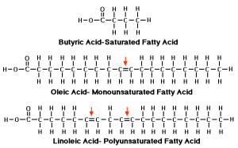
Esters
Saturated vs unsaturated fatty acids
In saturated fats, all the carbons have made bonds with other atoms.
In mono-unsaturated fats, there is ONE double bond between two carbon atoms.
In poly-unsaturated fats, there are many double bonds in the hydrocarbon chain.
Most animal fats are saturated molecules, all their C-C bonds are single.
Vegetable oils are mostly unsaturated molecules, they contain C=C double bonds.
Alcohols, carboxylic acids and esters

Slide 29
Energy changes in Chemistry

Slide 30
Energy Changes in Chemistry
When a reaction takes place, bonds are broken and new chemical bonds are made:
breaking bonds is an endothermic process, because energy has to be taken in from the surroundings to break the bonds
making bonds is an exothermic process, because energy is released in the formation of new chemical bonds
IN EVERY REACTION, SOME BONDS ARE BROKEN AND NEW ONES ARE MADE. The balance of these determines if the overall reaction is endothermic or exothermic
Energy changes in Chemistry

Slide 31
Exothermic reactions
Exothermic Reactions
An exothermic reaction releases energy.
The reaction mixture feels hot
We use exothermic reactions in burning fuels as a source of energy.
Energy changes in Chemistry

Slide 32
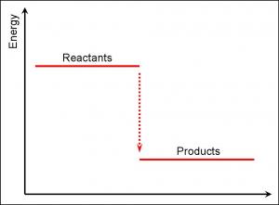
Exothermic reactions
This diagram shows the amount of energy stored in the reactants and products of an EXOTHERMIC reaction.
Energy out
Energy changes in Chemistry

Slide 33
Endothermic reactions
Endothermic Reactions
An endothermic reaction takes in energy from its surroundings.
The reaction mixture feels cold
More energy is needed to break to bonds of the reactants than is released in forming products.
Energy changes in Chemistry

Slide 34
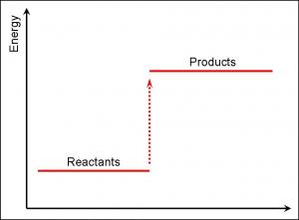
Endothermic reactions
This diagram shows the amount of energy stored in the reactants and products of an ENDOTHERMIC reaction.
Energy in
Energy changes in Chemistry

Slide 35
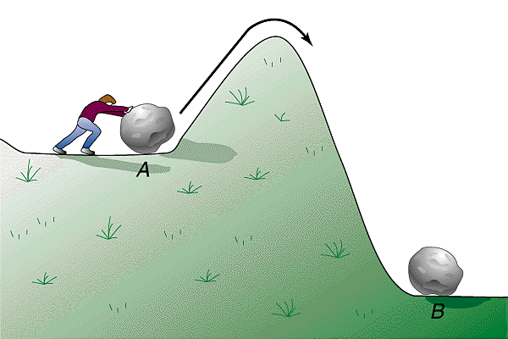
Activation Energy
Activation Energy
...is the energy needed to break bonds to start a reaction. Like getting a boulder rolling over the edge of a cliff!
...we provide activation energy or lower it by:
Heating the reactants
Using a catalyst
Making the reactants more concentrated
All of these will increase the rate of reaction
Energy changes in Chemistry

Slide 36
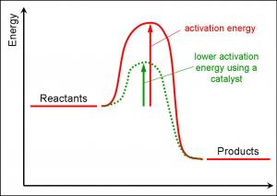
Activation Energy
Energy changes in Chemistry

Slide 37
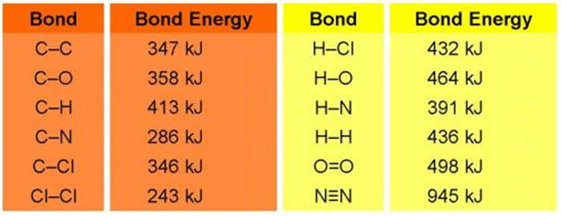
Bond energies
The energy needed to break apart a bond between two particular atoms is known as bond energy.
Bond energies are measured in kJ and we can use them to work out energy change in reactions.
Some of the most common bond energies are displayed below:
Energy changes in Chemistry

Slide 38
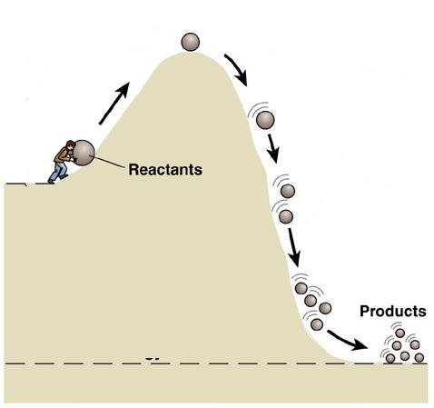
Energy Calculations – Worked Example 1
Burning hydrogen in oxygen.
Hydrogen + oxygen → water
2H_{2(g)} + O_{2(g)} → 2H₂O_{(g)}
H
H
O O
H
H
O
H
H
H
H
O
First we look up all the bond energies on either side of the reaction. You don’t need to learn these!:
H-H is 436kJ O=O is 496kJ O-H is 436kJ
Energy changes in Chemistry

Slide 39
Energy Calculations – Worked Example 1
2H_{2(g)} + O_{2(g)} → 2H₂O_{(g)}
H-H is 436kJ
O=O is 496kJ
O-H is 463kJ
Bonds broken:
2 x H-H and 1 x O=O
= (2 x 436) + 496
= 872 + 496
= 1368kJ
Bonds made:
4 x O-H
= 4 x 463
= 1852kJ
H
H
H
H
O O
O
H
H
H
H
O
Energy change = start – finish
= 1368 – 1852
= -484kJ
MORE ENERGY IS USED TO MAKE BONDS THAN BREAK THEM. IT IS AN EXOTHERMIC REACTION.
484kJ of heat is given out
Energy changes in Chemistry

Slide 40
Energy Calculations – Worked Example 2
Hydrogen and halogens react to form hydrogen halides.
Hydrogen + chlorine →hydrogen chloride
H_{2(g)} + Cl_{2(g)} → 2HCl_{(g)}
H
H
Cl Cl
H
Cl
H
Cl
First we look up all the bond energies on either side of the reaction. You don’t need to learn these!:
H-H is 436kJ Cl-Cl is 243kJ H-Cl is 432kJ
Energy changes in Chemistry

Slide 41
Energy Calculations – Worked Example 2
H_{2(g)} + Cl_{2(g)} → 2HCl_{(g)}
H-H is 436kJ
Cl-Cl is 243kJ
H-Cl is 432kJ
Bonds broken:
1 x H-H and 1 x Cl-Cl
= 436 + 243
= 679kJ
Bonds made:
2 x H-Cl
= 2 x 432
= 864kJ
H
H
Cl Cl
H Cl
H Cl
MORE ENERGY IS USED TO MAKE BONDS THAN BREAK THEM. IT IS AN EXOTHERMIC REACTION
Energy change = start – finish
= 679 – 864
= -185kJ
185kJ of heat is given out
Energy changes in Chemistry

Slide 42
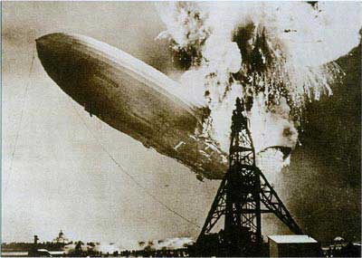
Endothermic reactions
Which of the worked examples gives out the most heat energy?
Hydrogen and oxygen
Hydrogen and chlorine
HYDROGEN AND OXYGEN!
Which is what went wrong with the Zeppelin airship in 1937. It was filled with hydrogen (lighter than air), but a stray spark provided the activation energy to start the reaction between the hydrogen and oxygen in air. It exploded spectacularly!
The Hindenburg Disaster
Energy changes in Chemistry

Slide 43
Reversible reactions and equilibria

Slide 44
Reversible reactions
In KS3 you looked at the difference between physical and chemical reactions. You will remember that there are signs that a CHEMICAL reaction is happening:
Colour change
Temperature change
Bubbles of gas formed
Cannot be easily reversed
This was an oversimplification! Some reactions are quite easily reversed.... REVERSIBLE REACTIONS
N_{2(g)} + 3H_{2(g)} 2NH_{3(g)}
Note the different type of arrow used for reversible reactions
Reversible reactions and equilibria

Slide 45
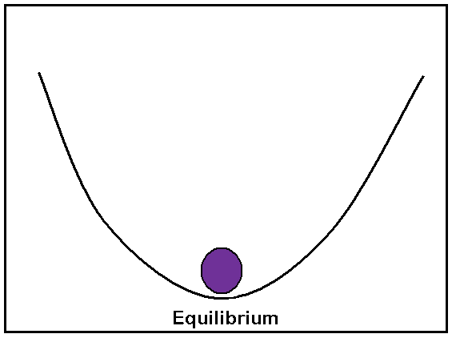
Dynamic Equilibrium
N_{2(g)} + 3H_{2(g)} 2NH_{3(g)}
In a closed system, where none of the reactants or products can escape, the reaction will reach DYNAMIC EQUILIBRIUM.
This means it’s going forward and backwards at the same rate.
Pure products – no reactants left
Pure reactants – no products formed yet
Products and reactants cycling at same rate. Reaction will appear to have stopped
Reversible reactions and equilibria

Slide 46
Strong acids and weak acids
Diluting a strong acid in water does not change its pH (otherwise dilution would turn an acid into an alkali!)
Dynamic equilibrium explains why some acids are weak and others are strong
Some strong acids are:
Hydrochloric acid - HCl
Nitric acid - HNO₃
Sulfuric acid - H₂SO₄
Carboxylic acids are weak acids
Reversible reactions and equilibria

Slide 47
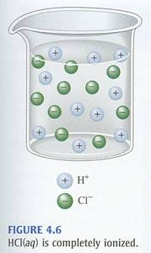
Strong acids and weak acids
How strong is an acid?
When an acid dissolves in water, it forms H⁺ ions. This is a hydrogen atom which has lost an electron (a proton).
The strength of an acid depends on the how much it ionises in water.
HCl_{(g)} H⁺_{(aq)} + Cl⁻_{(aq)}
A str
A strong acid or alkali is one which is completely (100%) ionised in water. Equilibrium is to the right.
Reversible reactions and equilibria

Slide 48
Strong acids and weak acids
A strong acid or alkali is one which is completely ionised in water. Equilibrium is to the right. eg hydrochloric acid
HCl
H⁺+ Cl⁻
REACTANTS
PRODUCTS
A weak acid or alkali is one which is only partly ionised in water. Equilibrium is NOT far over to the right. eg. methanoic acid
HCOOH
H⁺+ HCOO⁻
REACTANTS
PRODUCTS
Reversible reactions and equilibria

Slide 49
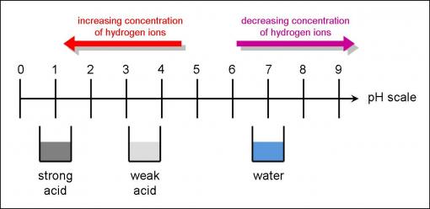
Strong acids and weak acids
pH is a measure of how ionised an acid is. It measures the concentration of hydrogen ions
Reversible reactions and equilibria

Slide 50
Analysis

Slide 51
Qualitative vs. quantitative
Qualitative analysis
Describes some quality of a substance
eg. It is blue, it smells of rotten eggs
Quantitative analysis
Tells us how much of a substance is present (its quantity)
eg. 16 g/ml
As a general rule. If you are given data with numbers in it, then its probably quantitative data, like continuous data in maths.
If it is discrete data, then it is likely to be qualitative.
Analysis

Slide 52
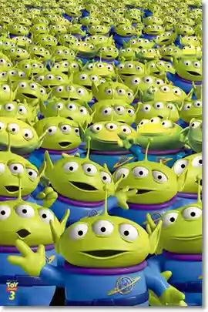
Sampling methods
When collecting data samples should represent the bulk of the material being tested
This is done by taking many samples at random
Multiple random sampling allows us to be more confident in our conclusion
Analysis

Slide 53
Standard Procedures
We use standard procedures for handling samples
This ensures that the results are reliable, since there’s less chance of human error
Standard procedures are similar to following a recipe to get the same results each time
Samples should be:
Collected in a sterile container
Sealed
Labelled
Stored in a safe place
Analysis

Slide 54
Standard Procedures
Sports men and women have to provide urine samples to check they have not been taking drugs → this is done in front of a testing officer to ensure it is not tampered with and labelled with a unique code so the lab does not know the identity of the athlete
2 samples of urine are taken from sports people → one is analysed immediately and one is frozen in case there is a query at a later date
Analysis

Slide 55
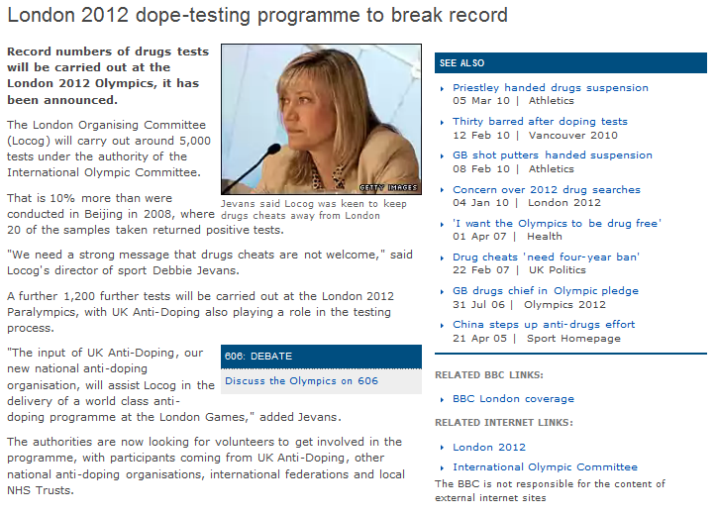
Standard Procedures in the news
Analysis

Slide 56
Chromatography
Chromatography is used to find out what is unknown mixtures are made up of.
This is done by comparing the unknown mixture with known reference samples
Colourless samples can be separated and then revealed by locating agents
Chromatography can be qualitative or quantitative
Analysis

Slide 57
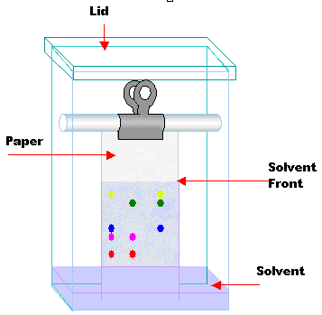
Chromatography
Stationary (not moving) phase = paper
Mobile (moving) phase = solvent
Substances are separated as they move between the mobile and stationary phases
Some substances stay dissolved in the solvent for longer
Others are more attracted to the stationary phase and stay there
Comparing the spots gives us qualitative data
Analysis

Slide 58
Chromatography
Analysis

Slide 59
Chromatography Solvents
Chromatography solvents (mobile phases)
Aqueous
Non-aqueous
Water based
Made from organic liquids, like alkanes or alcohols
There is a dynamic equilibrium between the mobile and stationary phases at the point where the chemical comes out of the solvent.
Analysis

Slide 60
Paper Chromatography
The 5 steps in paper chromatography
Put the bottom edge of the paper into the solvent, not touching the sample
4
2
Put a spot of the solution close to the bottom of the chromatography paper, allow to dry
The solvent rises up the paper, dissolves the spot and carries it up the paper
3
1
If the substance analysed is a solid, dissolve it in a suitable solvent
The different chemicals in the mixture travel different distances according to how soluble they are in the solvent
5
Analysis

Slide 61
Thin Layer Chromatography
Thin layer chromatography
Thin layer chromatography is a more sophisticated technique than paper chromatography
Can work with smaller samples
Gives better separation of samples
Done on a stationary phase of glass, plastic, or aluminum foil, which is coated with a thin layer of adsorbent material, usually silica gel, aluminium oxide, or cellulose
Analysis

Slide 62
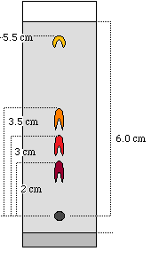
Quantitative Chromatography - calculating Rf value
Rf = distance moved by sample
distance moved by solvent
Solvent Front
Worked examples:
Rf = 5.5 = 0.92
6.0
Rf = 3.0 = 0.50
6.0
Sample start point
Solvent start point
Analysis

Slide 63
Quantitative Chromatography - calculating Rf value
Analysis

Slide 64
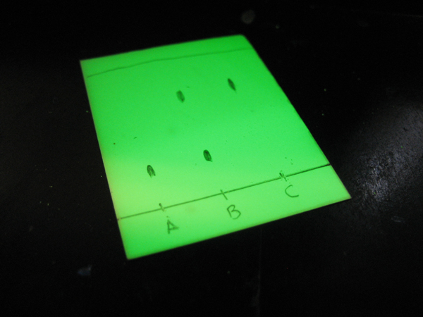
Chromatography locating agents
Using ultra violet light to as a locating agent, to reveal a sample that would otherwise be invisible
Analysis

Slide 65
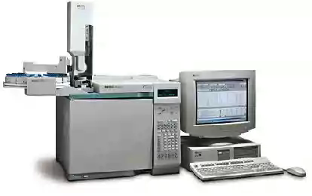
Gas Chromatography
Gas chromatography
Used to separate complex organic mixtures
Mobile phase is an unreactive gas (helium, nitrogen)
Stationary phase is a liquid layer on the inside surface of a column
Sample is injected into machine
Sample is vaporised and then carried through the column
Samples form dynamic equilibrium between mobile and stationary phases
Computer calculates exact quantities of each part of the mixture
Organic compounds have known retention times, they can be identified by looking up the values of the unknowns
Analysis

Slide 66
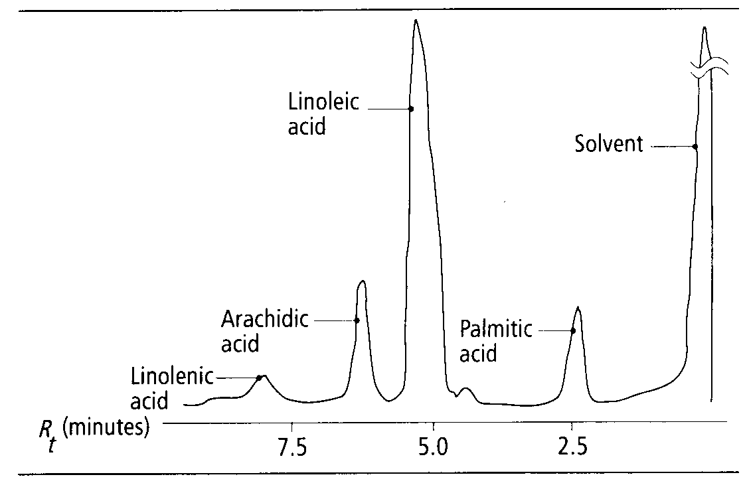
Interpreting Gas Chromatographs
The position of the peak identifies the compound
The area of the peak is used to calculate the quantity of material in the sample
eg. There is a lot more linoleic acid than arachidic acid. There is very little linolenic acid in this sample.
Analysis

Slide 67
Main Stages of Quantitative Analysis
Measuring out accurately a specific mass or volume of the sample
Working with repeated samples
Dissolving the samples in known volumes
Measuring and getting a quantitative result
Calculating a value from the measurements (eg the mean/min/max)
Estimating the degree of certainty in the results
This should be familiar, it is exactly what you did in your coursework ☺
Analysis

Slide 68
Standard Solutions
Solutions are a mixture of a chemical in a solvent (usually water)
Concentration of a chemical in solution is given in g/dm³ (grams of chemical in every litre of the solution)
The concentrations of standard solutions are known accurately so they can be used to compare the concentration of other solutions
Analysis

Slide 69
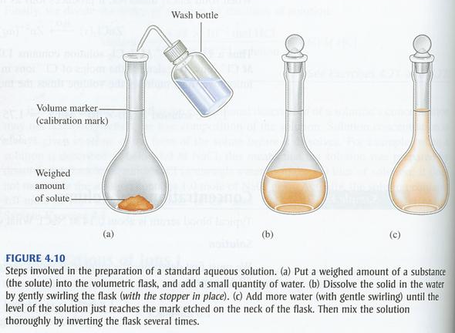
Standard Solutions
Preparing a standard solution
Analysis

Slide 70
Calculating Concentration and Mass
Calculate the concentration of a solution using this formula:
Concentration (g/dm³) = mass (g)
volume (dm³)
SWEET TEA!!
Worked example:
Calculate the concentration of the solution when 12.6g of sucrose is dissolved in 350cm³ water
First convert cm³ to dm³ by dividing by 1000... 350/1000 = 0.35dm³
Then calculate the concentration... 12.6g/0.35dm³ = 36g/dm³
Analysis

Slide 71
Calculating Concentration and Mass
Calculate the mass of solute by transposing the formula:
mass (g) = concentration (g/dm³) x volume (dm³)
Worked example:
Calculate the mass of solute in solution when the concentration is 26 g/dm³ and the volume is 0.2dm³
All volumes are given in dm³ so no need to convert any
Mass = 26g/dm³ x 0.2dm³
= 5.2 g
Analysis

Slide 72
Titration of acid with alkali
Titration
Acid/alkali titration is a common kind of quantitative analysis
It is used to work out the concentration of an acid, by titrating it with a known concentration of alkali
Reacting masses can be used to calculate the concentration of the acid solution
Analysis

Slide 73
Titration of acid with alkali
Analysis

Slide 74
Titration of acid with alkali
Analysis

Slide 75
Titration Calculations
Calculate the concentration of hydrochloric acid when...
Concentration of sodium hydroxide (NaOH) = 25 g/dm³
Volume of sodium hydroxide = 57 cm³
The experiment was done 3 times and the volume of acid used recorded, The results were:
10.0cm³
9.9cm³
10.1cm³
Worked example
Mean = 10.0 + 9.9 + 10.1 = 10.0 cm³
3
Analysis

Slide 76
Titration Calculations
Calculate the concentration of hydrochloric acid when...
Concentration of sodium hydroxide (NaOH) = 10 g/dm³
Volume of sodium hydroxide = 50 cm³
Mean volume of HCl used = 10.0 cm³ (=0.01dm³)
Worked example
HCl + NaOH → NaCl + H₂O
concentration
of acid (g/dm³)
= Volume (dm³) x concentration of NaOH (g/dm³)
Volume of HCl (dm³)
= 50 dm³ x 10g/dm³
0.01 dm³
= 500 g/dm³
Analysis

Slide 77
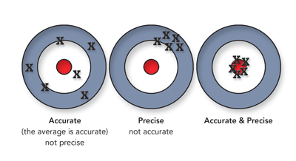
How reliable are the results?
The accuracy of an experiments results affects how valid the results are
Inaccurate results are often caused by human error
A wide range of values leads to lack of certainty and is not precise
Analysis

Slide 78
Calculating degree of uncertainty
Calculate the mean of your results
Find the range of your results
Results of 5 titrations
54.7 g/dm³
49.3 g/dm³
53.1 g/dm³
52.2 g/dm³
54.3 g/dm³
Mean = 52.7 g/dm³
Range = 49.3 to 54.7 g/dm³
Degree of uncertainty = range = 5.4 g/dm³
Percentage error = (degree of uncertainty / mean)*100
= (5.4/52.7)*100
= 10.2%
Certainty = 100 – 10.2 = 89.8%
Analysis

Slide 79
Green
Chemistry

Slide 80
Production of chemicals
Making useful chemicals for industry involves several stages:
Preparation of feedstocks (large quantities of reactants)
Synthesis
Separation of products
Handling of by-products and waste
Monitoring purity
Green Chemistry is about making these processes as sustainable as possible
Reducing and controlling waste
Social and economic benefits
Using renewable feedstocks
.
Environmental
impact
Energy in and out
Health and safety risks
No wasted atoms
Green Chemistry

Slide 81
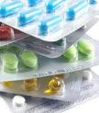
Bulk and fine chemicals
BULK CHEMICALS are made on a large scale - to fairly low quality
Ammonia
Sulfuric acid
Sodium hydroxide
Phosphoric acid
Mostly chemicals for agriculture or as chemical feedstocks
FINE CHEMICALS are made on a small scale - to a very high quality
Drugs
Food additives
Fragrances
Mostly for human consumption, quality strictly monitored
Green Chemistry

Slide 82
Bulk and fine chemicals
There is a lot of green chemical industry research into catalysts because:
They reduce the activation energy needed by a reaction
They make the reaction faster and more efficient
They remain unchanged and can be used repeatedly, making the process more sustainable
All new chemicals are the result of a lot of research and development.
Government has strict controls on chemical processes as well as on storage and transport of chemicals.
This is to protect people and the environment
Green Chemistry

Slide 83
Making ethanol
There are 3 ways of making ethanol:
Synthesis
Fermentation
Biotechnology
C₂H₅OH
H
H
H
C
C
O
H
H
H
Green Chemistry

Slide 84
Making ethanol
Why do we need to make large quantities of ethanol?:
Fuel
Feedstock for chemical industry
Alcoholic beverages
Antiseptic
Solvent
Green Chemistry

Slide 85
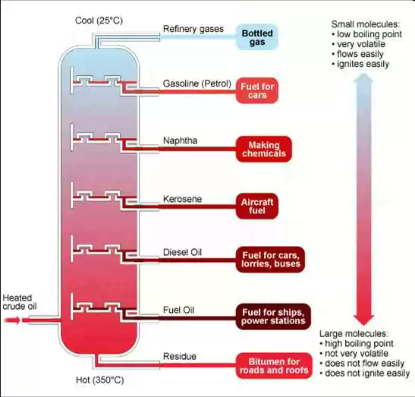
Making ethanol – Synthesis method
All hydrocarbons come originally from crude oil
The oil undergoes fractional distillation, to split its hydrocarbons up according to chain length
This is not sustainable
Green Chemistry

Slide 86
Making ethanol – Synthesis method
Ethanol can be made from another organic compound, ethene.
Crude oil is fractionated, and then the longer chain alkanes are cracked into shorter ones by heat and a catalyst
Ethene is one of the products of cracking
Cracked ethene is then used as a feedstock for manufacture of ethanol
Ethene reacted with steam at high temperature and pressure, with a catalyst, to make ethanol
Ethene is an unsaturated version of ethane, the C=C bond is a double bond
C₂H_{4(g)} + H₂O_{(g)}→ C₂H₅OH_{(g)}
ethene + water → ethanol
Unreacted reactants are recycled and fed through the system again
Green Chemistry

Slide 87
Making ethanol – Fermentation method
Ethanol can be made by fermenting sugar.
C₆H₁₂O_{6 (aq)} → 2C₂H₅OH_{(aq)} + 2CO₂ _{(aq)}
Ethanol for alcoholic beverages industry is made this way
Yeast provides the enzymes that make the reaction happen
Carried out at room temperature so the yeast isn’t denatured
Carbon dioxide is allowed to escape from the reaction vessel, but air is kept out, to keep the product clean
Green Chemistry

Slide 88
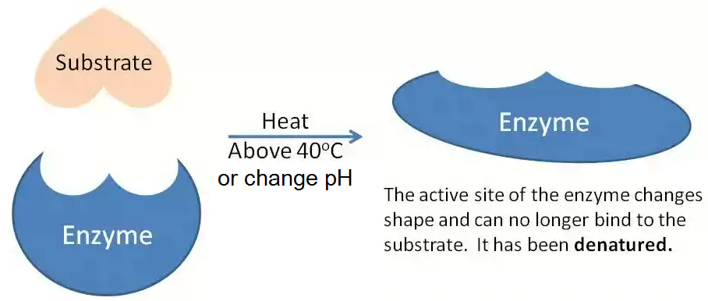
Making ethanol – Fermentation method
Ethanol made by fermentation has a limited concentration
The concentration of the alcohol is limited by:
the temperature – if it’s too high the enzyme is denatured
the amount of sugar in the mixture – once it’s gone, it’s gone
the pH of the reaction mixture – if it changes too much the enzyme is denatured
Green Chemistry

Slide 89
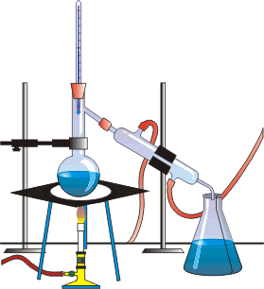
Making ethanol – Fermentation method
Ethanol can be made stronger by distillation.
Ethanol boils at 78ºC
Heat the ethanol and water mixture to 78ºC
Collect and condense the gases at this temperature
This is pure ethanol
The water is still in the first flask, at that temperature it won’t have boiled
Distillation on a
small scale
Green Chemistry

Slide 90
Making ethanol – Biotechnology method
Ethanol can be made by GM bacteria
The bacteria, e-coli can be genetically modified to help produce ethanol from waste biomass
Waste biomass includes corn stalks and remains of fruit that has been used to produce juice.
The steps in this process are::
1: The waste biomass is cut into small pieces.
2: The genetically modified e-coli converts the waste biomass into sugars.
3: The sugars produced are fermented.
4: The ethanol produced is distilled.
Green Chemistry

Slide 91
Making ethanol – assessing sustainability
There are drawbacks to every method
Fermentation can only produce small yields of ethanol.
Production from ethene is very energy intensive and the greenhouse gas, carbon dioxide is produced as a waste product.
Using waste biomass is a green option, but the waste biomass is often used for other things, such as feeding animals. This means other biomass now needs to be used to feed these animals.
Green Chemistry

