Slide 1
Analysis
C7.4 – Analytical Procedures

Slide 2
What do I need to know?
1. Recall the difference between qualitative and quantitative methods of analysis.
2. Describe how analysis must be carried out on a sample that represents the bulk of the material under test
3. Explain why we need standard procedures for the collection, storage and preparation of samples for analysis

Slide 3
Qualitative vs. Quantitative
A qualitative test is usually very quick. It can give vital information without needing to wait too long for it.
A quantitative test gives precise values, for example for a concentration in Moldm⁻³
Examples of qualitative tests include universal indicator, silver nitrate for halide ions and bromine water for unsaturation.
Examples of quantitative tests include titration, chromatography and spectroscopy.

Slide 4
Which sample should I test?
It is important that the sample represents the bulk of the material under test.
You may chose to test more than one sample from a range of points to ensure that you have results which represent the whole.
For example is it well mixed? Are their pockets of higher concentration/different composition?

Slide 5
Chemical industry
Analysis of samples is crucial to the chemical industry to ensure the quality of the chemicals they are manufacturing. Some are analysed numerous times a day or even within an hour.
To maintain consistency it is essential that we use standard procedures to:
collect the sample
store the sample
prepare the sample for analysis
analyse the sample.

Slide 6
Chromatography
C7.4 – paper chromatography

Slide 7
Chromatography

Slide 8
Solvents
The mobile phase is the solvent – the part that moves
2. In paper chromatography it is water or ethanol

Slide 9
Paper/column
The stationary phase is the paper in paper chromatography or the column in gas chromatography.
In thin layer chromatography it is silica gel on a glass plate
The stationary phase does not move.

Slide 10
How does the technique work?
In chromatography, substances are separated by movement of a mobile phase through a stationary phase.
Each component in a mixture will prefer either the mobile phase OR the stationary phase.
The component will be in dynamic equilibrium between the stationary phase and the mobile phase.

Slide 11
Substance A
This is substance A
Substance A prefers the stationary phase and doesn’t move far up the paper/column.
The equilibrium lies in favour of the stationary phase.

Slide 12
Substance B
This is substance B
Substance B prefers the mobile phase and moves a long way up the paper/column
The equilibrium lies in favour of the mobile phase

Slide 13
Using a reference
In chromatography we can sometimes use a known substance to measure other substances against.
This will travel a known distance compared to the solvent and is known as a standard reference.

Slide 14
Advantages of TLC
TLC has a number of advantages over paper chromatography.
It is a more uniform surface chromotograms are neater and easier to interpret
Solvent can be used which is useful if a substance is insoluble in water.

Slide 15
Past Paper Questions

Slide 16
Past paper question

Slide 17
Mark scheme

Slide 18
Describing how chromatography works – exam definition
stationary phase is paper and mobile phase is solvent / mobile phase moves up through stationary phase (1)
for each compound there is a dynamic equilibrium between the two phases (1)
how far each compound moves depends on its distribution between the two phases (1)

Slide 19
Using an R_{f} value
In order to be more precise we can use measurements on the TLC plate to compare the distance travelled by our substance (the solute) with the distance travelled by the solvent.
The Rf value is constant for a particular compound.
The distance travelled however could be different on different chromatograms.
The Rf value is always less than 1.

Slide 20
Rf value

Slide 21
Example question
This question relates to the chromatogram shown in the earlier question. Refer back…

Slide 22
Mark scheme

Slide 23
Example question

Slide 24
Mark scheme

Slide 25
Past paper question

Slide 26
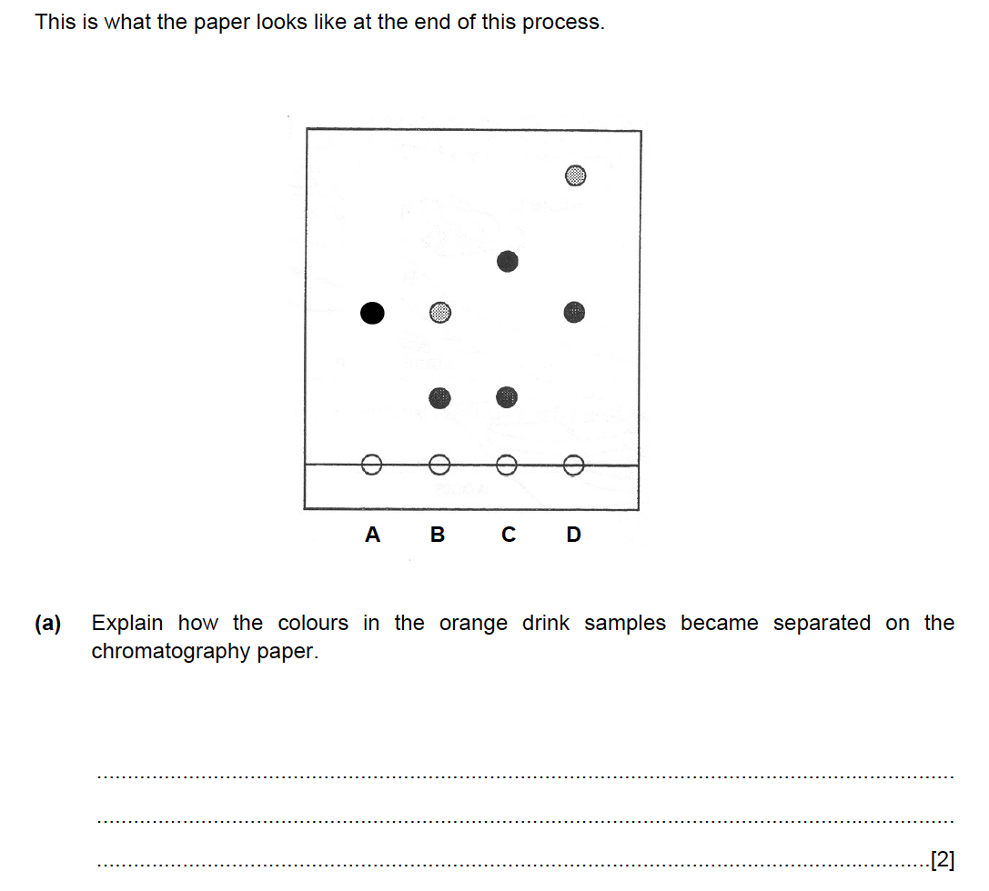

Slide 28
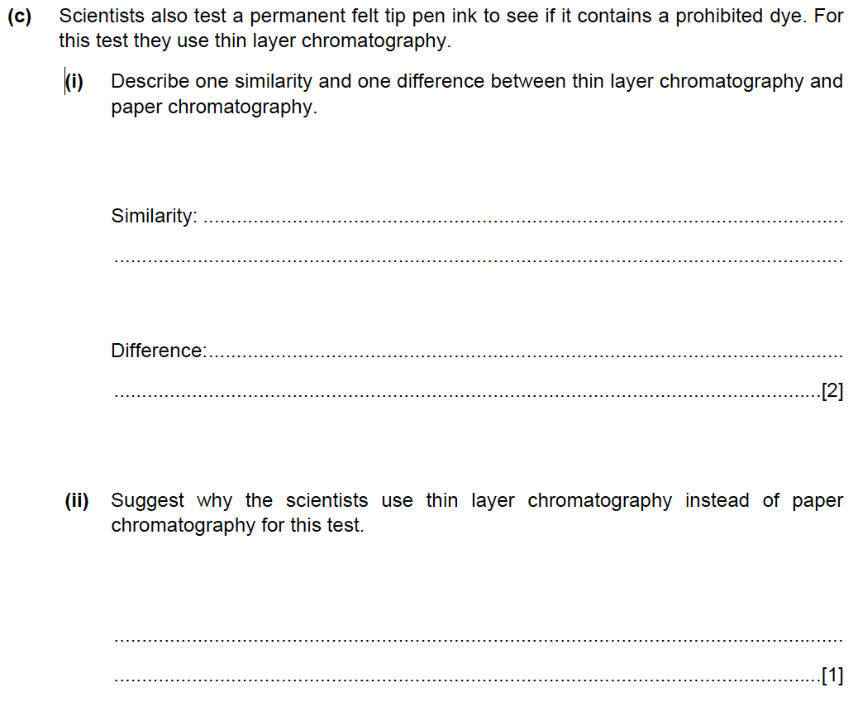

Slide 29
Mark scheme

Slide 30
Gas-liquid chromatography
C7.4 GLC

Slide 31
What do I need to know?
recall in outline the procedure for separating a mixture by gas chromatography (gc);
understand the term retention time as applied to gc;
interpret print-outs from gc analyses.

Slide 32
Gas chromatography
The mobile phase is an unreactive gas known as the carrier gas this is usually nitrogen
The stationary phase is held inside a long column and is lots of pieces of inert solid coated in high bp liquid.
The column is coiled in an oven
The sample to be analysed is injected into the carrier gas stream at the start of the column.

Slide 33
GC

Slide 34
GC analysis
Each component of the sample mixture has a different affinity for the stationary phase compared with the mobile phase
Therefore each component travels through the column in a different time.
Compounds favouring the mobile phase (usually more volatile) emerge first.
A detector monitors the compounds coming out of the column and a recorder plots the signal as a chromatogram

Slide 35
GLC Chromatograph

Slide 36
Interpretation
The time in the column is called the retention time
Retention times are characteristic so can identify a compound
Area under peak or relative heights can be used to work out relative amounts of substances

Slide 37
The key points – revise this!
the mobile phase carries the sample (1)
components are differently attracted to the stationary and mobile phases (1)
the components that are more strongly attracted to the stationary phase move more slowly (1)
the amount of each component in the stationary phase and in the mobile phase is determined by a dynamic equilibrium (1)

Slide 38
Past paper question

Slide 41
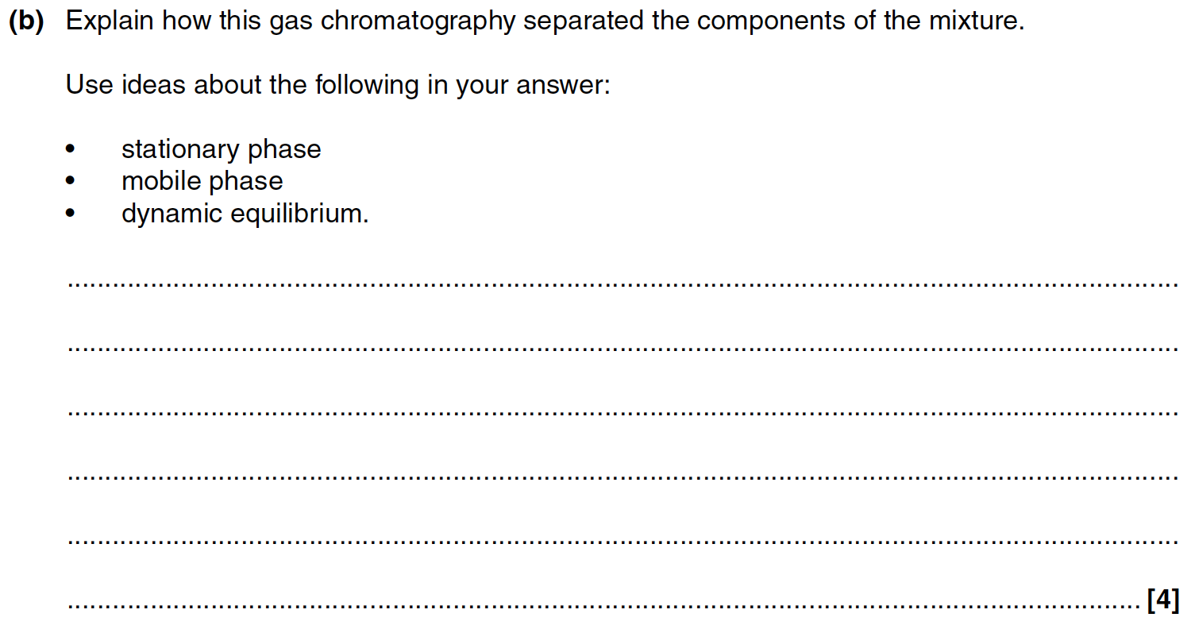

Slide 42
Mark scheme

Slide 43
Titration
C7.4

Slide 44
What do I need to know?
Calculate the concentration of a given volume of solution given the mass of solvent;
Calculate the mass of solute in a given volume of solution with a specified concentration;
Use the balanced equation and relative formula-masses to interpret the results of a titration;

Slide 45
Concentration
We can measure the concentration of solution in grams/litre. This is the same as g/dm³
1dm³ = 1000cm³
If I want to make a solution of 17 g/dm³ how much will I dissolve in 1dm³.
17 g
If I want to make a solution of 17g/dm³ but I only want to make 100cm³ of it how much will I dissolve?
1.7g

Slide 46
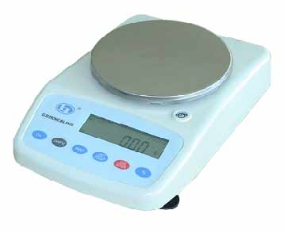
Making standard solutions
For a solution of 17g/dm³
First I will measure 17g of solid on an electronic balance

Slide 47
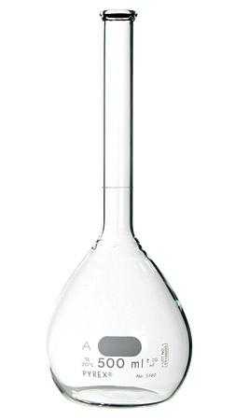
Making standard solutions
Now I must dissolve it in a known 1dm³ of water.
I transfer it to a volumetric flask and fill up with distilled water to about half the flask.
I then swirl to dissolve
Top up with a dropping pipette so that the meniscus is on the line.

Slide 48
How much to dissolve?
Worked example:
I want to make 250cm³ of a solution of 100g/dm³.
How much solid do I transfer to my 250cm³ volumetric flask?

Slide 49
How much to dissolve?
Worked example:
I want to make 250cm³ of a solution of 100g/dm³.
1. Work out the ratio of 250cm³ to 1000cm³
250/1000 = 0.25
2. I therefore need 0.25 of 100g in 250cm³ which is 0.25x100=25g

Slide 50
General rule

Slide 51
Practie - how much to dissolve?
I want to make 250cm³ of a solution of 63.5g/dm³.
How much solid do I transfer to my 250cm³ volumetric flask?
250/1000 x 63.5 = 15.9 g

Slide 52
Practice - how much to dissolve?
I want to make 100cm³ of a solution of 63.5g/dm³.
How much solid do I transfer to my 100cm³ volumetric flask?
100/1000 x 63.5 = 6.35 g

Slide 53
Concentration from mass and volume
We need to rearrange this:
To give

Slide 54
What is the concentration of?
12g dissolved in 50cm³
50g dissolved in 100cm³
47g dissolved in 1000cm³
200g dissolved in 250cm³

Slide 55
What is the concentration of?
12g dissolved in 50cm³
= 1000/50 x 12
= 240g/dm³
50g dissolved in 100cm³
=1000/100 x 50
= 500g/dm3
47g dissolved in 1000cm³
= 1000/1000 x 47
= 47g/dm³
200g dissolved in 250cm³
1000/250 x 200
= 800g/dm³

Slide 56
Solutions from stock solutions
Stock solution
highest concentration
Extract a portion of stock solution
as calculated
Dilute with distilled water
Making a known volume of a lower concentration
use to make other solutions

Slide 57
Making solutions from stock solutions
If I have a solution containing 63g/dm³, how do I make up 250cm³ of a solution of concentration 6.3g/dm³?
To make 1dm³ of 6.3g/dm³ I would need 100cm³
To make 250cm³ of 6.3g/dm³ I would therefore need 25cm³ and make it up to 250cm³ with distilled water

Slide 58
Working out masses
We can use the useful relationship
Where Mr is the molecular mass
eg Mr of NaOH is (23 + 16 + 1) = 40
This can help us to calculate an unknown mass

Slide 59
Titration calculations
In a titration we have added a known amount of one substance usually an acid (in the burette) to a known amount of another substance usually an alkali (in the conical flask).
The amount added allows us to determine the concentration of the unknown.

Slide 60
Titration equipment

Slide 61
Using a table
It can be helpful to sketch a table to keep track of information you know…
Value | Acid | Alkali
Volume (cm³)
Mass (g)
Concentration (g/dm³)
Molecular weight (Mr)

Slide 62
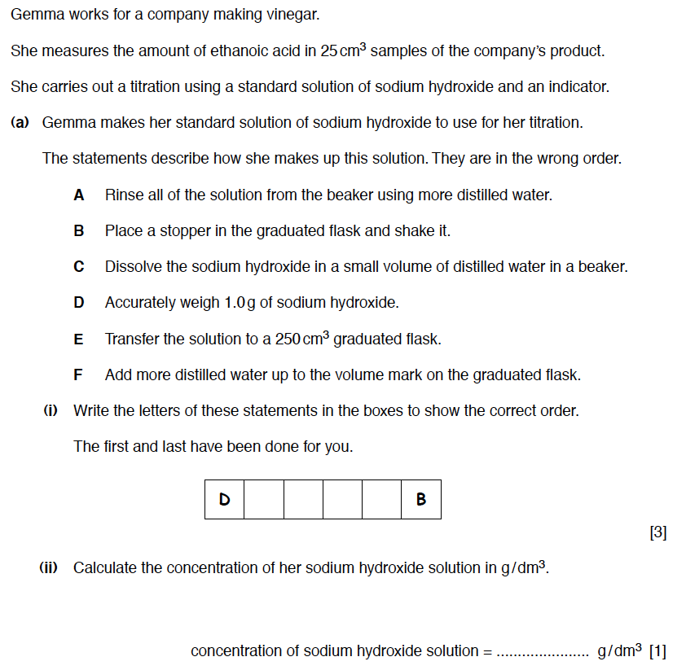

Slide 63
Mark scheme

Slide 64
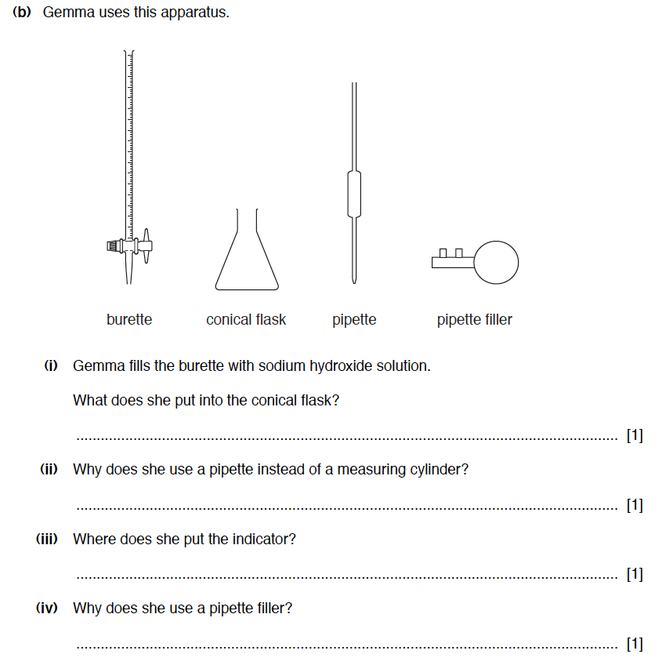

Slide 65
Mark scheme

Slide 66
Uncertainty
Uncertainty is a quantification of the doubt about the measurement result.
In a titration the uncertainty is the range of the results.
If results are reliable then it will be within 0.2cm³
NOTE THAT THIS IS RELIABLE NOT NECESSARILY ACCURATE

Slide 67
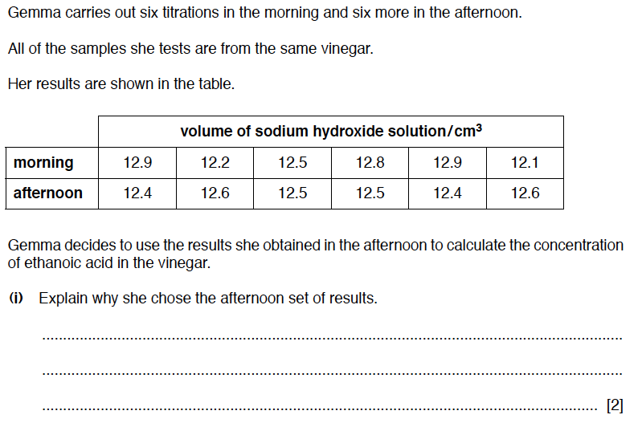

Slide 68
Mark scheme

Slide 70
Mark scheme

Slide 71
C7.5 Green Chemistry
The Chemical Industry

Slide 72
What do I need to know?
Recall and use the terms 'bulk' (made on a large scale) and 'fine' (made on a small scale) in terms of the chemical industry with examples;
Describe how new chemical products or processes are the result of an extensive programme of research and development;
Explain the need for strict regulations that control chemical processes, storage and transport.

Slide 73
Bulk processes
A bulk process manufactures large quantities of relatively simple chemicals often used as feedstocks (ingredients) for other processes.
Examples include ammonia, sulfuric acid, sodium hydroxide and phosphoric acid.
40 million tonnes of H₂SO₄ are made in the US every year.

Slide 74
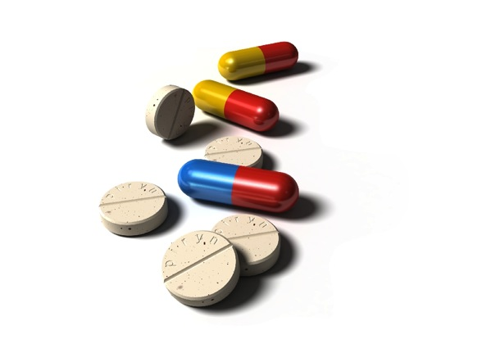
Fine processes
Fine processes manufacture smaller quantities of much more complex chemicals including pharmaceuticals, dyes and agrochemicals.
Examples include drugs, food additives and fragrances
35 thousand tonnes of paracetamol are made in the US every year.

Slide 75
Example question

Slide 76
Mark scheme

Slide 77
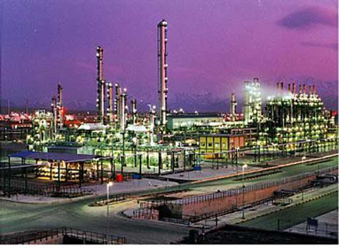
Research and Development
All chemicals are produced following an extensive period of research and development.
Chemicals made in the laboratory need to be “scaled up” to be manufactured on the plant.

Slide 78
Research in the lab

Slide 79
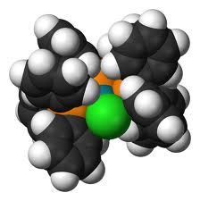
Examples of making a process viable
Trying to find suitable conditions – compromise between rate and equilibrium
Trying to find a suitable catalyst – increases rate and cost effective as not used up in the process.

Slide 80
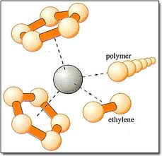
Catalysts
Can you give a definition of a catalyst?
A substance which speeds up the rate of a chemical reaction by providing an alternative reaction pathway.
The catalyst is not used up in the process
Catalysts can control the substance formed eg Ziegler Natta catalysts.

Slide 81
Regulation of the chemical industry
Governments have strict regulations to control chemical processes
Storage and transport of chemicals requires licenses and strict protocol.
Why?
To protect people and the environment.

Slide 82
Example question

Slide 83
Mark scheme

Slide 84
Process development
preparation of feedstocks
synthesis
separation of products
handling of by-products and wastes
monitoring of purity

Slide 85
Example question – part 1

Slide 86
Example question part - 2

Slide 87
Mark scheme

Slide 88
Example question – part 3

Slide 89
Mark scheme

Slide 90
Factors affecting the sustainability of a process
Sustainability
renewable feedstock
atom economy
type of waste and disposal
energy inputs and outputs
environmental impact
health and safety risks
social and economic benefits

Slide 91
Example question

Slide 92
Mark scheme

Slide 93
Atom economy

Slide 94
Atom economy calculation
For example, what is the atom economy for making hydrogen by reacting coal with steam?
Write the balanced equation:
C(s) + 2H₂O(g) → CO₂(g) + 2H₂(g)
Write out the Mr values underneath:
C(s) + 2H₂O(g) → CO₂(g) + 2H₂(g)
12 2 × 18 44 2 × 2
Total mass of reactants 12 + 36 = 48g
Mass of desired product (H₂) = 4g
% atom economy = 4⁄48 × 100 = 8.3%

Slide 95
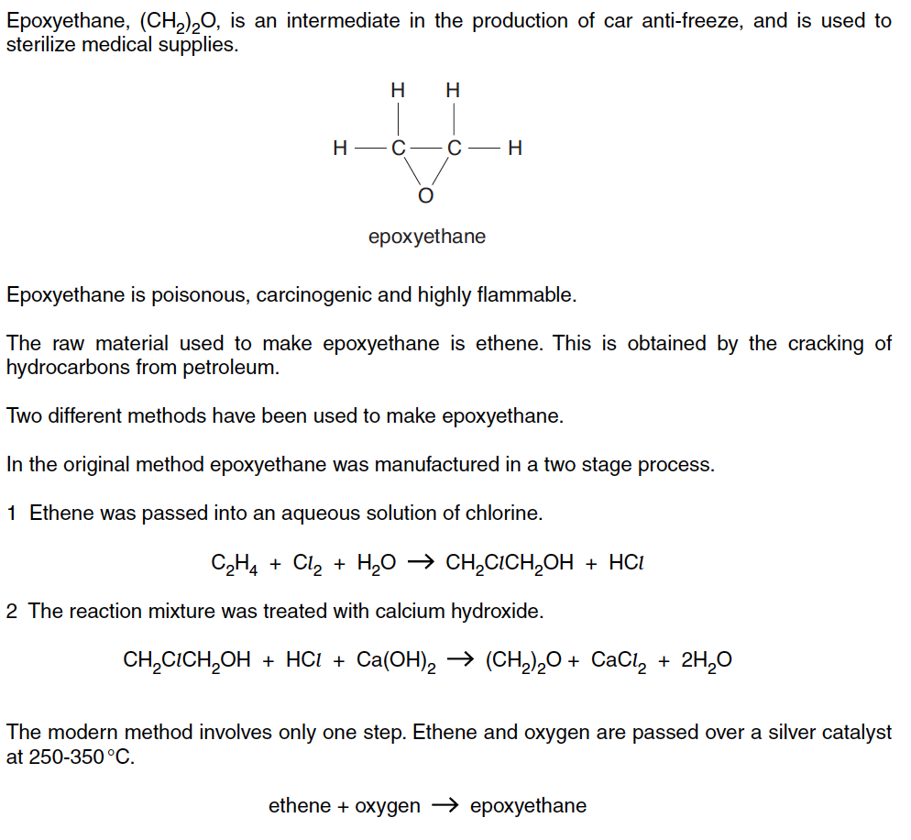
Example question

Slide 96
Example question – part 2

Slide 97
Mark scheme

