Slide 1
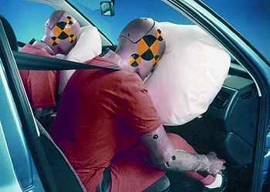
Change in momentum and Car Safety
D - Change in momentum = Force (N) x Time (s)
C – List car safety features as passive or active
A/B – Explain why car safety features achieve the change in momentum in the longest time possible

Slide 2
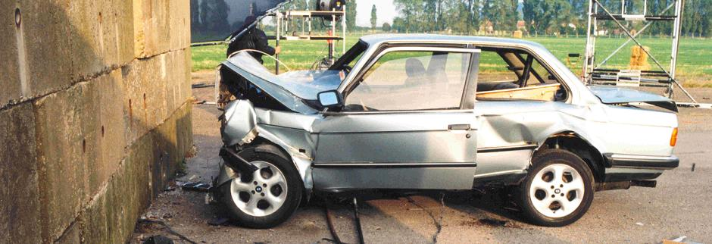
Change in momentum
When a car smashes into a wall its momentum is transferred to wall.
The amount of momentum transferred is called the change in momentum

Slide 3
Change in momentum
A force leads to a change in momentum
The greater the force, the greater the change in momentum
Also…
The longer the force acts for, the greater the change in momentum
So the total change depends on the force and the time

Slide 4
Change in momentum = Force x Time
Change in momentum= Force (N) x Time (s)
Units of Change in momentum= kg m / s
Write the equation in your books, with units.
Draw an equation triangle and rearrange the equation to find
Force = …
Time = …

Slide 5
Change in momentum - worked example
Question:
A force of 30 N acts for 4 s. Find the Change in momentum of the event.
Answer:
Change in momentum = Force x time (equation)
= 30 N x 4 s (correct numbers)
= 120 Ns (answer, units)
(which causes a gain in momentum of 120 kg m / s)

Slide 6
Imagine the max force a passenger’s chest can bear = 350 N
A seatbelt acted on a passenger over 2 s. The total change in momentum of the passenger was 800 kg m /s. Find the size of the force exerted. Does the passenger die?
Solution: Change in momentum= 800 kg m / s
Force = Change in momentum / time(equation stage)
= 800 / 2 (correct numbers)
= 400 N (answer, units)

Slide 7
Car Safety Features
Active – serve to prevent the accident
ABS brakes, proximity sensors, rear-view mirrors, 70mph warnings,
Passive – serve to reduce damage to passengers in case of an accident
Seatbelt, airbag, crumple zones, Head rests, reinforced pillars, roll cage

Slide 8
Car Safety and Change in momentum – Learn this!
An 80kg passenger at velocity 20 m / s has a momentum of 1600 kg m / s.
So, to stop them in a crash needs Change in momentum of 1600 Ns
Change in momentum = force x time
To achieve this in 0.25 seconds = force of 6400 N
To achieve this in 1 second = force of 1600 N
To achieve this in 2 seconds = force of 800 N
Car features achieve the necessary impulse with as long a time as possible and as small a force as possible

