Slide 1
Drug trials
Learning Outcome: Describe the use of open label, blind and double blind tests in human trials (higher) and the use of placebos.

Slide 2
What cells are activated when a microorganism re-infects the body?
What does a vaccine contain?
Why is it that medicines are never risk-free?
Why do people react differently to drugs and vaccines?
What do anti-microbials do to MO’s?
What causes microbes to become resistant to antibiotics?

Slide 3
How do we know paracetamol is safe?
Discuss in pairs

Slide 4
Drug trials
New drugs tested in Laboratories
Drugs are developed using human cells that have a disorder e.g. Cancer
Monitor the effect the drug has on the cell
If a result is seen- must test on a live mammal (rats/monkeys) to confirm effect
Why else?
Why use mammals?
What is a side effect?
What happens to the drug testing if there are serious side effects?

Slide 5
Clinical trials
If drug trials are successful – what next?
Check the drug has the same effect in humans
Drug is first tested on healthy volunteers – why?
Check for harmful side effects- why not test on sick volunteers first?
If no side effects – test on sick volunteers – checks safety and effectiveness

Slide 6
Open label trial
A study of the effects of a drug in a group of patients in which both the patient and the person evaluating the effectiveness of the therapy know exactly what drug and dose of drug is being taken

Slide 7
Though much easier to perform than double-blind clinical trials, the reliability and applicability of the results of open label drug studies are less clear – why?
Both patients and the evaluators might have a bias towards wanting the study drug to work better than the control treatment.

Slide 8
Blind trial
A blind or blinded experiment is a scientific experiment where some of the people involved are prevented from knowing certain information that might lead to conscious or subconscious bias on their part, invalidating the results

Slide 9
For example, when asking consumers to compare the tastes of different brands of a product, the identities of the product should be concealed – otherwise consumers will generally tend to prefer the brand they are familiar with.
Similarly, when evaluating the effectiveness of a medical drug, both the patients and the doctors who administer the drug may be kept in the dark about the dosage being applied in each case – to forestall any chance of a placebo effect, observer bias, or conscious deception.

Slide 10
Double blind trial
In a double-blind, placebo-controlled clinical trial, neither the patients nor the researchers know who is getting a placebo and who is getting the treatment.
Why?
Because patients don't know what they're getting, their belief about what will happen doesn't taint the results.
Because the researchers don't know either, they can't hint to patients about what they're getting, and they also won't taint results through their own biased expectations about what the results will be.

Slide 11
Placebo
Tablet/medication that DOESN’T contain the drug
Fake!!!!!!
placebo is an inactive substance (often a sugar pill) given to a patient in place of medication. Clinical trials show that between 30% to 40% of people will show improvement when given a placebo because they believe it will work.

Slide 12
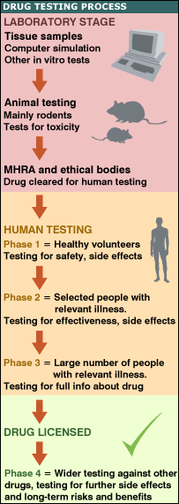

Slide 13
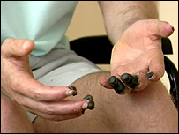

Slide 14
http://news.bbc.co.uk/1/hi/england/london/4807042.stm

