Slide 1
Evolution and classification
L.O: look at how evidence shows evolution
Describe biodiversity, classification and sustainability

Slide 2
Legumes – plants that improve soil fertility
Root nodules – lumps on roots that contain bacteria that fix nitrogen

Slide 3
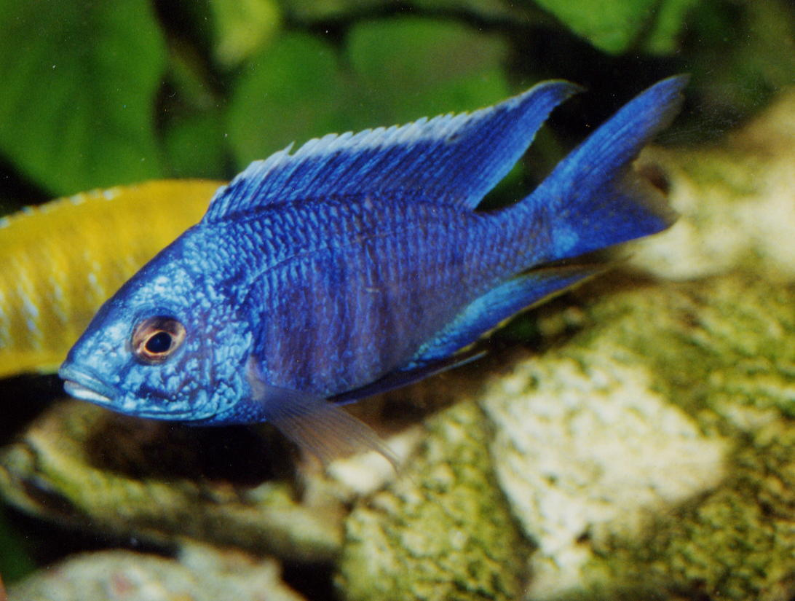
Copadichromis nkatae

Slide 4
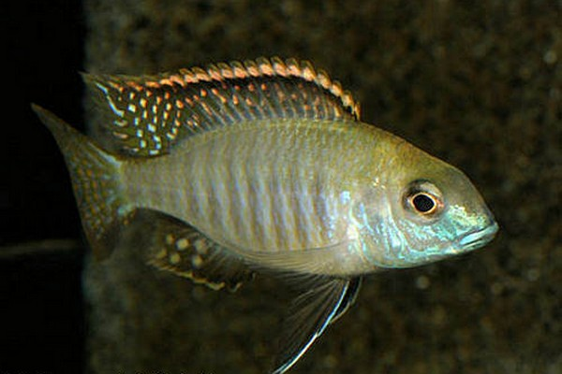
Lethrinops auritus
Why has the fish lost its colouring?
Doesn’t confer any advantage to its existence in the specific region of the lake
Why is it an advantage to lose a characteristic?
Use the energy in other areas e.g. Growth, protein production, movement

Slide 5
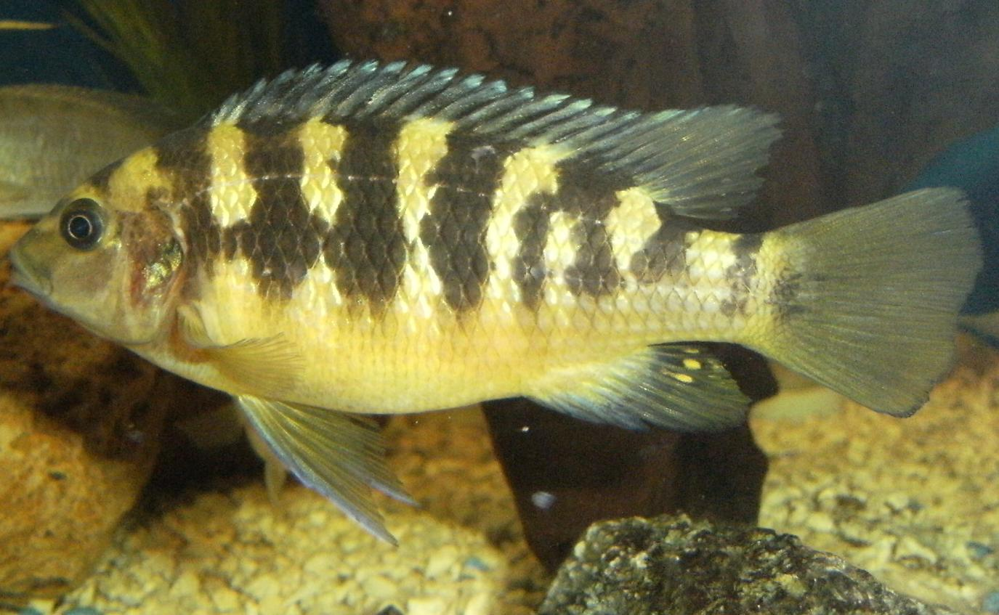
Metriaclima crabro

Slide 6
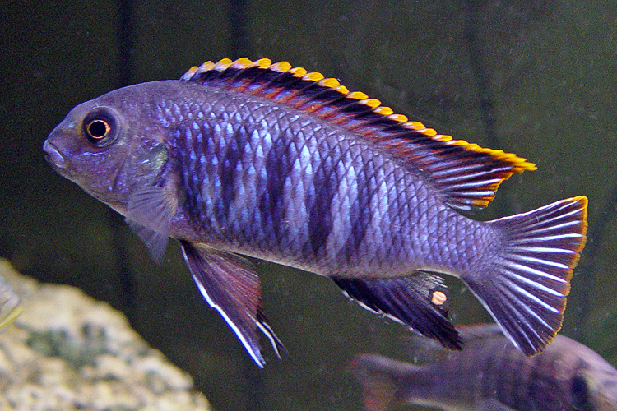
Tropheops

Slide 7
6 mark question
The Mexican tetra is a species of fish. It lives in rivers and is a silver colour.
Some of this fish have become trapped in caves where there is no light.
Over time the population of fish living in caves have lost their ability to produce the protein that gives them their body colour. They now appear colourless.
The cave fish are also blind because they do not have developed eyes.
Suggest and explain the evolutionary processes through which these changes could have occurred.

Slide 8
mutations cause fish to not make pigment and/or not develop eyes
In caves there is no (or little) light, so fish would not be able to see, would not be able to be seen, and would not need protection from (strong) sunlight
Therefore lack of eyes and pigment give no disadvantage
Can save resources by not producing pigment / eyes
These resources can be used for growth/movement etc
This is an advantage
Idea that advantage = fitness
Fitness allows each form to survive / breed more successfully / increase in number
This is natural selection
Over time, blind form only in caves / normal form only in rivers

Slide 9
Biodiversity
The variety of life on Earth, including:
The number of different species
The range of different types of organisms, eg plants, animals and microorganisms
The genetic variation between organisms within the same species

Slide 10
Classification
So how do we group something as diverse as all the living organisms on Earth?
Group according to similarities and differences:
Physical features (flowers in plants/skeletons in vertebrates)
DNA

Slide 11
Order of classification
Species all grouped into five KINGDOMS:
Bacteria, fungi, algae, plants, animals
Each kingdom is divided into more groups:
Animals grouped into: mammals, birds, reptiles, amphibians, fish
These groups are further divided until you get down to a species
As you go down these groups, the number of type of organism in each group DECREASES, but the number of characteristics that the organisms have in common INCREASES

Slide 12
How can classification help?
The classification of living and fossil organisms can help to:
a. Make sense of the enormous diversity of organisms on Earth
b. Show the evolutionary relationships between organisms

Slide 13
Why is it important to maintain biodiversity?
Stops species from becoming extinct
More plants we have the more resources there are
More plants we have the more medicines can be discovered
More species there are more food in food webs for other species

Slide 14
Sustainability
Sustainability means meeting the needs of today’s population without harming the environment so that future generations can still meet their own needs
Examples that are not sustainable:
Burning fossil fuels, non-biodegradable materials (plastics),using limited resources that are non-recyclable (metals), pollution, de-forestation
Maintaining biodiversity to ensure the conservation of different species is one of the keys to sustainability
Loss of biodiversity means that future generations won’t be able to get the things from the environment that we can today

Slide 15
Farming – monoculture crop production
Monoculture – growing one type of crop in large fields
Doesn’t maintain biodiversity
Fewer species can survive from the crop
Certain types of nutrients are stripped from the soil, preventing growth of other crops

Slide 16
Making more sustainable packaging
Why is packaging seen as non-sustainable?
Resources that have gone into making packaging cannot be re-used (no longer available for future use)
Lots of energy has been used to make packaging material e.g. Burning fossil fuels
Packaging waste is thrown into landfill sites, using up space, giving off toxic fumes

Slide 17
How can we make packaging more sustainable?
Use renewable materials (paper, card-plant more trees)
Use less energy (recycling uses less energy than producing new material)
Creating less pollution (make packaging biodegradable so packaging thrown away will biodegrade, returning nutrients to the soil)
It is preferable to decrease the use of some materials, including packaging materials, even when they are biodegradable, because of:
Use of energy in their production and transport
Slow decomposition in oxygen deficient landfill sites.

