Slide 1
Natural selection and selective breeding
L.O: Explain how natural selection increases a species’ chance of survival
Compare natural selection and selective breeding

Slide 2
Living indicators can help scientists to measure the level of pollutants in an area.
Give two examples of how living indicators show the presence of pollution and explain why a living indicator is not as accurate a measurement of nitrate pollution as a non-living indicator

Slide 3
Mayfly nymph – oxygen levels
Low levels of oxygen – less mayfly nymphs in water
Mayfly nymphs indicate clean water
Phytoplankton – nitrate levels
High levels of phytoplankton indicate high nitrate levels
Phytoplankton use nitrates for making proteins – use oxygen for photosynthesis
High nitrate levels indicate low oxygen levels
Presence of phytoplankton gives rough estimates of nitrate levels
Not as accurate as having a level of nitrate measure by equipment

Slide 4
Questions
Why is there variation between individuals within a species?
How does this variation get passed on to offspring?
How does a characteristic become altered?
How might this help a species to survive?

Slide 5
http://news.bbc.co.uk/1/hi/health/8364895.stm
How has the over-use of lice shampoo/treatments lead to “super-lice”?

Slide 6
Drosophila Melanogaster (fruit fly)
Can produce 200 off- spring every 2 weeks!!!

Slide 7
Nile crocodile
Produces between 25-80 eggs each year!!

Slide 8
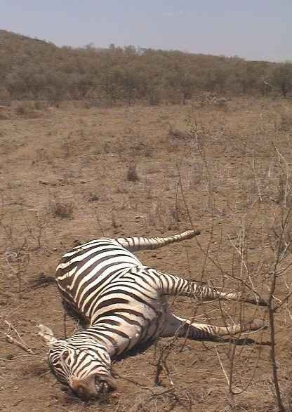
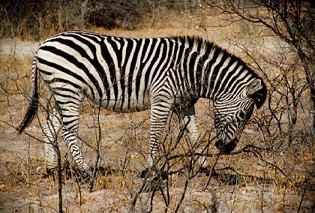
(4) There are variations between members of the same species. Because of these variations, some individuals are more successful than others. In harsh conditions, the fittest survive

Slide 9
Oysters in Malpeque Bay, Canada, 1922, nearly wiped out by disease
Only a few with a genetic mutation (mistake in copying DNA) survived
Mutation made them resistant to disease
All oysters carry mutated allele

Slide 10
Natural selection
Survival of the fittest
Individuals within a species adapt to changes in surroundings
Mutations can produce a more desirable characteristic and that is passed on to offspring
Greater proportion of individuals in the next generation will have this characteristic, increasing chances of survival
Competition will also increase survival of fittest in a species
So only the strongest offspring, with genes most suited to their habitat…
Will survive to mate….so the best genes carry on!!!

Slide 11
What characteristics would be most beneficial to a rabbit??

Slide 12
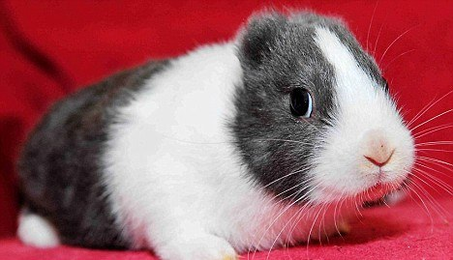
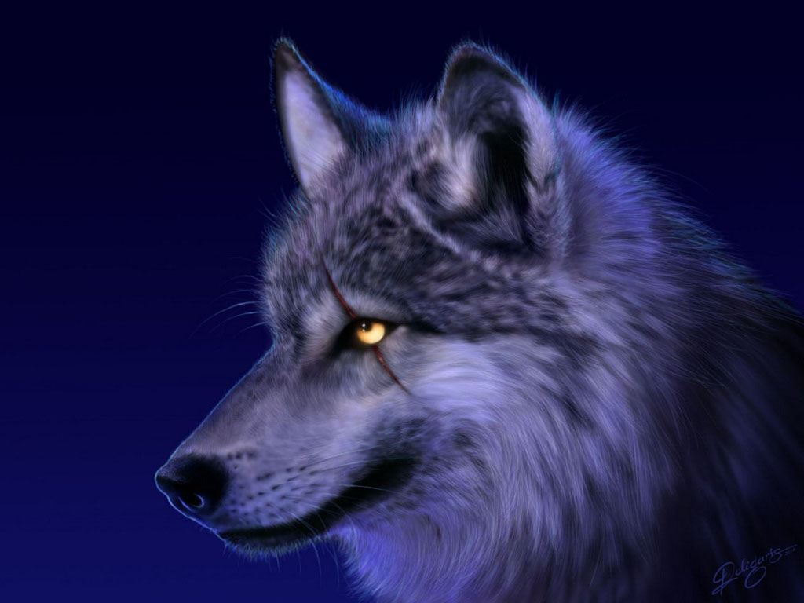
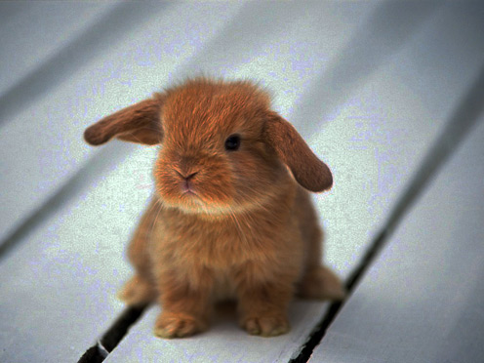
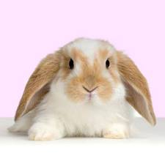

Slide 13
Evolution
L.O: Explain this process and look at selective breeding

Slide 14
What is evolution??
A gradual change in a species that occurs over a long period of time and can confer an advantage to survival

Slide 15
What evidence is there that evolution occurs
Fossil records
Fossils – remains of dead organisms
Evidence that species have changed and have adapted to environment
How do you compare different fossil species?
Analyse DNA – look for similarities and differences

Slide 16
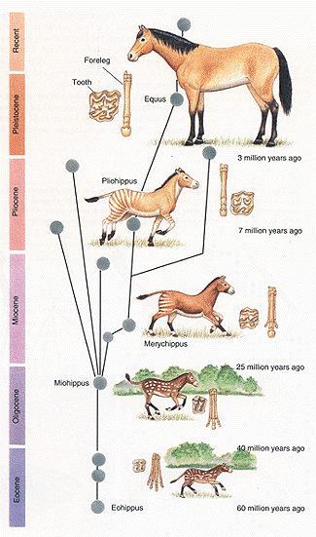
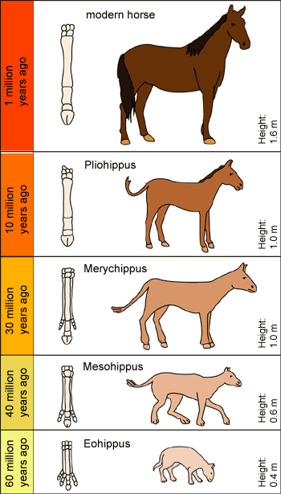

Slide 17
How can evolution produce a new species from an existing species?
Same species in different environments
Different mutations create new features that are of benefit and spread through population
Enough change could produce a new species

Slide 18
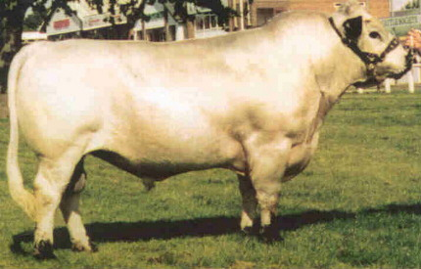
You can produce animals and the plants with the features you want by a process called “SELECTIVE BREEDING”
British white cattle
800 years of breeding
The characterisitics of the British White:
Healthy, hardy and long lived
Lean and fast growing
Good milky mothers
Easy calving
Excellent feet and legs
Docile
Colour marked
These characteristics make the British White:
The ideal bull for use on beef and dairy heifers
The ideal sire of a milky, polled suckler cow
The ideal cow for single or multiple suckling

Slide 19
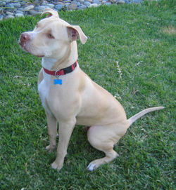
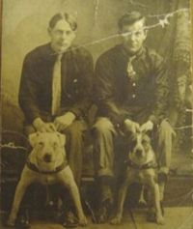
Took to America from England and Ireland in the 1800’s for bull baiting
Changed to dog fighting, and then as a working dog
When bred for fighting, the breeder would look for strength, and gameness: from its bulldog and terrier ancestors it inherited the instincts to never give up and to bite down and never let go.

Slide 20
Compare natural selection and selective breeding and explain why selective breeding causes disease in animals (6 marks)
Competition for resources
Mutation improves characteristic
Organism with stronger characteristic survives
Adapts to environment
Inherit better characteristics
Environment selects survival
Characteristic becomes more common in population
Natural selection
Selective breeding selects for a limited number of characteristics
Humans select characteristic
Only certain characteristics passed on to offspring
Characteristics to protect from illness/disease lost

Slide 21
Charles Darwin – what did he propose?
Proposed theory of evolution by natural selection
What does this mean?
Mutations confer an advantage to survival so only those with the best genes produce offspring
Selects best genes so species evolves to be better suited to its environment

