Slide 1
P1:
Earth in the Universe

Slide 2
What is the Solar System?
Our solar System was formed about 5ooo million years ago from clouds of gases and dust in space. It contains:
Sun – star at the centre of the solar system
8 planets
Dwarf planet
Moons – natural satellites that orbit some planets
Comets – big lumps of ice and dust
Asteroids – lumps of rock that are smaller than planets
Mercury
Venus
Earth
Mars
Jupiter
Saturn
Uranus
Neptune

Slide 3
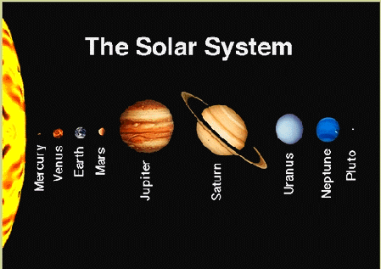

Slide 4
Type of body | Diameter (km) | Orbit
Planet | Smallest - Mercury, 4800 Biggest – Saturn, 120 000 Earth, 12 700 | Almost circular path around the Sun
Dwarf planet | Pluto, 2 306 | Elliptical path around the Sun
Moon | Earth’s moon. 3 500 and it is usually smaller than the planet | Circular path around a planet
Comets | Few km | Rush past the Sun then return to the Solar System
Asteroids | Up to 1000; most are much smaller | Almost circular, mostly between Mars and Jupiter

Slide 5
What is the Universe?
The sun is a star and is a ball of hot gases, mainly hydrogen. In the Sun, hydrogen atom nuclei join together by nuclear fusion realising energy and forming energy. All the other elements were made by fusion reactions in stars.
There are thousands of millions of stars in our galaxy, Milky Way. The Universe is made up of thousands of galaxies.

Slide 6
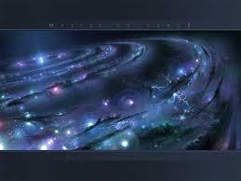
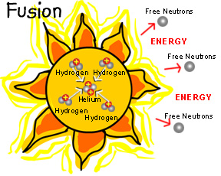

Slide 7
How do we find out about stars?
Astronomers can learn about other stars and galaxies only by studying the radiation. They measure the distance to the stars by their relative brightness or by parallax.
There are uncertainties about the distances in space because making accurate observations is difficult and also because astronomers make assumptions when interpreting observations.
Light travels through a vacuum at 3oo,000 km/s so when astronomers observe a distant object they see what it looked like when light left the object. Astronomers measure distances in light-years and so one-light year is the distance that light travels through a vacuum. Light pollution makes it difficult to observe so astronomers set up telescopes away from big cities.

Slide 8
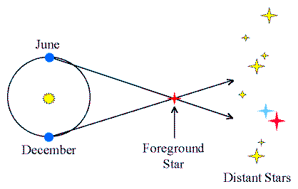

Slide 9
How is the Universe changing?
Other galaxies are moving away from us and this is the evidence that the Universe started with the big band about 14 000 million years ago. Evidence that the galaxies are moving away from us comes from redshift meaning that the light from galaxies is shifted towards the red end of the spectrum. Galaxies that are further away from us move faster than those that are closer. This is the evidence that pace is expanding.
It is difficult to predict how the Universe will end because it is difficult to study the motion of distant objects, and to measure huge distances. It is also difficult to measure the mass of the Universe.

Slide 10
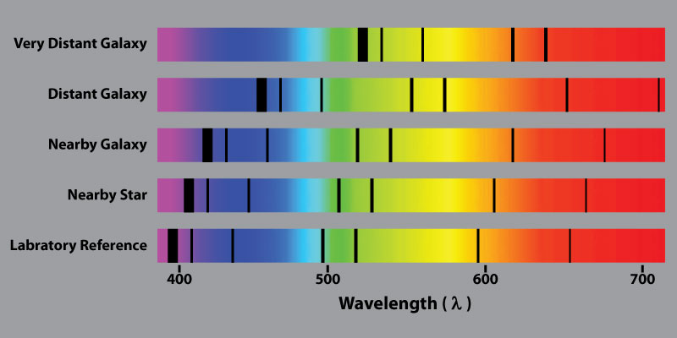

Slide 11
What can we learn from rocks?
Evidence from the rocks tell us about the structure of the Earth. For example, the Earth must be older than its oldest rocks, which are 4000 million years old. Geologists use radioactive dating to estimate rocks’ ages.
Rock processes we see today explain past changes. For example, mountains are being made all the time – if not, erosion would wear down continents to sea level. Sedimentation explains why older rocks are usually found under younger rocks.

Slide 12
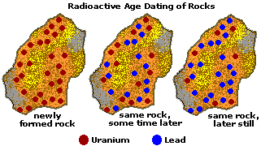

Slide 13
What is Wegner’s theory?
In 1912, Wegner suggested his theory of continental drift. He explained that today’s continent were once joined together for millions of years, they have been slowly moving apart. That explains why there are mountain chains at the edges of continents. Wegner’s theory was not accepted at that time because movements of continents not detectable, too big an idea from limited evidence, simpler explanations of the same evidence and Wegner was an outside to the community of geologists.

Slide 14
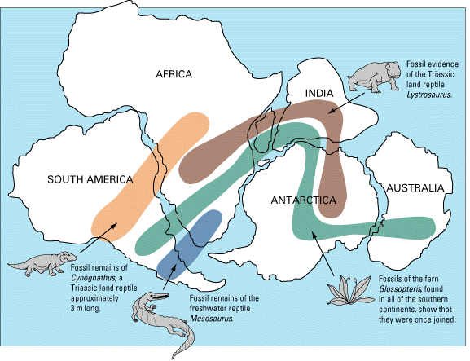

Slide 15
What is seafloor spreading?
Scientists detected ocean ridges, which are lines of mountains under the sea. New ocean ridges is made at these ridges so seafloor spread by about 10cm a year.
New ocean floor is made when material from the solid mantle rise slowly. Some of the mantle material melts to form magma. Movements in the mantle, caused by the convection currents, pull an ocean ridge apart. Magma erupts and cools to make new rocks.
The new rock has a symmetrical pattern of magnetic stripes because as solid magnifies, it becomes magnetised in the direction of the Earth’s magnetic field at the time.

Slide 16
What is plate tectonics?
The outer layer of the Earth is made from rocks, called tectonic plates. They move slowly all the time. Earthquakes, volcanoes, and a mountain building usually happen where tectonic plates meet.
In the Himalayas, plates move towards each other. They collide and the edges of the continents crumple together and pile up building mountains.
Most volcanoes are at plate boundaries where the crust is either being stretched or being compressed
In some places, tectonic plates slide past each other and huge forces build up along the fault lines and the forces become so big that the locked together rocks break and the plates move causing an earthquake.

Slide 17
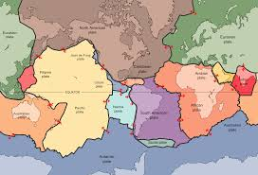

Slide 18
What are seismic waves?
Earthquakes release energy and it spreads out as vibration or seismic waves. Seismometers detect waves on the Earth’s surface. Two types of waves produced by earthquakes are:
S-waves, which travel through solids only
P-waves, which travel through both solids and liquids only

Slide 19
What are waves?
A wave is travelling vibration that transfers energy from place to place without transferring matter. There are two types of waves:
Longitudinal waves travel as compressions so the particles vibrate in the same direction as the moving wave. Sound waves and P-waves are longitudinal wave
Transverse wave, the particles vibrate 90º to the direction of the moving wave. S-waves and water waves are transverse

Slide 20
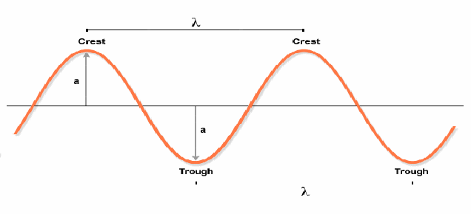

Slide 21
How can we measure waves?
Frequency of a wave is the number of waves that pass ant point each second and units for these are Hertz (Hz)
Distance = wave speed x time
Wave speed = frequency x time
Frequency ∝ 1/wavelength

Slide 22
What can waves show us?
Geologists use seismic waves to find out about the Earth’s structure. P-waves travel through solids and liquids, so they can get through the core, mantle and crust to the other side of the Earth. S-waves travel only solids and not liquids so they cannot get through liquid core and are not detected in S-wave shadow zone.

Slide 23
