Slide 1
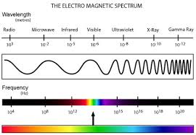

Slide 2
Distances
Diameter of Earth
Diameter of Sun
Diameter of Earth’s orbit
Diameter of Solar System
Distance from sun to nearest star
Diameter of Milky Way
Distance from Milky Way to the nearest galaxy

Slide 3

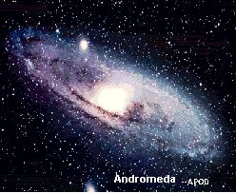
Identify the different bodies:
A galaxy
A star
The Universe

Slide 4
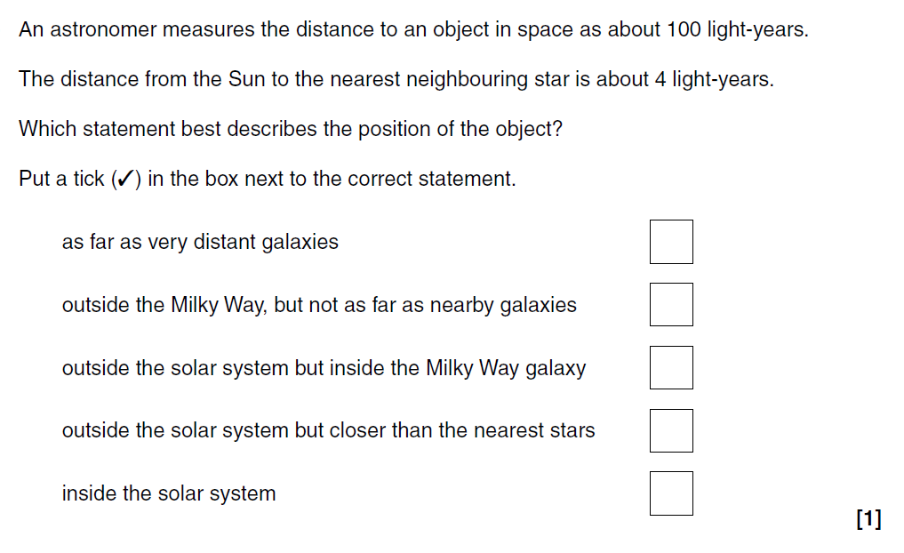

Slide 5
Red shift
https://www.youtube.com/watch?v=Djz_rtnXSfY
https://www.youtube.com/watch?v=U-OUP_mXMCw

Slide 6
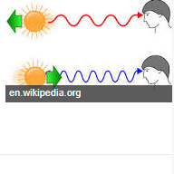

Slide 7
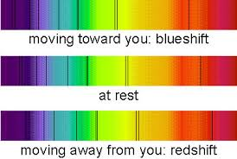

Slide 8
Hubble
Hubble was a famous scientist who examined the light from nearby galaxies. He noticed two things:
That most of the galaxies’ light was shifted towards the red end of the spectrum;
The further away a galaxy was, the more its light was red-shifted.
From these observations he concluded:
That most galaxies were moving away from our own;
The further away a galaxy was, the faster it was moving away from us;
And therefore he concluded that the universe is expanding.

Slide 9
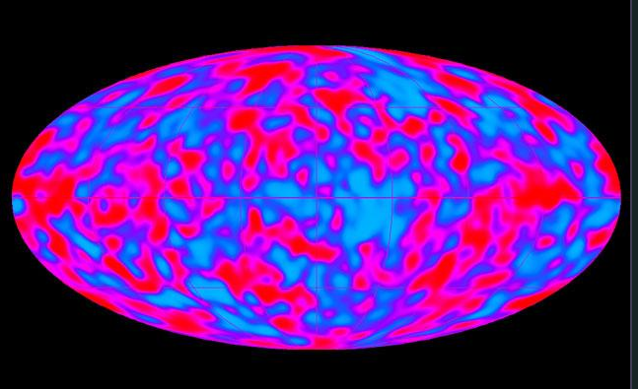

Slide 10
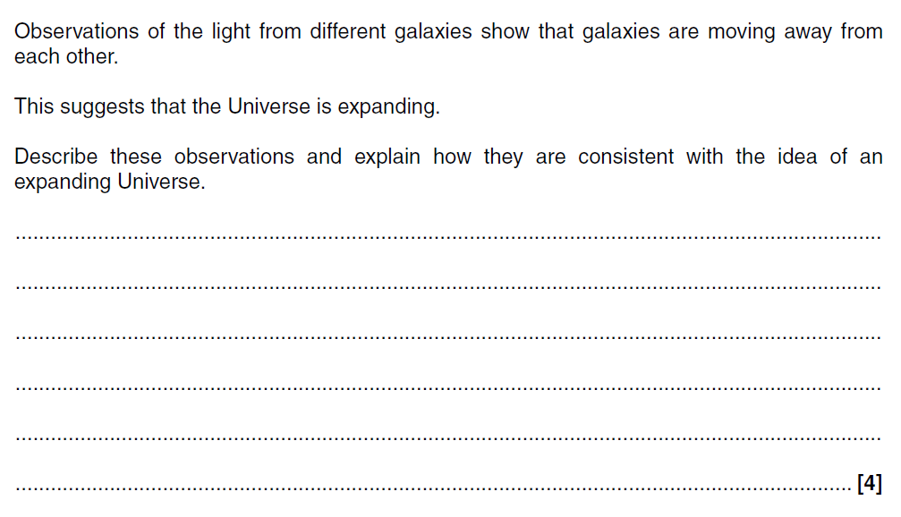

Slide 11
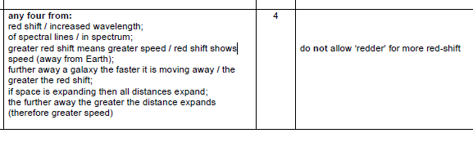

Slide 12
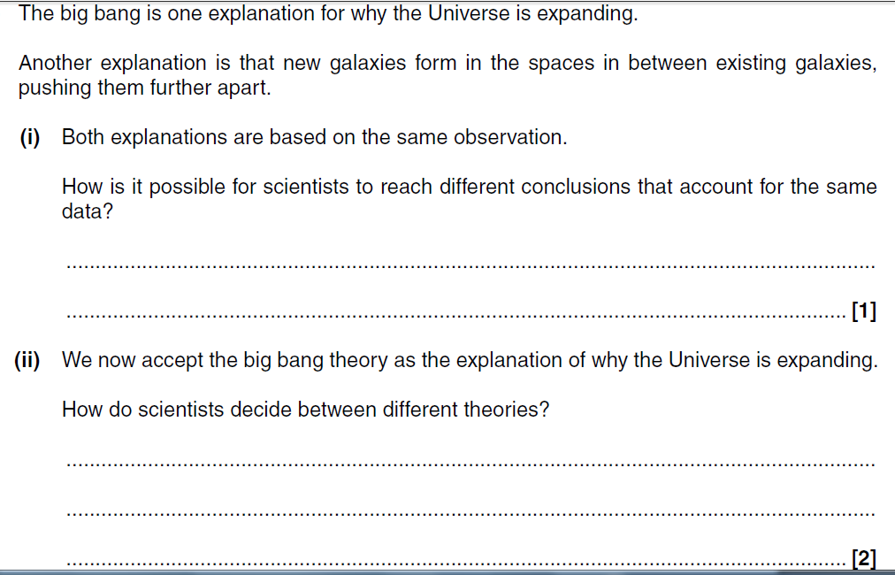

Slide 13
Continental Drift
Africa
S. America
The edges of land masses (continents) which are separated by thousands of kilometres of ocean:
Have shapes which fit quite closely.
Have similar patterns of rocks and fossils.
This suggests that they were once part of a single land mass which has split and been moved apart.

Slide 14
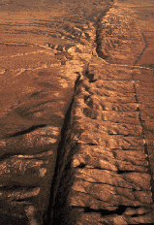
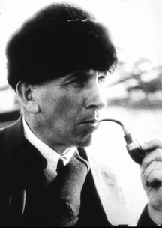
Continental drift
Alfred Wegener died in 1931
His idea of continental drift not accepted until the 1960s because:
He wasn’t a geologist
Other theories were acceptable
Couldn’t feel continents moving
No explanation for movement
San Adreas Fault in California

Slide 15
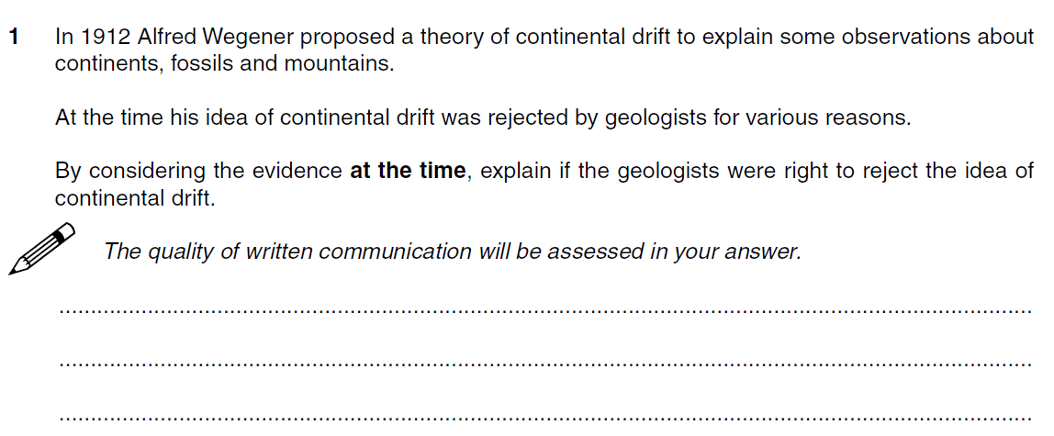

Slide 16
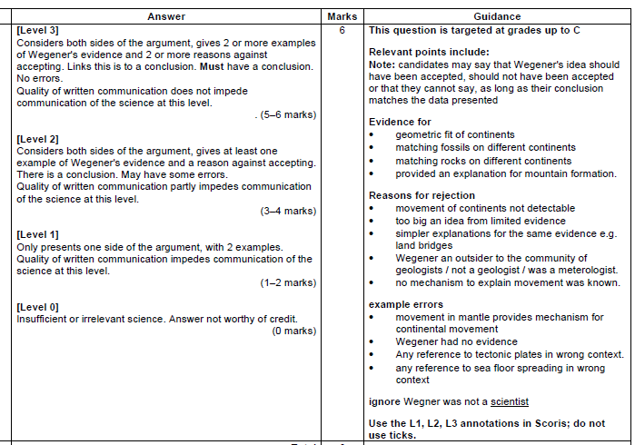

Slide 17
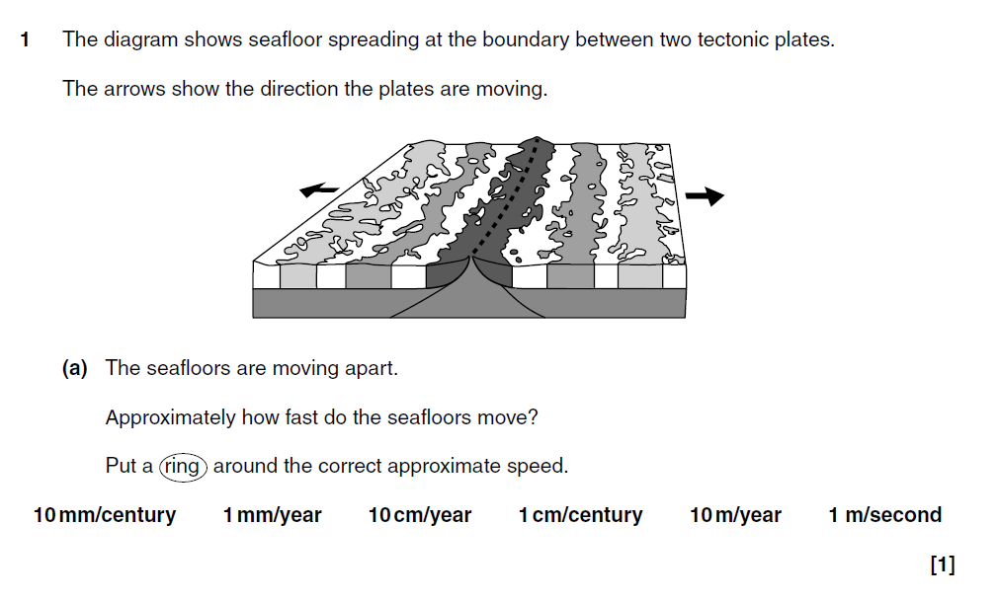

Slide 18
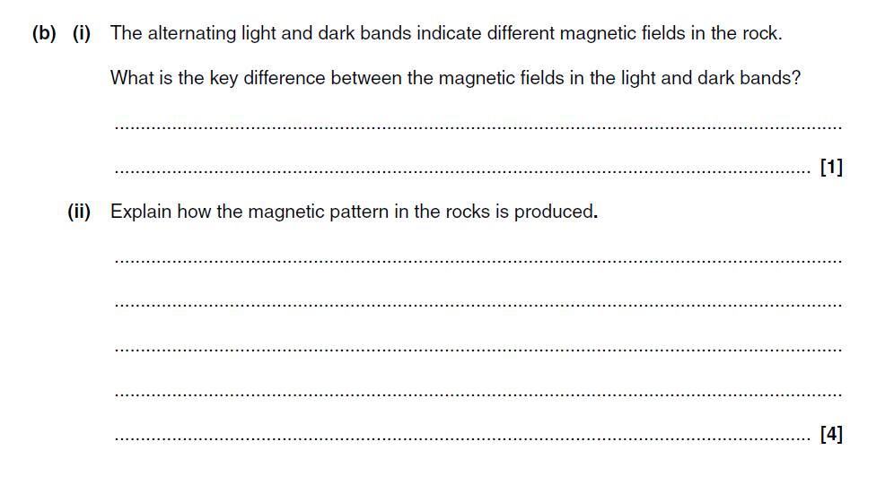

Slide 19
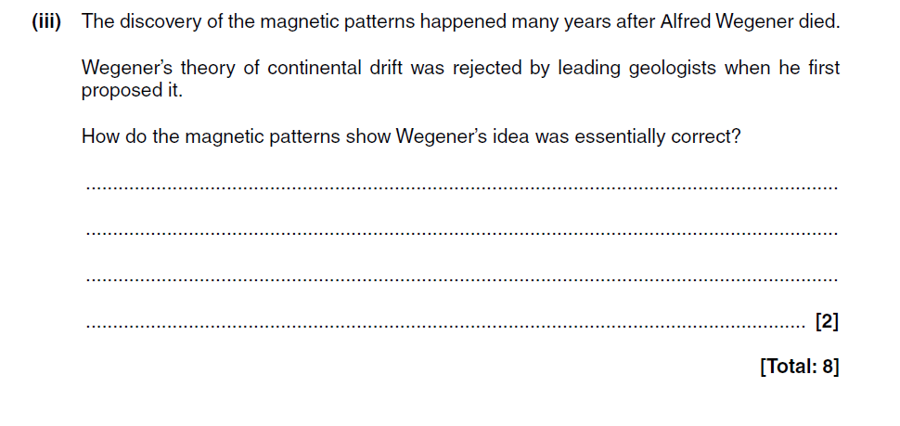

Slide 20
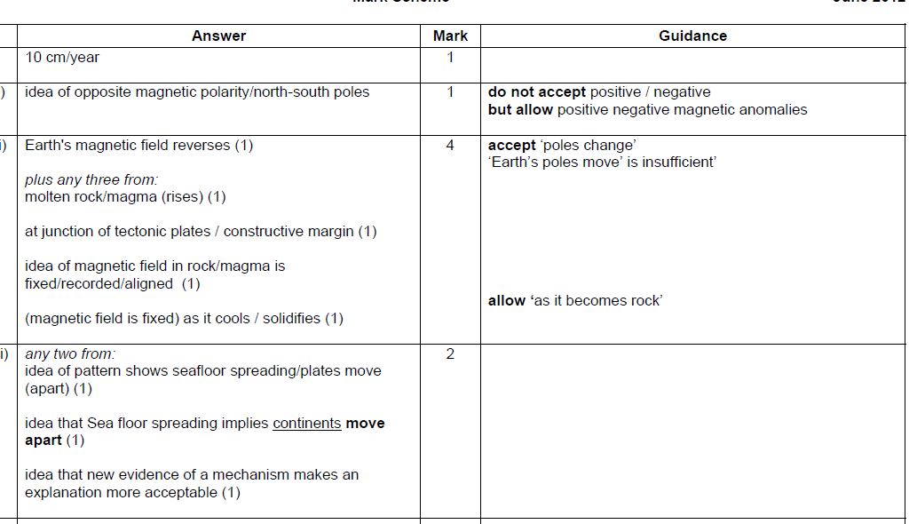

Slide 21
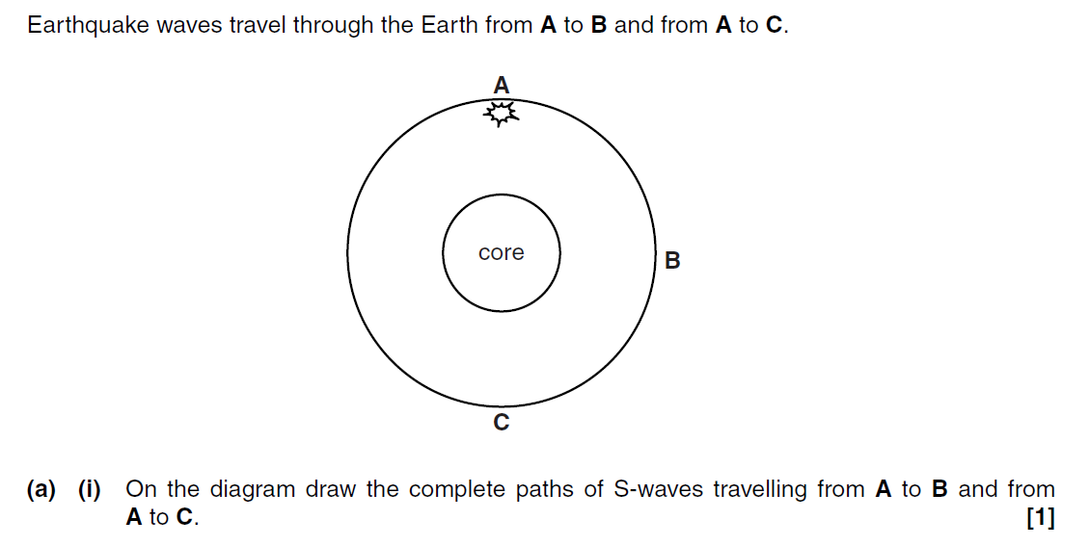

Slide 22
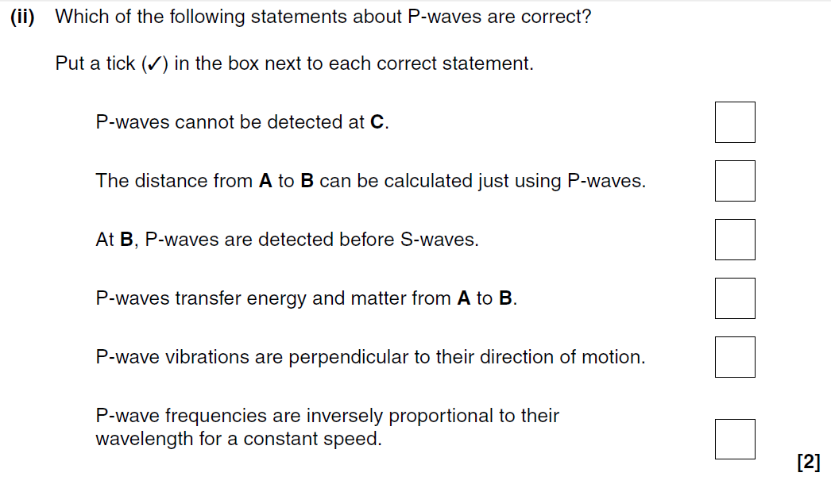

Slide 23
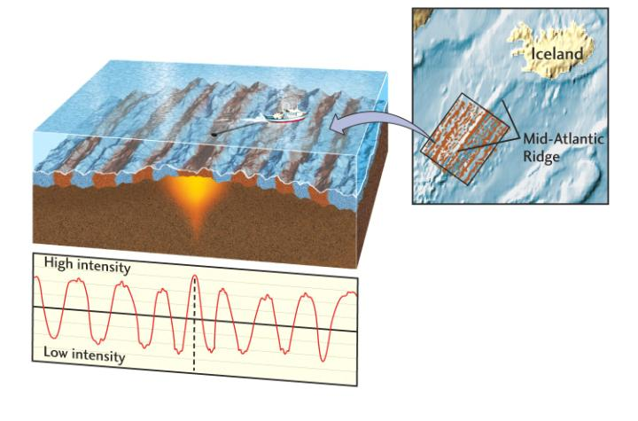
Waves ► Tectonics ► Boundary Types
Tectonic Plates may move away from each other.
This causes fractures which are filled by magma producing new, basaltic, oceanic crust.
This is known as sea floor spreading and is happening along oceanic ridges, including the mid-Atlantic ridge.

Slide 24
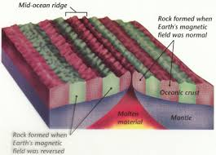
Waves ► Tectonics ► Magnetic Stripes
N
S
The iron-rich minerals in the magma record the direction of the Earth's magnetic field at the time when the rising magma solidified.
Magnetic reversal patterns in oceanic crust occur in stripes parallel to oceanic ridges, matching the period reversals of the Earth's magnetic field and so supporting the concept of sea floor spreading.

