Slide 1
P4: Explaining Motion

Slide 2
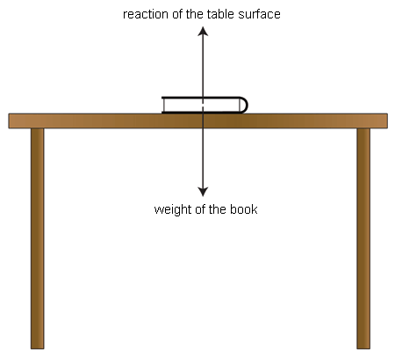
What are forces?
Interaction forces
Forces arise from an interaction between two objects. They come up in pairs
Each force in an interaction pair acts on a different object. The forces are equal in size and opposite in direction

Slide 3
What are forces?
Resultant force
Resultant force on an object is the sum of the individual forces that act on it, taking their directions into account
Reaction of surfaces
E.g. Vincent’s feet push down on the floor. The floor pushes up on his feet with an equal force. This force is the reaction of the surface.

Slide 4
What are forces?
Friction
David tries to push a skip. The force of friction stops the skip sliding over the road’s surface. As David pushes harder, the size of the friction force increases. Eventually, the friction force reaches its limit. Now the skip moves. There was no friction force between the skip and the road before David tried to push the skip. Friction arose in response to the force that David applied.
Friction – the force exerted on an object due to the interaction between it and another object that it is sliding over. It is caused by the roughness of both surfaces at a microscopic level.

Slide 5
How do objects start moving?
Using friction
When a car engine starts, the wheels turn. They exert a backward force pushing on the road surface. The other force in the interaction pair, the forward force, is the same size. This gets the car moving.
When you walk, your foot pushes from the ground. The friction between the ground and your foot pushes you forward with an equal force.

Slide 6
How do objects start moving?
Using friction
When a car engine starts, the wheels turn. They exert a backward force pushing on the road surface. The other force in the interaction pair, the forward force, is the same size. This gets the car moving.
When you walk, your foot pushes from the ground. The friction between the ground and your foot pushes you forward with an equal force.

Slide 7
How do objects start moving?
Rocket and jet engines
Rocket pushes out hot gases as it fuels burn. The rocket pushes down on these gases. The escaping gases exert an equal and opposite force on the rocket, and push the rocket upwards.
Jet engines draw in air at the front and pushes it out at the back. An equal and opposite forces pushes the engines forwards.

Slide 8
How do objects start moving?
Rocket and jet engines
Rocket pushes out hot gases as it fuels burn. The rocket pushes down on these gases. The escaping gases exert an equal and opposite force on the rocket, and push the rocket upwards.
Jet engines draw in air at the front and pushes it out at the back. An equal and opposite forces pushes the engines forwards.

Slide 9
Why do objects keep moving?
Driving and counter forces
Driving force pushes the object forward. Counter force in the opposite direction, which is cause because of air resistance and friction.
If driving force is greater than the counter force, the object speeds up
If the driving force is equal to the counter force, the object moves at a constant speed in a straight line
If the driving force is less than the counter force, the objects slows down.

Slide 10
Why do objects keep moving?
Speed and velocity
Instantaneous speed is its speed at a particular instant, or its average speed over a very short time interval.
Instantaneous velocity of an object is its instantaneous speed in an direction

Slide 11
Why do objects keep moving?
Acceleration
If a car gets faster, it is accelerating. The acceleration of the car is its change of speed, or change of velocity, in a given time interval.

Slide 12
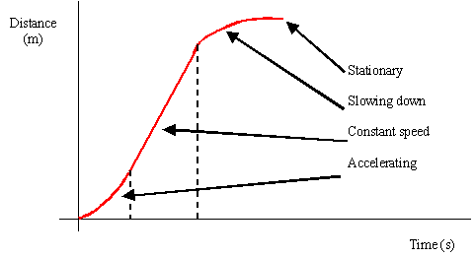
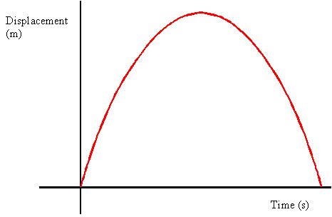
How can we describe motion?
Distance-time graphs and displacement-time graphs.
Steeper the gradient of a distance-time graph, the greater the speed. You can calculate the speed using the graph and the equation of the speed.
The displacement of an object at a given moment is the straight-line distance from its starting point, with an indication of direction.

Slide 13
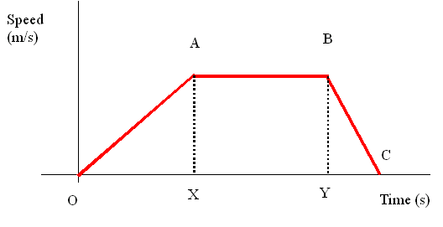
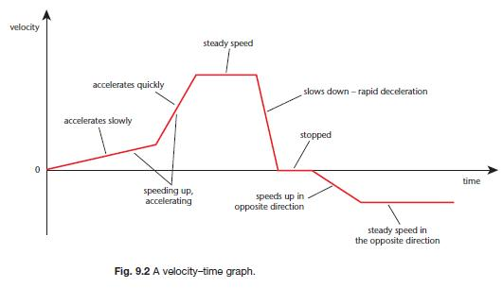
How can we describe motion?
Speed-time and velocity-time graphs
Speed-time graphs show how speed varies with time. The graph opposite shows the speed variation.
Velocity-time graph shows how the velocity of an object at every instant of its journey. The gradient of each section of the graph is equal to the acceleration

Slide 14
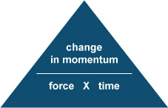
How are forces and motion connected?
Momentum
All moving objects have momentum – mass in motion
When a resultant force acts on an object, the momentum of the object changes in the direction of the force.

Slide 15
How are forces and motion connected?
If the resultant force on an object is zero, its momentum does not change:
If it is stationary, it stays stills
If it is already moving, it continues at a steady speed in a straight line

Slide 16
How are forces and motion connected?
Road safety
If two cars collide and stop, their momentum changes until it become zero. The more time the change of momentum takes, the smaller the resultant force. Road safety measures use this idea:
Car crumple zones squash slowly in a collision so the collision lasts longer so the resultant force on the car is less
Seat belts stretch in a collision making the change of momentum take longer so the force is less
Helmets change shape when they hit something. Your head stops moving more slowly so the force on it is less.
Air bags also increase the time for the change of momentum

Slide 17
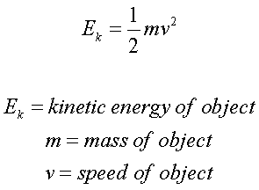
How can we use energy changes to describe motion?
More force used, more work done and so transfers more energy.
work done = force x distance
(joule, J)= (newton, N) x (metre, m)
Faster an object moves, more kinetic energy it has.
The gain of kinetic energy is less because energy must also be transferred to overcome air resistance and friction. This energy is transferred to the surroundings as heat.
Overall, all the energy is conserved.

Slide 18
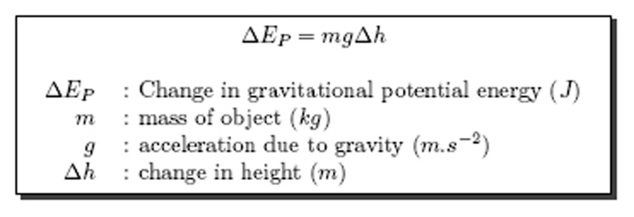
How can we use energy changes to describe motion?
Gravitational potential energy.
GPE lost = kinetic energy gained
Calculate velocity of an object if kinetic energy and mass is known.

