Slide 1
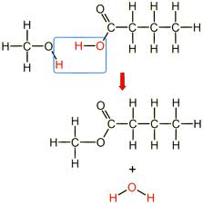
Write 1-10 and then the key word from each image!
1

Slide 2
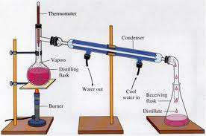
Write 1-10 and then the key word from each image!
2

Slide 3
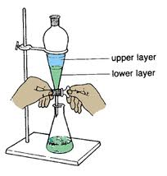
Write 1-10 and then the key word from each image!
3

Slide 4
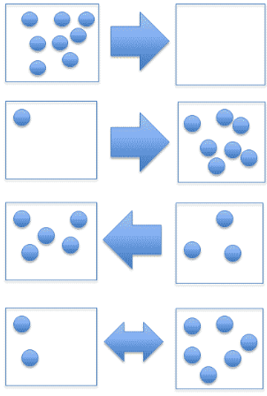
Write 1-10 and then the key word from each image!
4

Slide 5
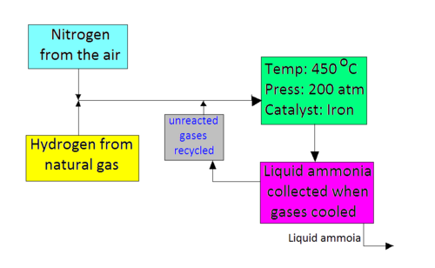
Write 1-10 and then the key word from each image!
5

Slide 6
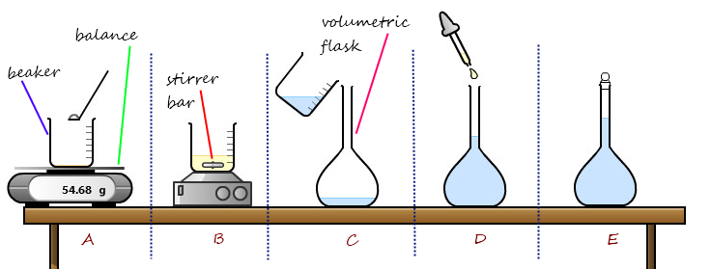
Write 1-10 and then the key word from each image!
6

Slide 7
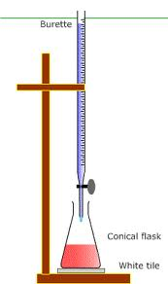
Write 1-10 and then the key word from each image!
7

Slide 8
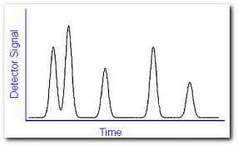
Write 1-10 and then the key word from each image!
8

Slide 9
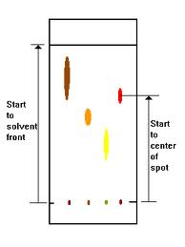
Write 1-10 and then the key word from each image!
9

Slide 10
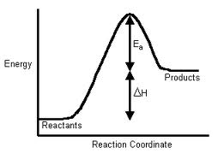
Write 1-10 and then the key word from each image!
10

