Slide 1
Revision

Slide 2
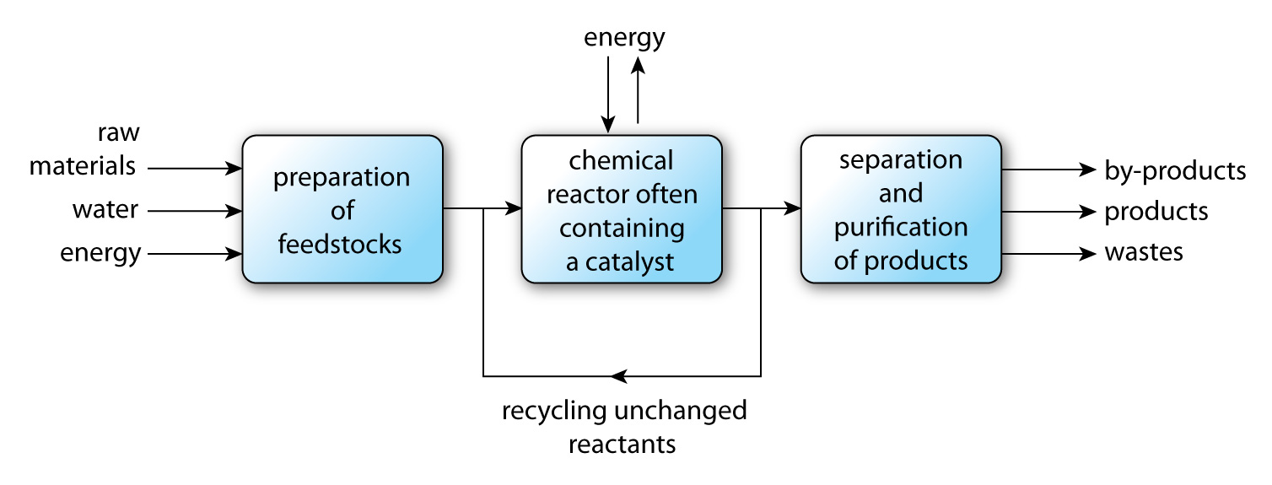

Slide 3
Sustainable?
Is feedstock renewable?
Atom economy- what is this?
Nature of by-products or waste
Energy input/output
Environmental impact
Health and safety risks
Social/economic benefits

Slide 4
Catalysts
What is activation energy?
How does a catalyst affect the activation energy?
What conditions must be controlled when using a catalyst?

Slide 5
Alkanes
What are they?
Molecular formula of: methane, ethane, propane, butane
Molecular, structural, ball-and stick representations
Burn in plenty air to carbon dioxide and water
Unreactive – why?
What bond is reactive? Why?
Word equations
Number of atoms of an element, number of molecules present or number of formulas
Production of ethanol from ethane
Which process is more sustainable?

Slide 6
Carboxylic acids
Properties due to functional group
Molecular and structural formula of methanoic and ethanoic acid
Unpleasant smells/tastes – sweaty socks, rancid butter
Reactions of esters with metals, alkalis and carbonates
Vinegar is ethanoic acid
Why are carboxylic acids classed as weak acids? (reactivity and pH)

Slide 7
Alcohols
Functional group-gives alcohols its properties
Molecular and structural formula of methanol and ethanol
Two uses of each
How ethanol reacts compared to water and alkanes
What is produced when you burn an alcohol?
Fermentation – optimum conditions
limited amount of ethanol produced – why?
Distillation –concentrated ethanol (spirits)
Conversion of biomass to ethanol – optimum conditions

