Slide 1
Memory and brain analysis
L.O: consider the above and general revision

Slide 2
Cerebral cortex
Why do we more advanced than other organisms?
Evolution, larger brain, more complex
Intelligence, memory, language, consciousness
http://www.youtube.com/watch?v=kNdM9JhTPJw&safe=active
http://www.youtube.com/watch?v=_0aNILW6ILk&feature=related&safe=active
love, concern for others, empathy, self-insight, creativity, initiative, autonomy, rationality, abstract reasoning, judgment, future planning, foresight, will-power, determination and concentration

Slide 3
http://www.youtube.com/watch?v=eqiiYYmJNKQ&blend=2&lr=1&ob=4&safe=active

Slide 4
745484873

Slide 5
745 484 873

Slide 6
Three stage multi model

Slide 7
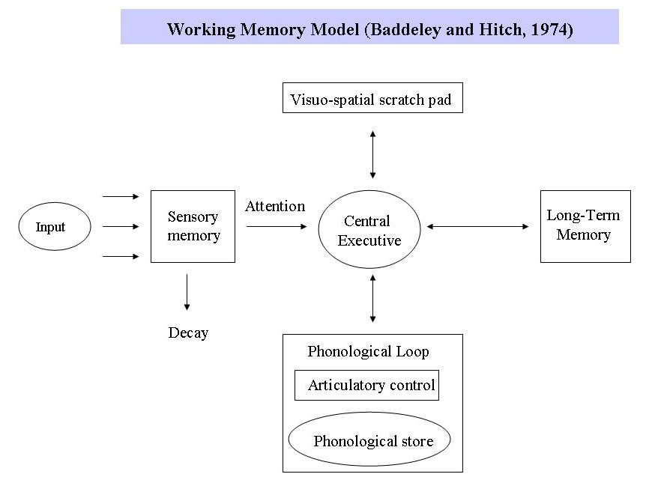
Working memory model

Slide 8
Working memory is STM. Instead of all information going into one single store, there are different systems for different types of information. Working memory consists of a central executive which controls and co-ordinates the operation of two subsystems: the phonological loop and the visuo-spatial sketchpad.
Central Executive: Drives the whole system (e.g. the boss of working memory) and allocates data to the subsystems (VSS & PL). It also deals with cognitive tasks such as mental arithmetic and problem solving.
Visuo-Spatial Sketch Pad (inner eye): Stores and processes information in a visual or spatial form. The VSS is used for navigation.
The phonological loop is the part of working memory that deals with spoken and written material. It can be used to remember a phone number. It consists of two parts
o Phonological Store (inner ear) – Linked to speech perception Holds information in speech-based form (i.e. spoken words) for 1-2 seconds.
o Articulatory control process (inner voice) – Linked to speech production. Used to rehearse and store verbal information from the phonological store.

Slide 9
Sensory memory store
Store visual info
Wave a sparkler – leaves a trail....you see the trail because the sensory store stores separate images so you see the whole trail
It’s how we see separate images in a film seem continuous

Slide 10
Brain analysis
Studying the effects of loss of function of certain regions of the brain – why useful?
Can understand which parts of brain control which function
Brain damage, lose long term, but not short term memory
Alzheimers – short term memory loss
What does this tell you about memory in the brain?
EEG recording electrical activity of brain. Electrodes detect regions where there is neurone activity
By stimulating receptors, brain responses can be mapped
MRI – colour shows brain activity, depends on what person is doing/thinking

Slide 11
http://www.newscientist.com/blogs/nstv/2011/02/inside-the-head-of-a-beatboxer.html

Slide 12
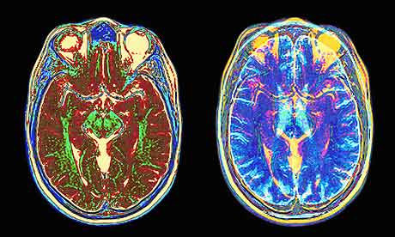
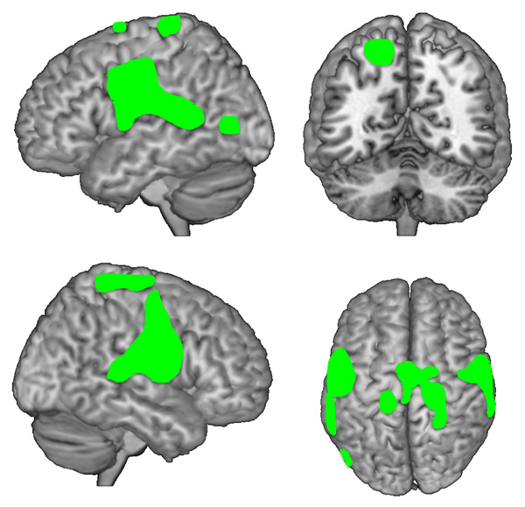

Slide 13
http://www.youtube.com/watch?v=STn3bpTTU6c&feature=related&safe=active

