Slide 1
P1 – Seafloor spreading

Slide 2
Today you need to know
Explain what evidence there was to support the theory of continental drift – suggested by Alfred Wegener
Explain why the scientific community did not accept his theory
Understand how seafloor spreading provided further evidence that his theory was correct

Slide 3
Continental Drift
Africa
S. America
The edges of land masses (continents) which are separated by thousands of kilometres of ocean:
Have shapes which fit quite closely.
Have similar patterns of rocks and fossils.
This suggests that they were once part of a single land mass which has split and been moved apart.

Slide 4
Continental drift
Alfred Wegener died in 1931
His idea of continental drift not accepted until the 1960s because:
He wasn’t a geologist
Other theories were acceptable
Couldn’t feel continents moving
No explanation for movement
San Adreas Fault in California

Slide 5
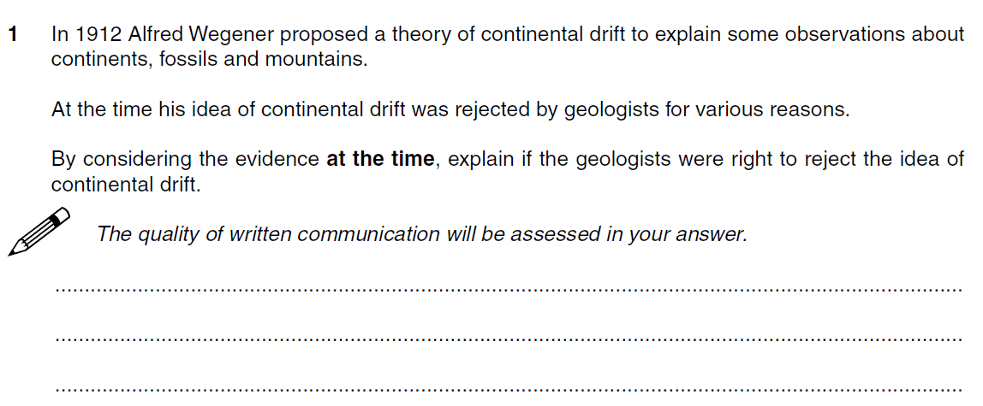
So now answer a 6 mark question!!

Slide 7
So why do we now believe Wegener’s theory??
Seafloor spreading

Slide 8
Seafloor spreading
https://www.youtube.com/watch?v=R2UDEDvejm4

Slide 9
Tectonic Plates may move away from each other.
This causes fractures which are filled by magma producing new, basaltic, oceanic crust.
This is known as sea floor spreading and is happening along oceanic ridges, including the mid-Atlantic ridge.

Slide 10
Seafloor spreading - Explanation
Movement of mantle
Pushes crust apart
Crust plates moving slowly apart at mid-atlantic ridge
Molten rock exuded (released) at mid-ocean ridge
So new magma rises to the surface and solidifies
New rocks formed in opening in crust
Newer rocks closer to gap and older rocks further off
Ridge moves approximately 2.5-10 cm every year
What happens to rock at the outer edge of the ridge?
Old rock at the edge of the ridge is forced downwards and becomes magma in the mantle

Slide 11
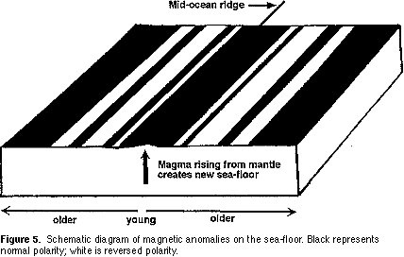

Slide 12
Magnetic rocks and seafloor spreading
https://www.youtube.com/watch?v=BCzCmldiaWQ

Slide 13
Describe how magnetic rocks on the seafloor provide evidence for tectonic theory
Earth has a magnetic field
Polarity of field reverses every 100 million years
When new rock forms at plate boundary at the oceanic ridge, the rock cools and solidifies and magnetic minerals in the rock (magnetite) align with the Earths polarity
As new rock forms the rock aligns with the Earths polarity at that time, forming stripes of rock
Can estimate how quickly new rock is formed and therefore how quickly the plates are moving

Slide 14
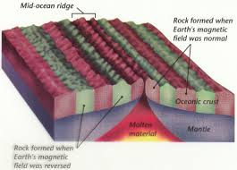
Magnetic Stripes
N
S
The iron-rich minerals in the magma record the direction of the Earth's magnetic field at the time when the rising magma solidified.
Magnetic reversal patterns in oceanic crust occur in stripes parallel to oceanic ridges, matching the period reversals of the Earth's magnetic field and so supporting the concept of sea floor spreading.

Slide 15
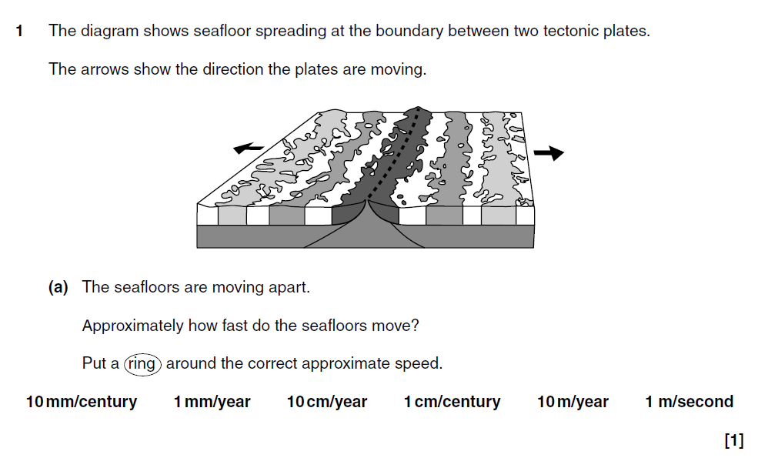

Slide 16
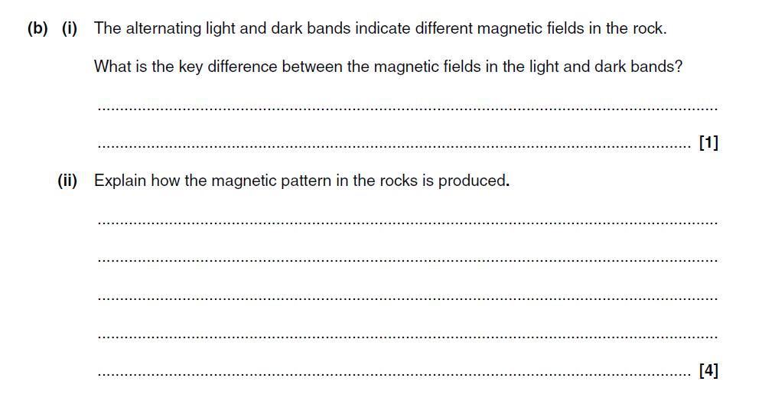

Slide 18
