Slide 1
Unsustainable activity
L.O: explain how humans are upsetting the eco-balance

Slide 2
Crops
What is the impact on an ecosystem of replacing vegetation with agricultural crops?
Loss of biodiversity
Removal of habitats
Silting of rivers (addition of solid material e.g. Soil)
Desertification (Desertification means loss of trees and other plants and resulting loss of rainfall, causing drought, soil erosion, and loss of habitat for humans, plants, and animals. )

Slide 3
Sustainability
Humans have to use the resources in an ecosystem to survive. What can make the use of resources sustainable?
Replacing the resources at a rate that allows them to carry on being re-used

Slide 4
Timber/fish
How can the cutting down of trees and the fishing of fish be sustainable?
Replace felled trees with new
Only fish to certain quotas

Slide 5
Fossil fuels
Fossil fuels have used sunlight that was present millions of years ago
Fossil sunlight energy
The carbon has also been locked up for millions of years
When we burn the fuels it isn’t a closed loop system – why?

Slide 6
Fossil sunlight energy
The energy stored in coal (and indeed all fossil fuels) is ancient sunlight. As you know plants need CO2 form the air and sunlight and water to undergo the biochemical process called 'photosynthesis'. Photosynthesis converts the CO2, and Water into sugars which are then used by the plant to make wood and oxygen - the plant grows. You will all be familiar with the fact that wood will burn using the oxygen in the air to produce heat, water and CO2. The heat given off is the sunlight energy that the plant trapped and stored as it 'photosynthesised'. Plants therefore affectively trap and store sunlight as chemical energy. when they were living all those millions of years ago - fossil sunlight!

Slide 7
If many plants form a layer and this layer gets covered with soil and buried, the plants turn into fossils and if there are enough of them they form a layer of biological matter. Time and heat in the earth turns this biological matter into coal (and oil and gas). The coal, oil or gas will burn in air to produce heat, water and CO2. The heat is the sunlight that the plants trapped

Slide 8
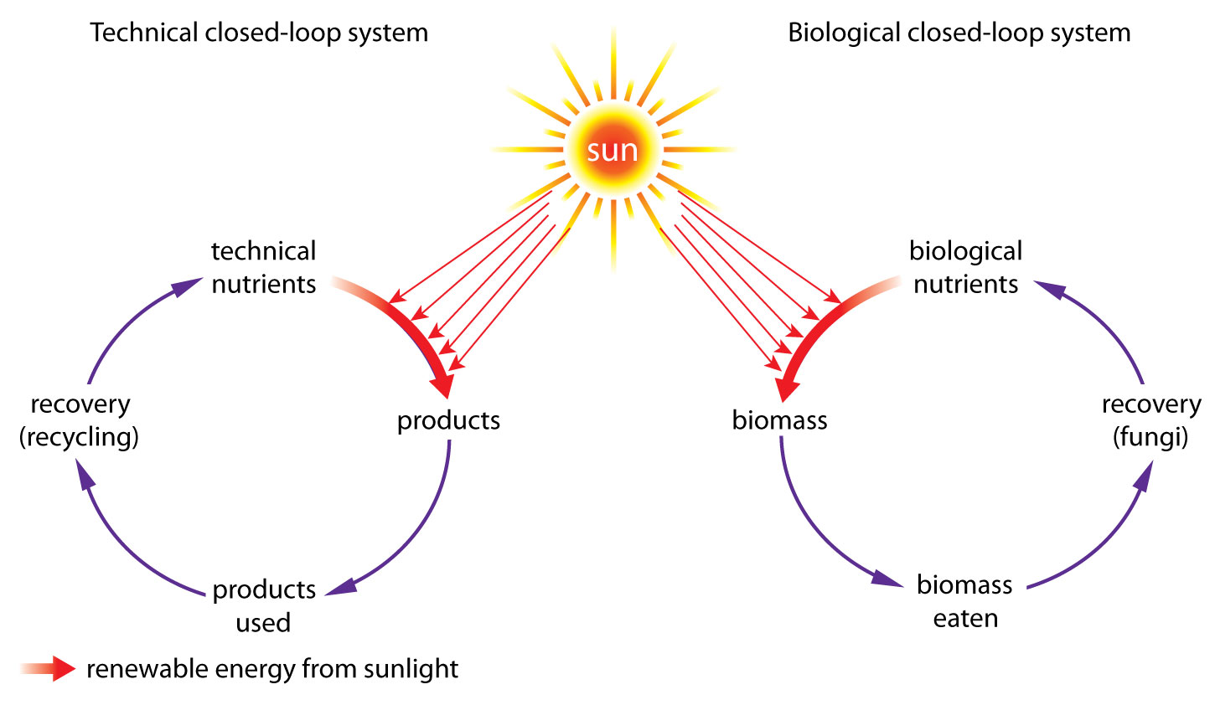
Making technology a closed loop system

Slide 9
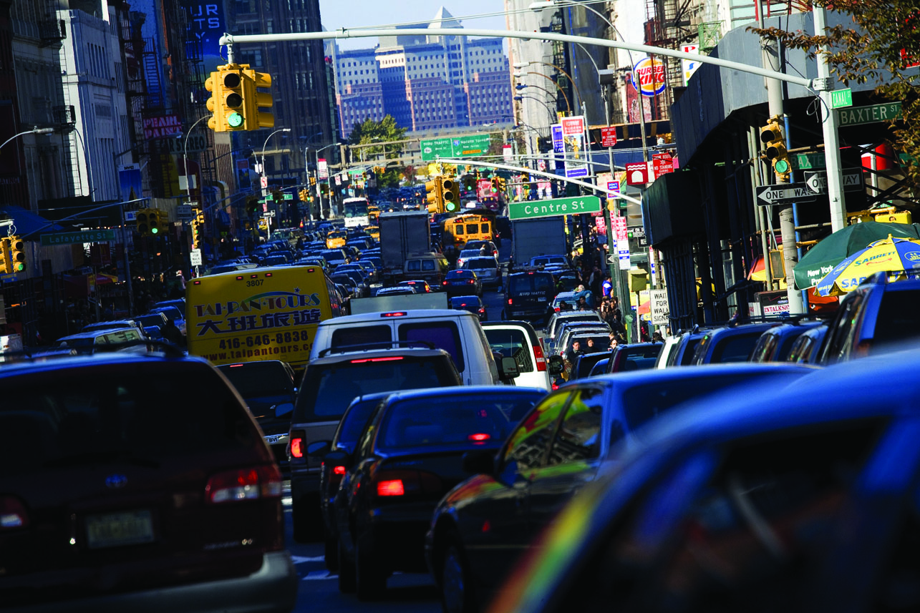

Slide 10
Explain what is meant by a ‘fossil fuel’.
Oil is made constantly from minute plants and animals, which were built from carbon that was fixed in photosynthesis. When we burn oil, this returns the carbon in these organisms into the atmosphere. Explain why this system cannot be regarded as a closed loop.
What is biofuel?
Explain the term ‘carbon neutral’ with reference to biofuels.
Explain why resources last longer using closed-loop technical systems rather than linear systems.

Slide 11
A fossil fuel is made from organisms that have been dead along time, which used long-ago sunlight to grow.
Burning oil from fossil fuel and returning the carbon to the atmosphere cannot be regarded as a closed loop because of the time-lag of millions of years between when the carbon was locked up in the fuel and when the carbon returned to the atmosphere.
Biofuel is fuel made from crops – recent sunlight not ancient sunlight. Examples include biodiesel and gasohol (ethanol).
Carbon neutral’ means no increase in atmospheric carbon dioxide. The same amount of CO2 fixed in photosynthesis is released when the biofuel is burned.
In a closed-loop system, substances are reused/recycled...in a linear system the substances are used but not recycled

