Slide 1
Uses of Alkalis and Chlorine
1. recall that, even before industrialisation, alkalis were needed to neutralise acid soils, make chemicals that bind natural dyes to cloth, convert fats and oils into soap and to manufacture glass
10. recall that chlorine is used to kill microorganisms in domestic water supplies and as a bleach
16. recall examples of important uses by industry of the sodium hydroxide, chlorine and hydrogen produced by electrolysis of brine

Slide 2
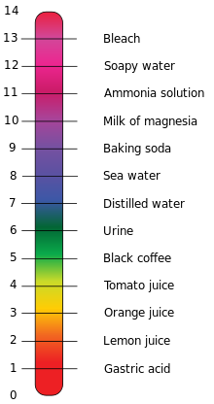
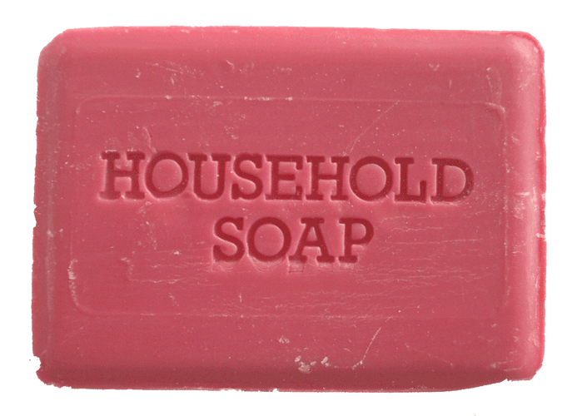
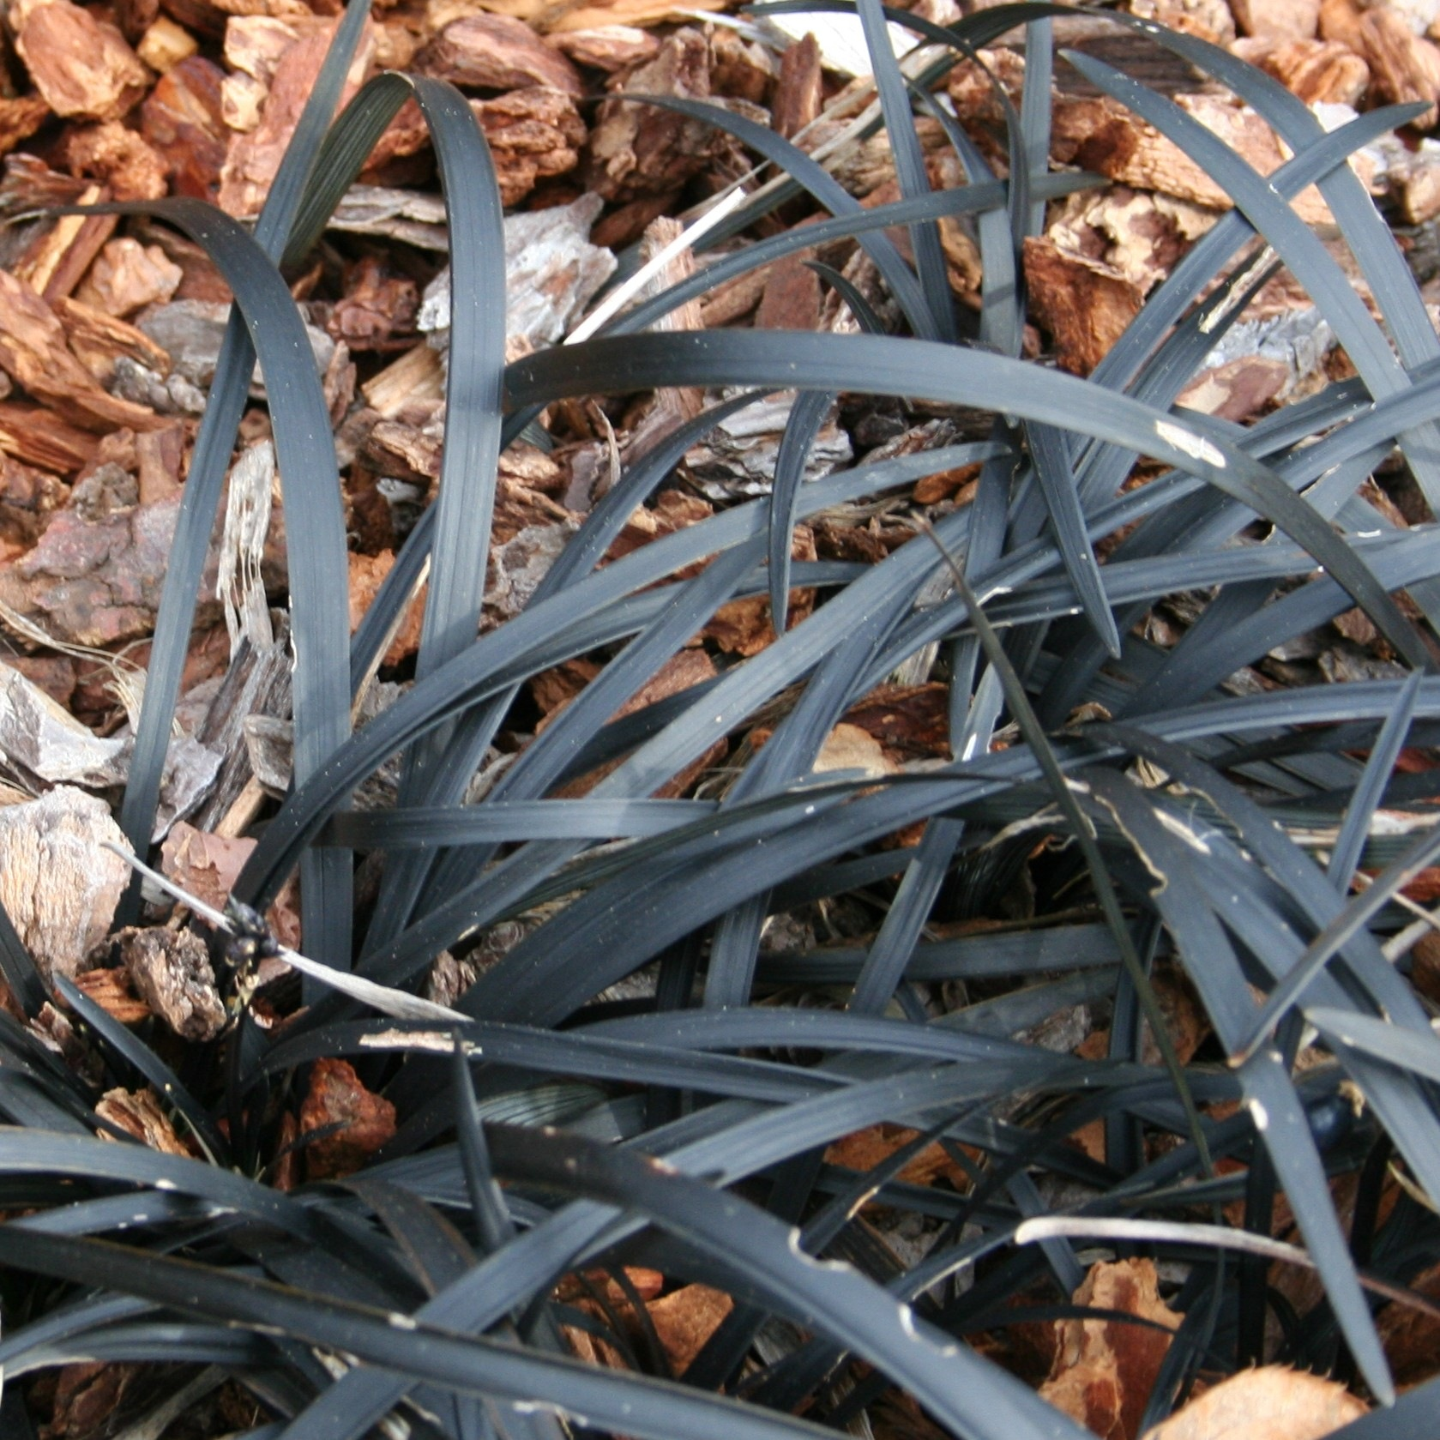
Uses of Alkalis
An alkali is a compound that dissolves in water to give a solution with a pH greater than 7.
Even before industrialisation they were used for:
Converting oils and fats into soap
Making glass
Neutralising acidic soils
Making chemicals that bind natural dyes to cloth.
alkalis
acids

Slide 3
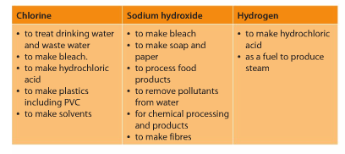
Uses of Chlorine
Chlorine is used for water treatment
It kills microorganisms in the water
This can prevent spread of diseases such as typhoid, cholera and dysentery.
Sometimes chlorine can react with organic compounds in the water to form THMs (trihalomethanes).
Some people have argued this can cause cancer, however there is no firm evidence for this theory.

Slide 4
Uses of the Products from Electrolysis

Slide 5
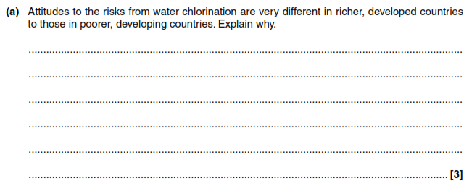
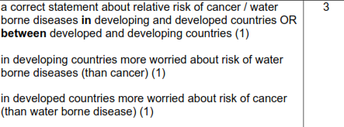
Exam Questions
People in developing counties are more likely to catch diseases from dirty water than in developed countries where the water is treated, therefore they are more worried about water borne disease. Developed countries are more worried about the risk of cancer since water borne diseases have been eliminated.

Slide 6
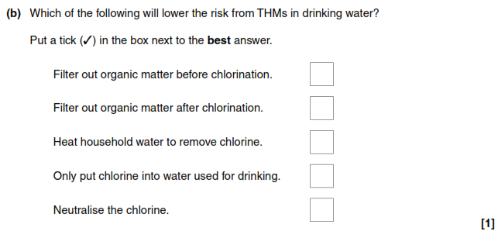
Exam Questions
√
THMs are caused by reactions of chlorine with organic matter. Therefore removing them before chlorination will lower the risk.

Slide 7
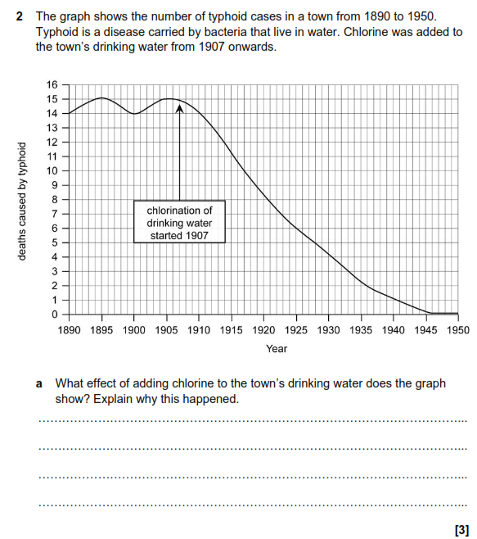
Exam Questions
How many marks would this answer get? Explain how you could improve it.
Chlorination reduced the deaths from typhoid from 15 a year to none over 40 years. This is because chlorine kills the bacteria in the water.

Slide 8
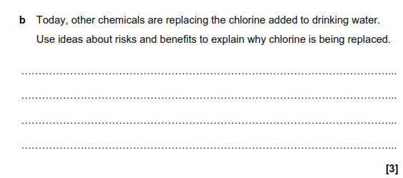
Exam Questions
THMs formed could cause cancer. The risk of this outweighs the benefit of using chlorine to kill bacteria. Other chemicals can do this job just as well.

