Slide 1
Blood Valves and tissue fluid
L.O: explain the importance of all of the above

Slide 2
Learning outcomes...
describe the function of the valves in the heart and the veins
H: explain how tissue fluid is formed in capillary beds and how it makes possible the exchange of chemicals such as oxygen, carbon dioxide, glucose and urea between the capillaries and the cells

Slide 3
Heart beat
What causes the sound?

Slide 4
What is meant by a double circulatory system?
Blood carries glucose molecules and oxygen to the muscles, and waste products such as carbon dioxide away from muscles

Slide 5
Red blood cells are adapted to their function, limited to:
a. packed with haemoglobin (to bind oxygen)
b. no nucleus (more space for haemoglobin)
c. biconcave shape (increased surface area for oxygen exchange)

Slide 6
What is the function of a valve?
Prevents backflow of blood when it is returning to the heart
Allows blood to flow in one direction only
Where do we find valves in the body?
Heart and veins
Why don’t arteries have valves?
Blood is pushed through under high pressure and so doesn’t flow backwards

Slide 7
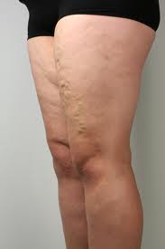
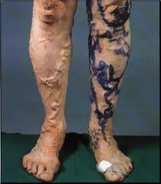
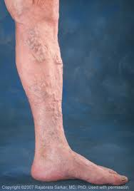

Slide 8
Tissue fluid
explain how tissue fluid is formed in capillary beds and how it makes possible the exchange of chemicals such as oxygen, carbon dioxide, glucose and urea between the capillaries and the cells

Slide 9
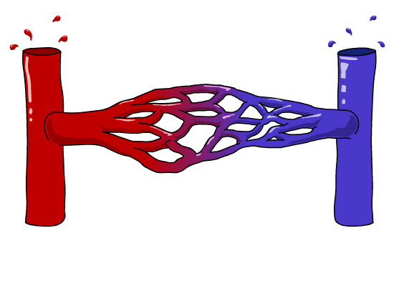
Different types of blood vessels
There are three types of blood vessels, as shown in this magnified part of the circulatory system.
blood from the heart
blood to the heart
artery
vein

Slide 10
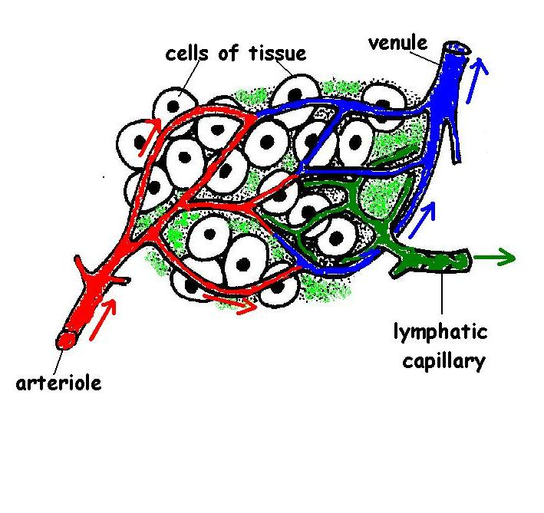

Slide 11
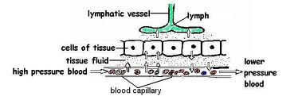

Slide 12
